Slide 1
Arial 40 Bold, Please use ‘Paste as text’ to keep formatting.
Month DD, YYYY
[MPO Staff Member], [Title]
Arial 24, Please use ‘Paste as text’ to keep formatting.

Slide 2
Arial 40 Bold, Please use ‘Paste as text’ to keep formatting.
Month DD, YYYY
[MPO Staff Member], [Title]
Arial 24, Please use ‘Paste as text’ to keep formatting.

Slide 3
Arial 40 Bold, Please use ‘Paste as text’ to keep formatting.
Month DD, YYYY
[MPO Staff Member], [Title]
Arial 24, Please use ‘Paste as text’ to keep formatting.

Slide 4
The Broward MPO is located in Southeast Florida
Notes:
The Broward MPO is located in Southeast Florida in the Fort Lauderdale Metropolitan area. We’re about 45 minutes north of a little city you may have heard of called “Miami”.

Slide 6
Text Slide Sample 1; Arial 35, Bold; Please use ‘Paste as text’ to keep formatting.
Arial 28, will auto-size as needed, Please use ‘Paste as text’ to keep formatting.
Other Bullets

Slide 7
Text Slide Sample 2; Arial 35, Bold
Arial 28 Bold; Option 1: Arial 28; White board concept Arial 20; https://fast.wistia.net/embed/iframe/aus27se8tm?popover=true
Option 2: Graphic Video with music, script,
voiceover
Option 3: Graphic Video with music and key messages
https://www.youtube.com/watch?feature=player_embedded&v=FbGXy68lKew

Slide 8
Text Sample Slide 3; Arial 35, Bold
Arial 28, will auto-size as needed, Please use ‘Paste as text’ to keep formatting.
Arial 28, will auto-size as needed, Please use ‘Paste as text’ to keep formatting.
Can place a photo here instead of text.

Slide 9
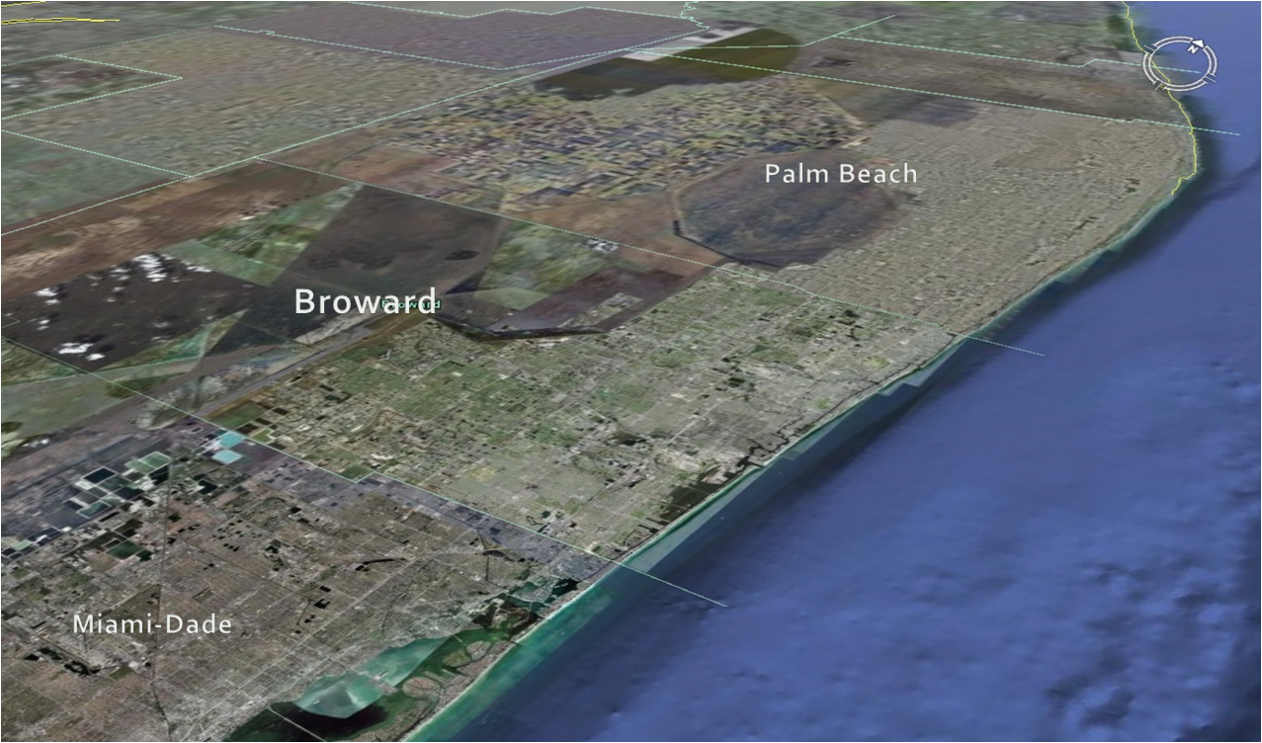
Photo Slide Sample 1 (Smaller Photos); Arial 32, Bold
Arial 28, can size as needed, Please use ‘Paste as text’ to keep formatting.
PHOTO format:
No Line
Shadow: Transparency: 60
Blur: 7pt
Angle: 300
Distance: 4pt
DO NOT COVER WAVE WITH PHOTO- larger photos use next template

Slide 10
Photo Slide Sample 2- Larger photos; Arial 32, Bold
Arial 26; can size as needed, Please use ‘Paste as text’ to keep formatting.
PHOTO format:
No Line
Shadow: Transparency: 60
Blur: 7pt
Angle: 300
Distance: 4pt

Slide 11
Photo Slide Sample 2- Larger photos; Arial 32, Bold
Arial 26; can size as needed, Please use ‘Paste as text’ to keep formatting.
PHOTO format:
No Line
Shadow: Transparency: 60
Blur: 7pt
Angle: 300
Distance: 4pt

Slide 12
Contact Us
James Cromar
Deputy Executive Director, Strategic Initiatives
(954) 876-0038
cromarj@browardmpo.org
[Staff Member]
[Subsection & Title combined]
(954) 876-00XX
lastnamefirstinitial@browardmpo.org
Arial 22; will autosize according to contents of box

Slide 13
Contact Us
Gregory Stuart
Executive Director
(954) 876-0035
stuartg@browardmpo.org
@MPOGreg
← Arial 26 Bold
←Arial 26
Please adhere to style guide guidelines when formatting ALL contact information

