Slide 1
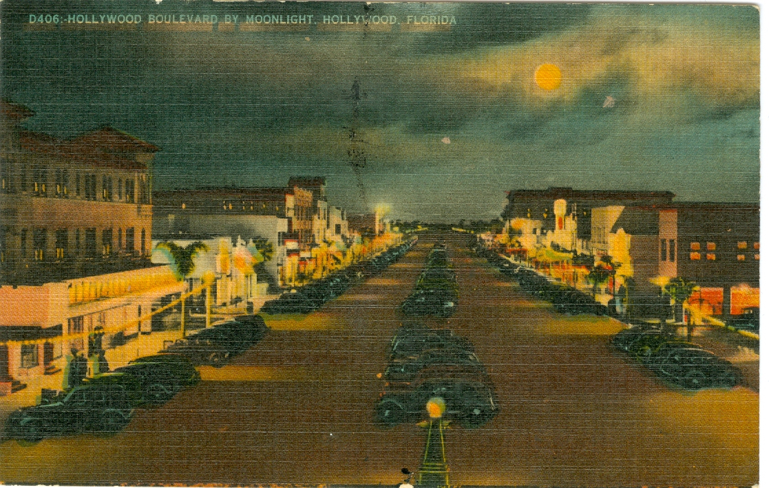
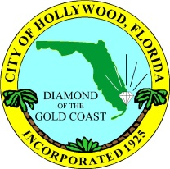
City of Hollywood
SELECTION OF CURRENT PROJECTS

Slide 2
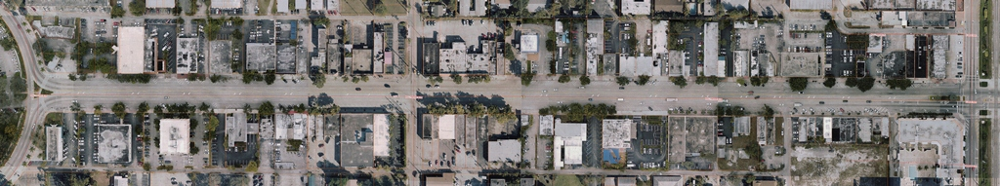
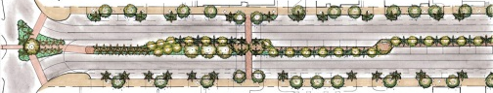
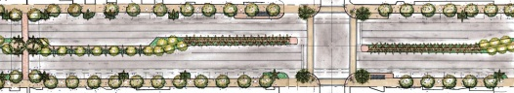
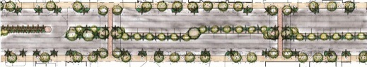
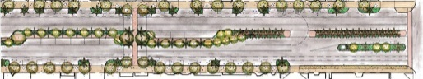
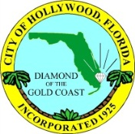

Hollywood Blvd. Complete Streets Concept

Slide 3
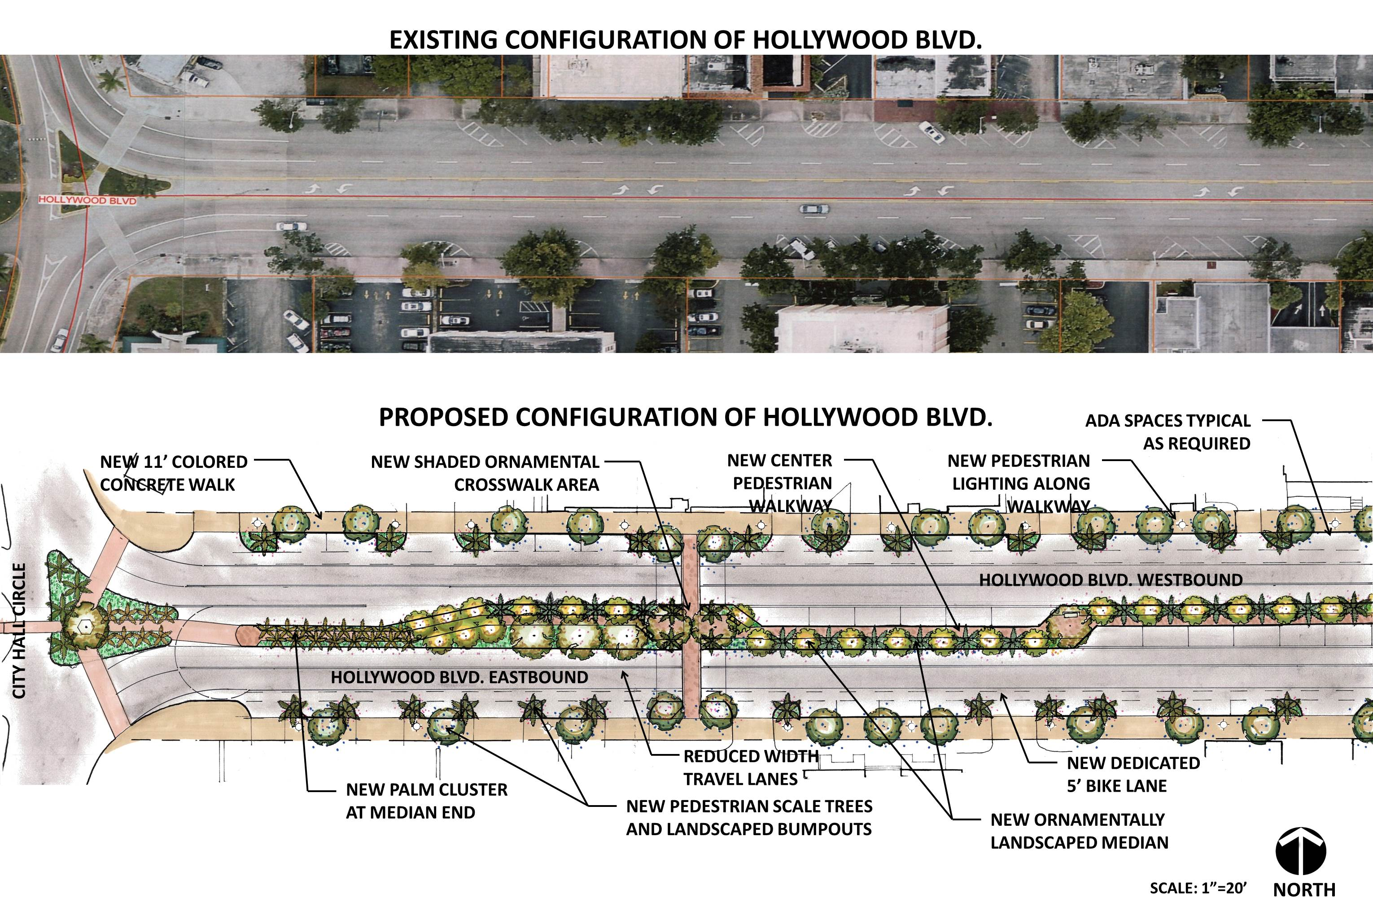
Hollywood Blvd. Complete Streets Concept

Slide 4
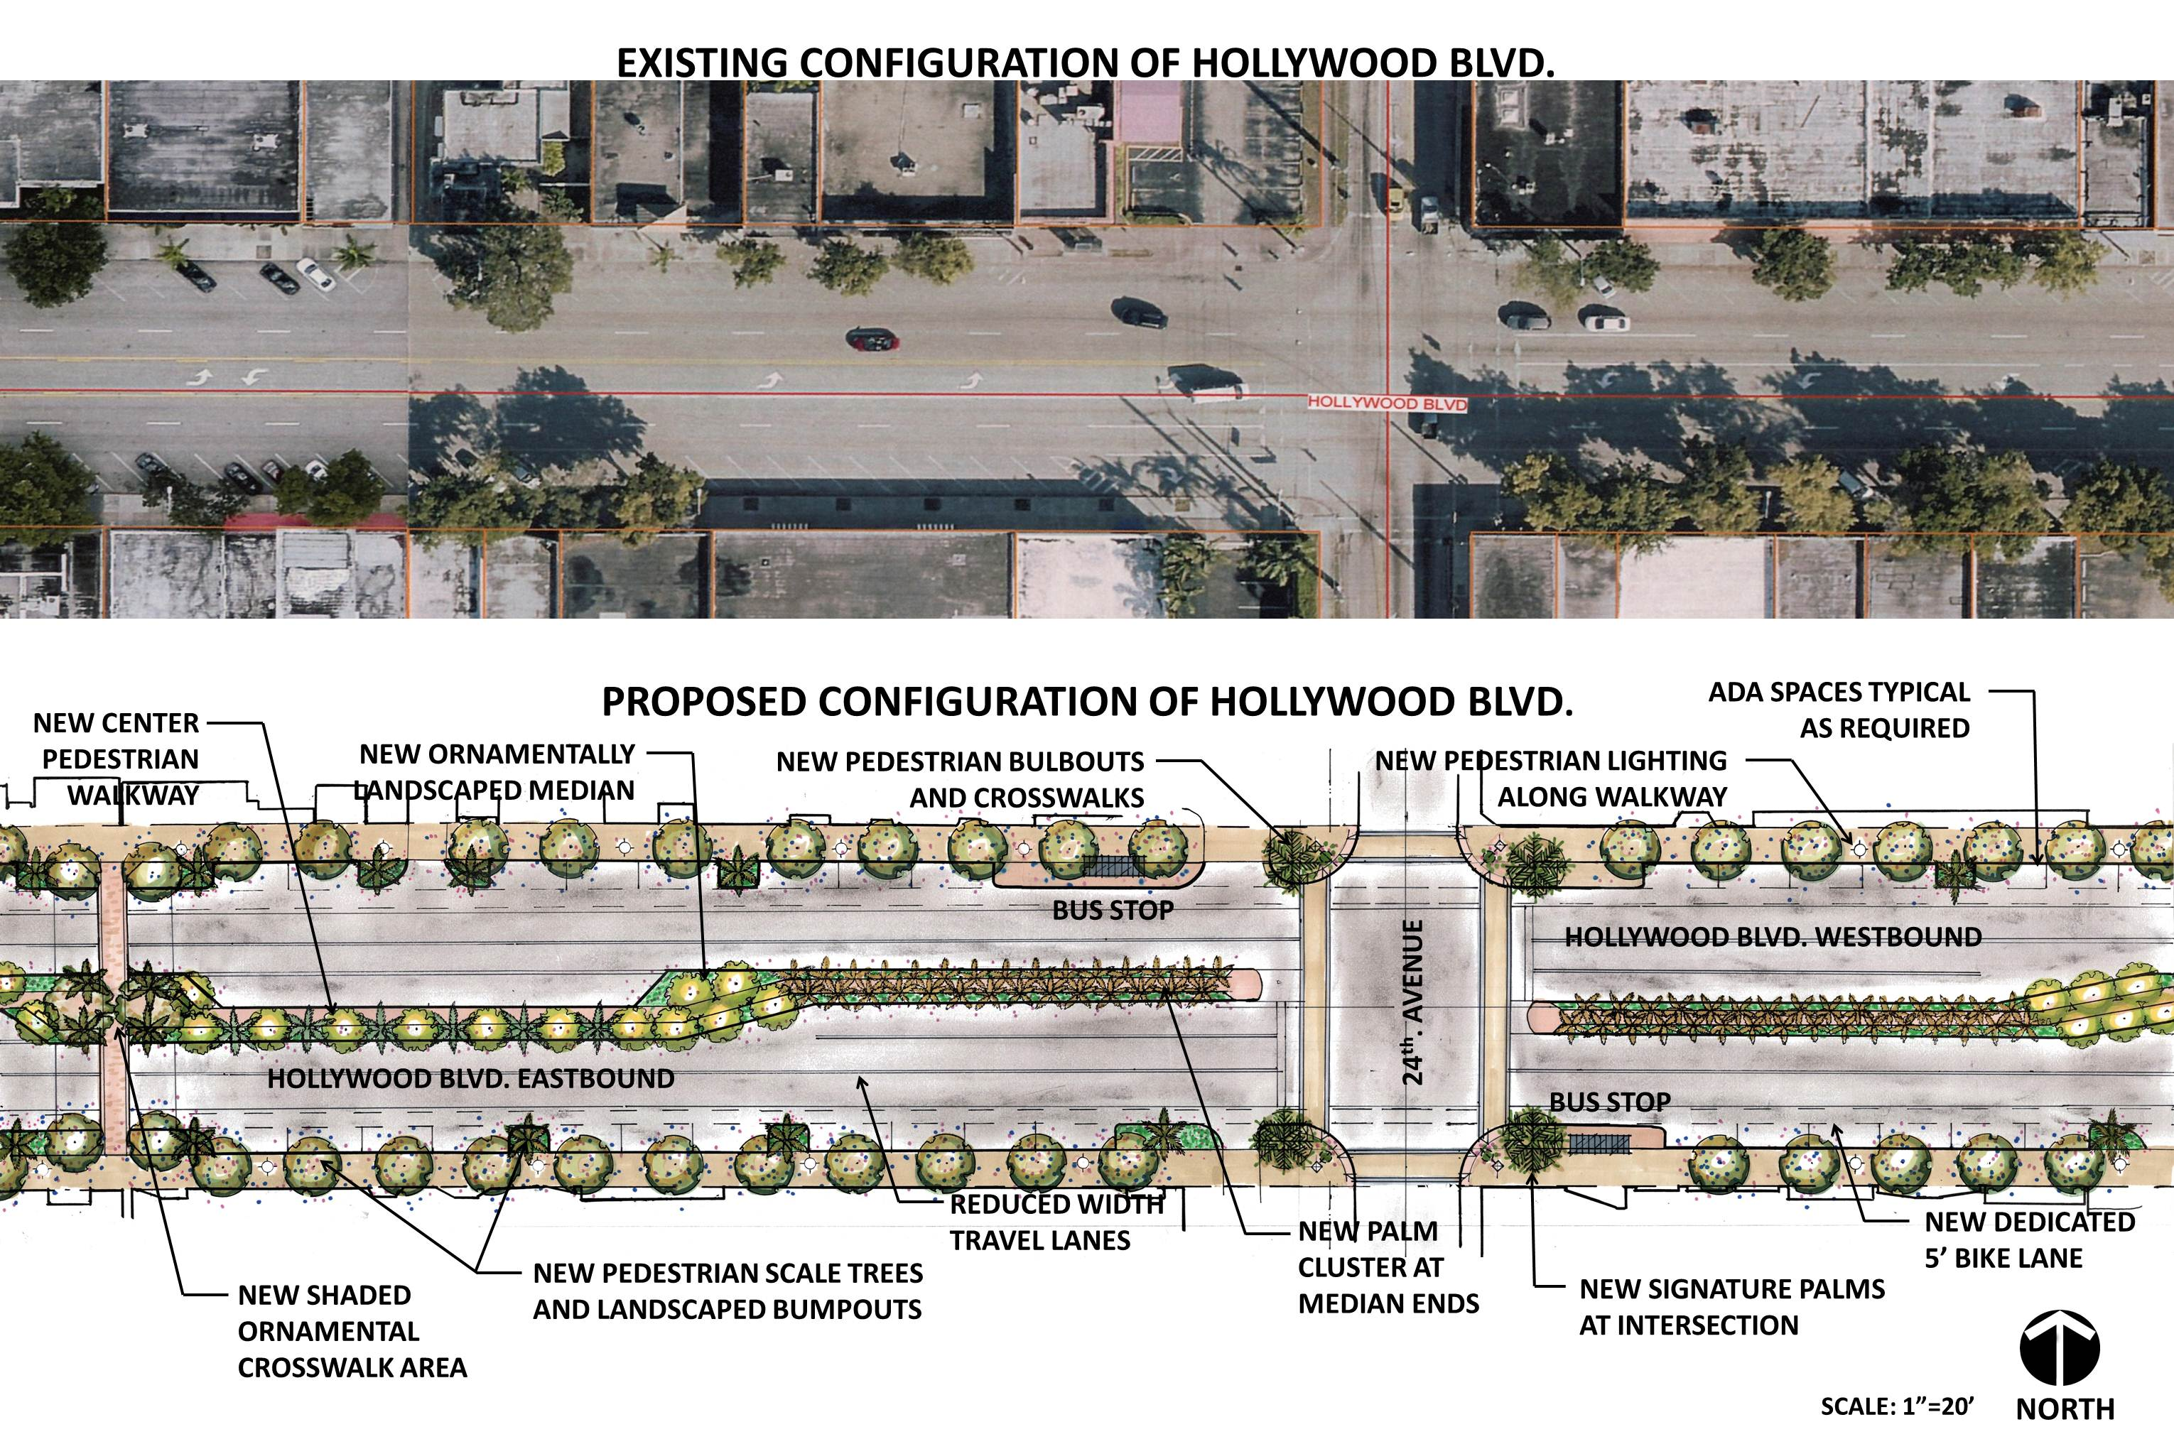
Hollywood Blvd. Complete Streets Concept

Slide 5
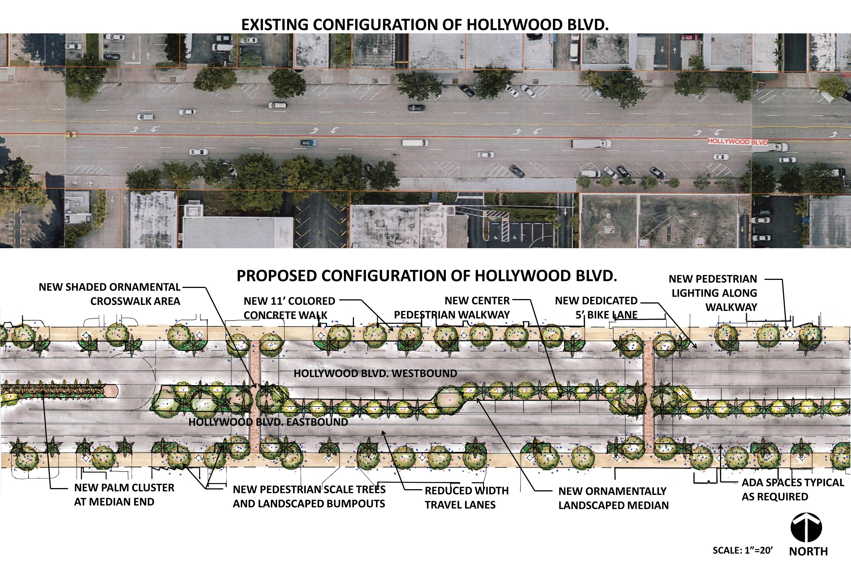
Hollywood Blvd. Complete Streets Concept

Slide 6
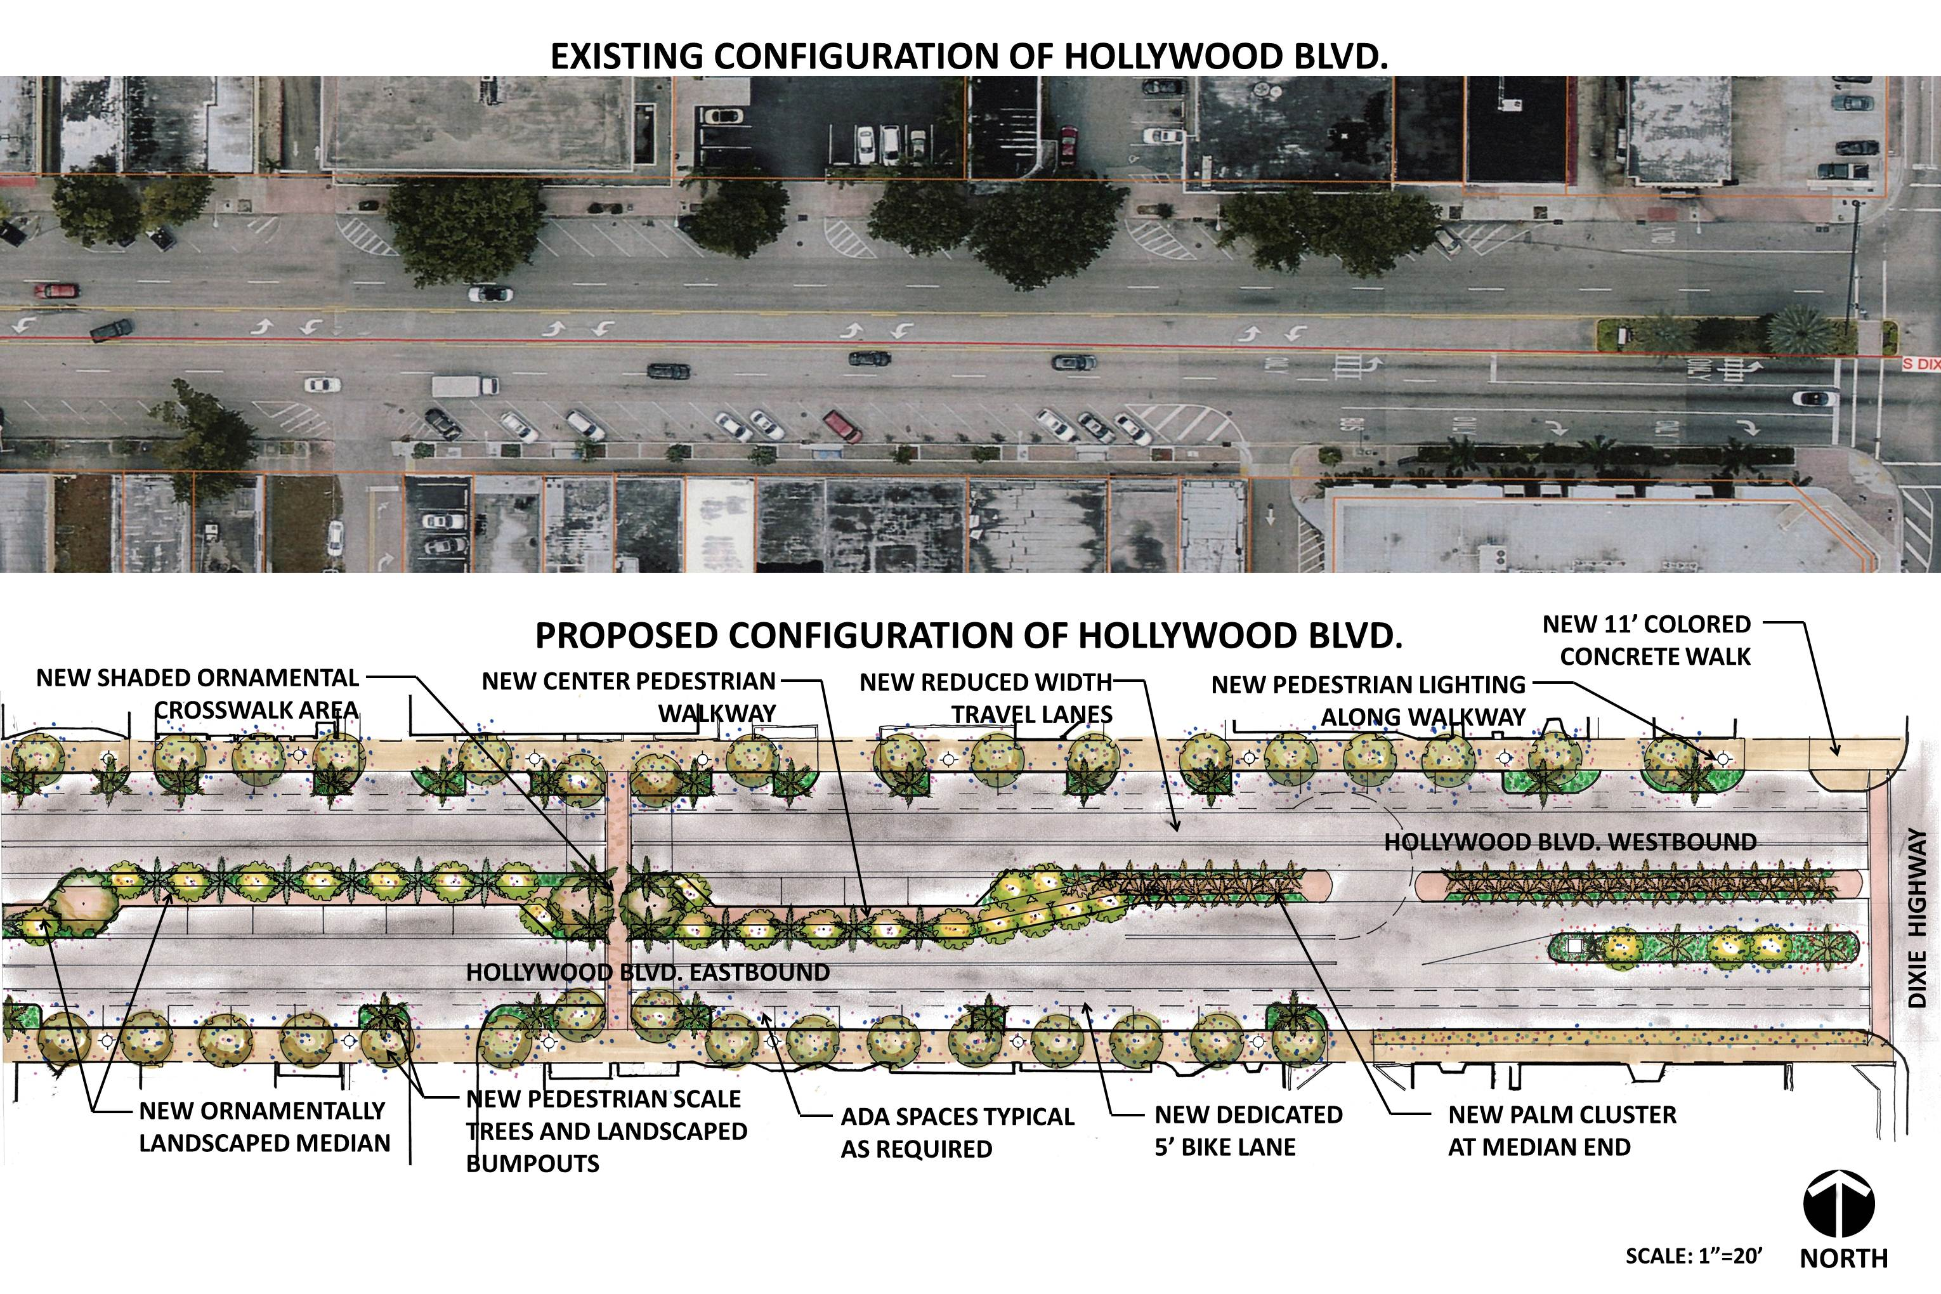
Hollywood Blvd. Complete Streets Concept

Slide 7
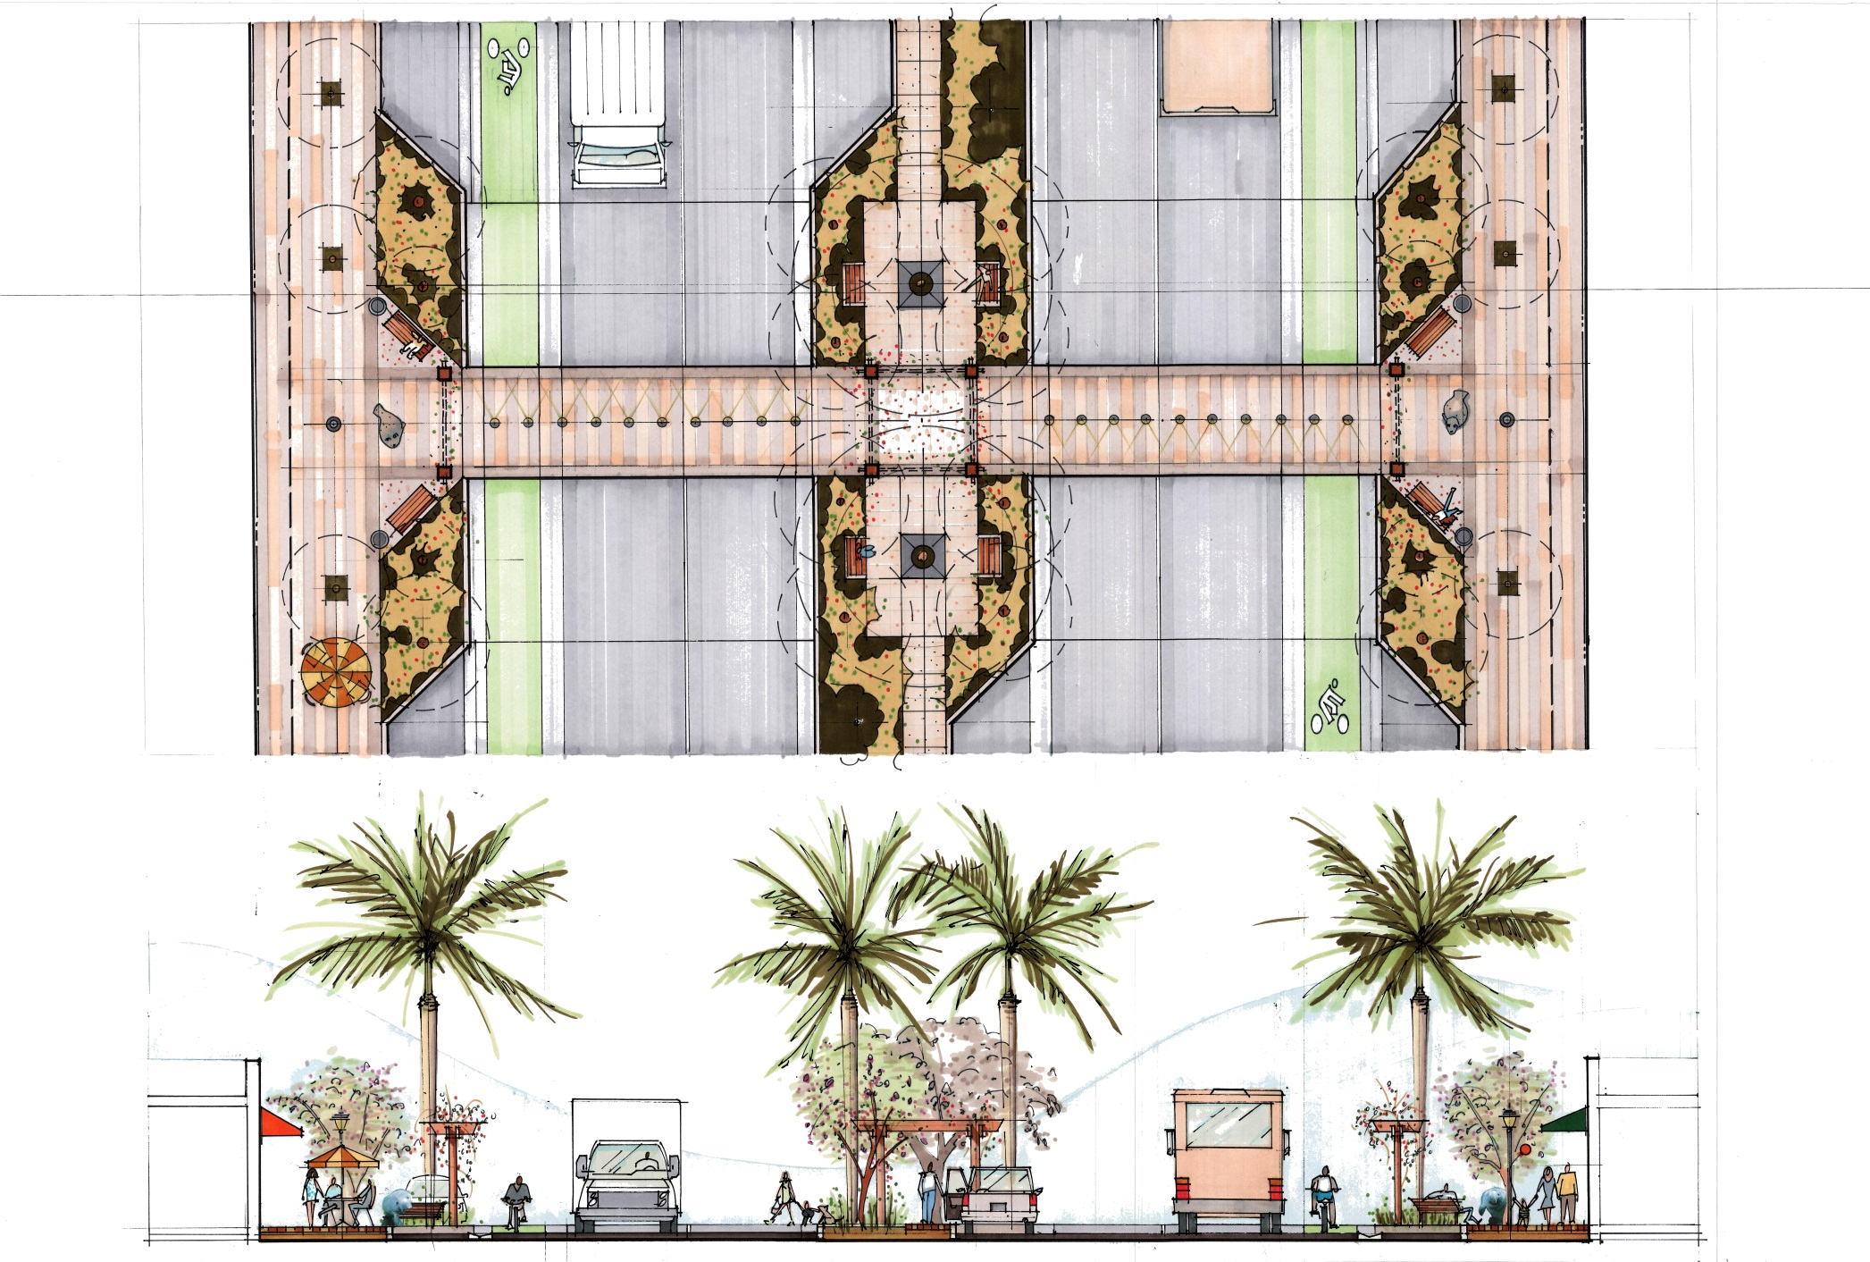
Hollywood Blvd. Typical Plan-Section

Slide 8
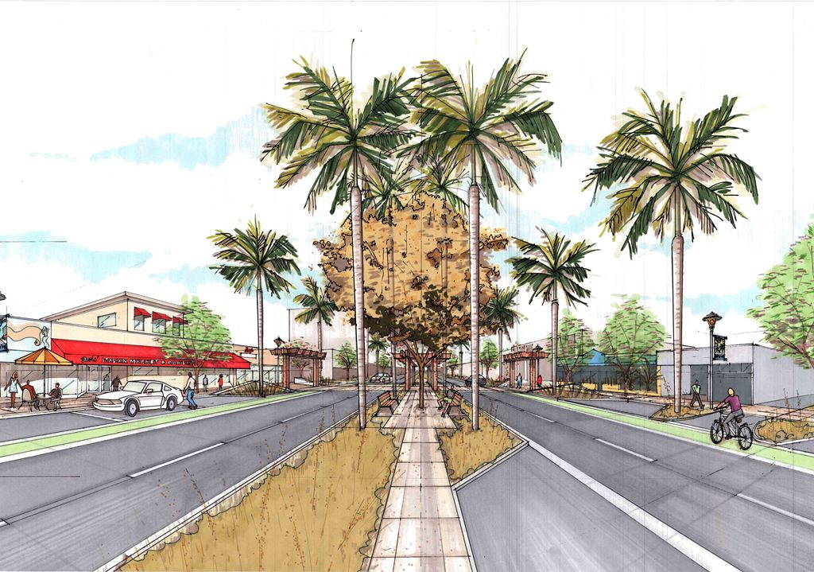
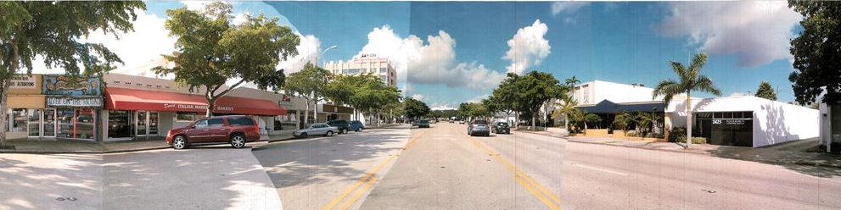
Hollywood Blvd. Conceptual Perspective

Slide 9
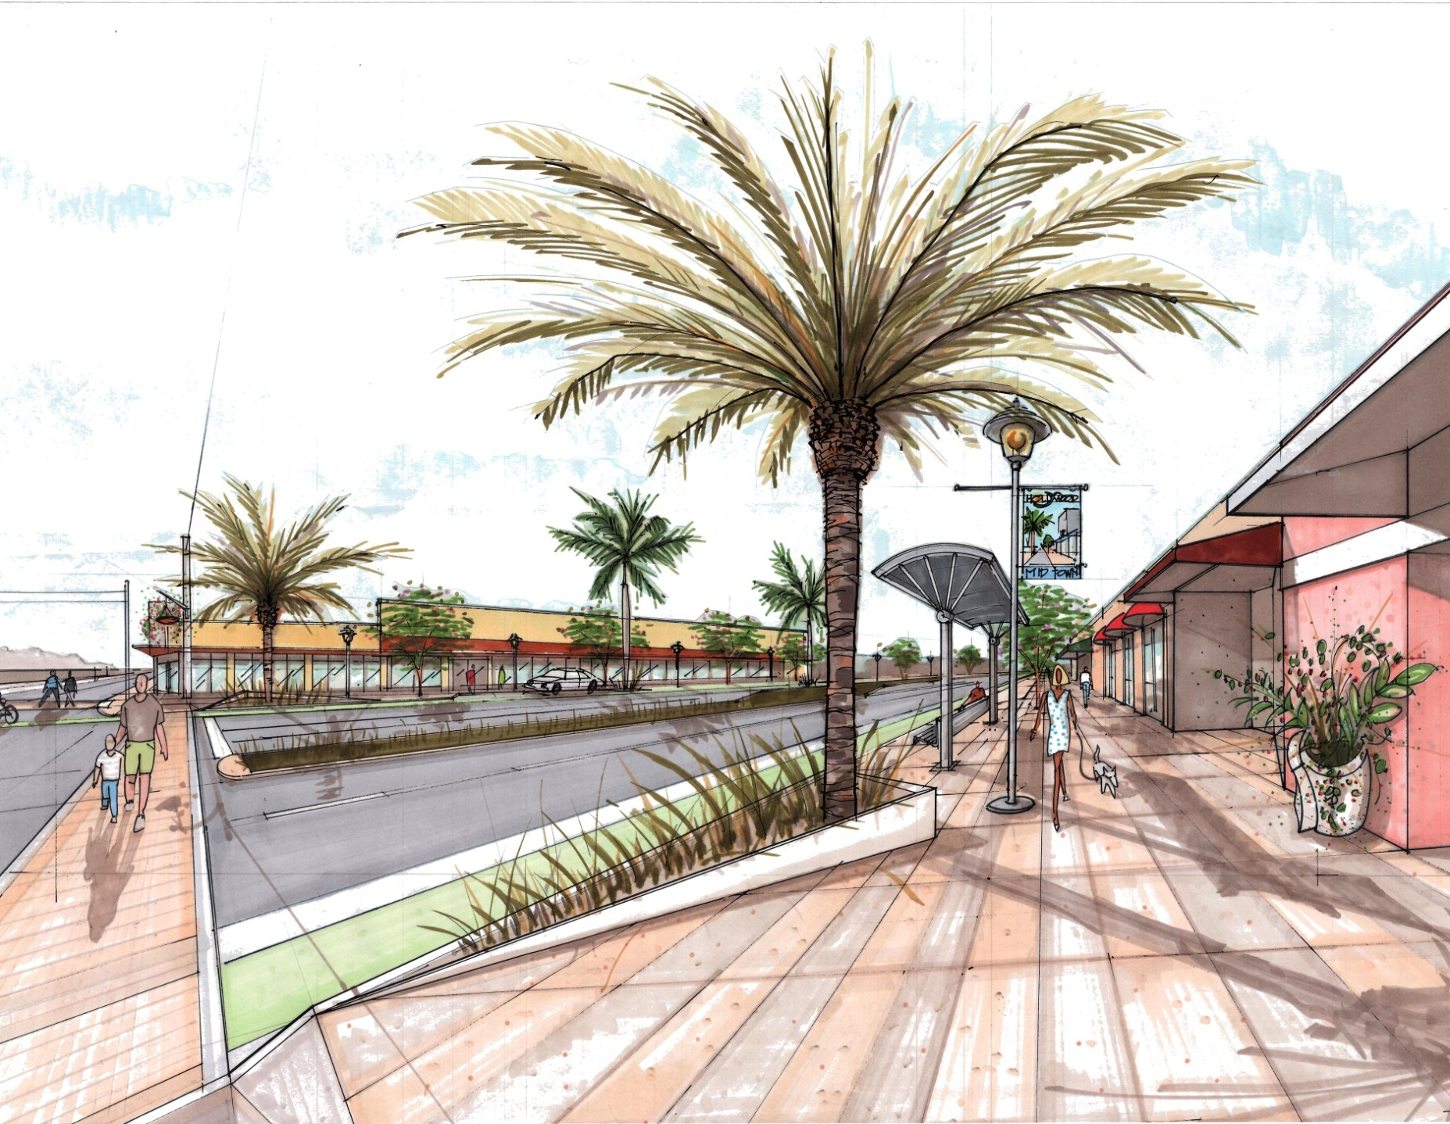
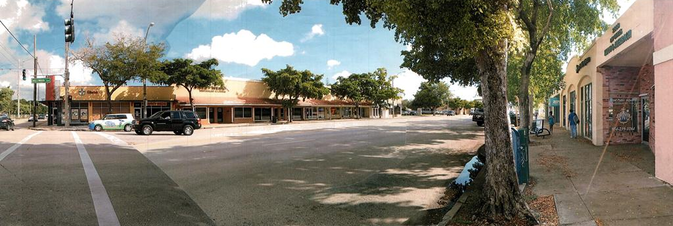
Hollywood Blvd. Conceptual Perspective

Slide 10
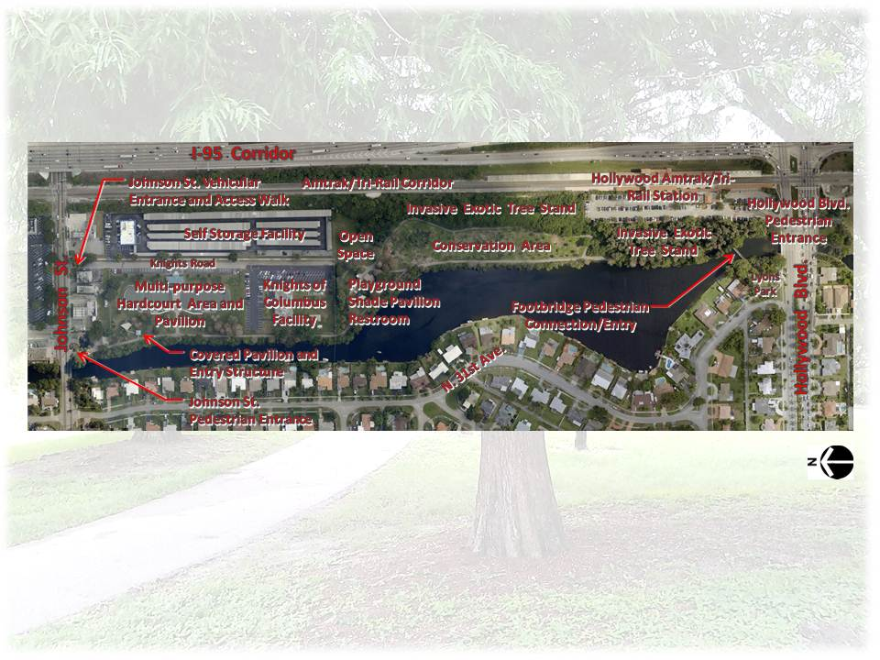
Hollywood Blvd. Conceptual Perspective
Stan Goldman Memorial Park
Existing Conditions Map

Slide 11
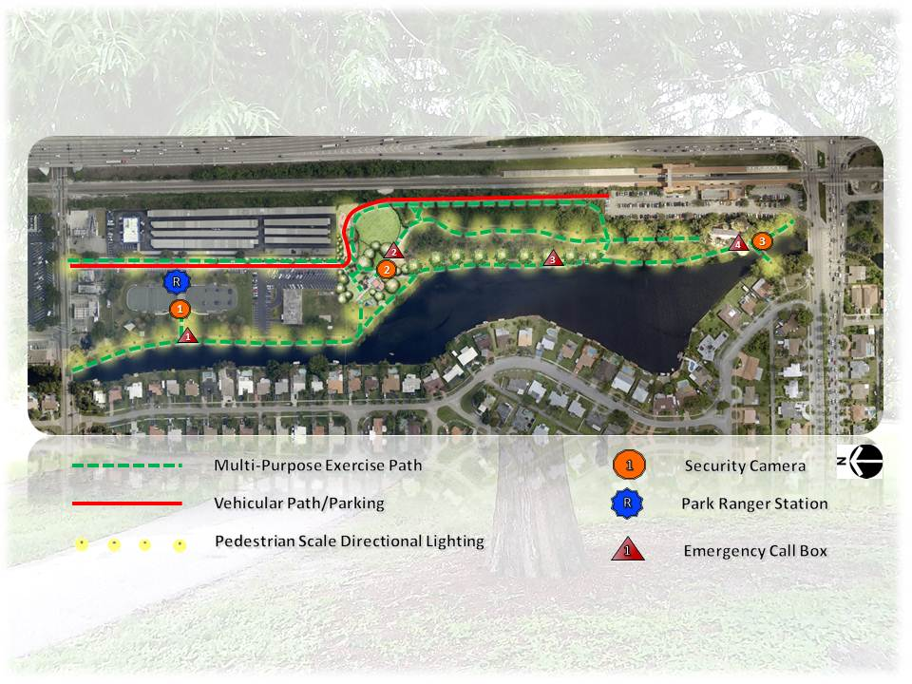
Hollywood Blvd. Conceptual Perspective
Stan Goldman Memorial Park
Circulation/Security/Surveillance Plan

Slide 12
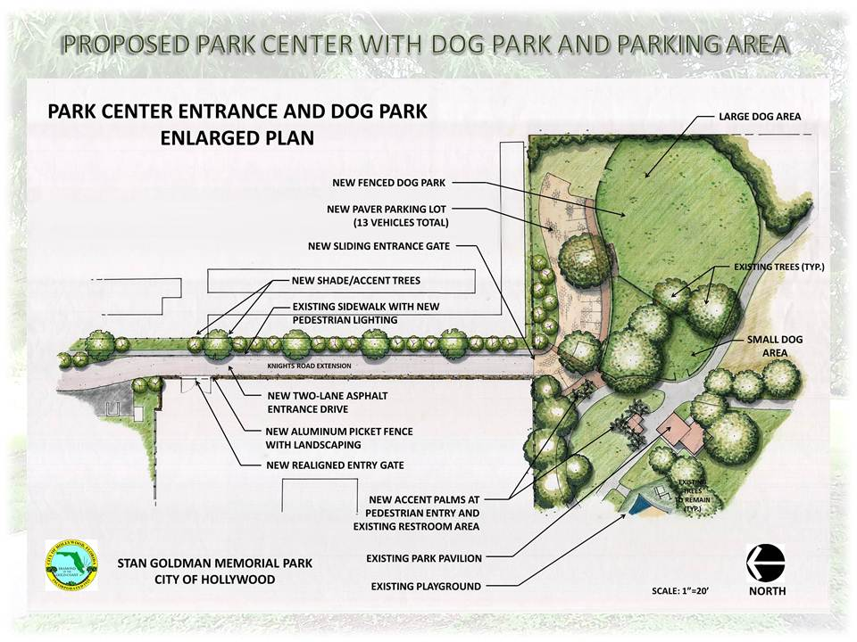
Stan Goldman Memorial Park

Slide 13
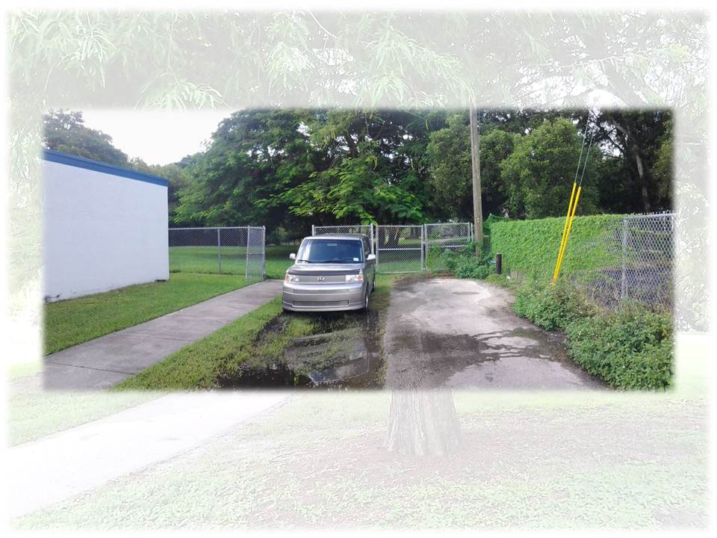
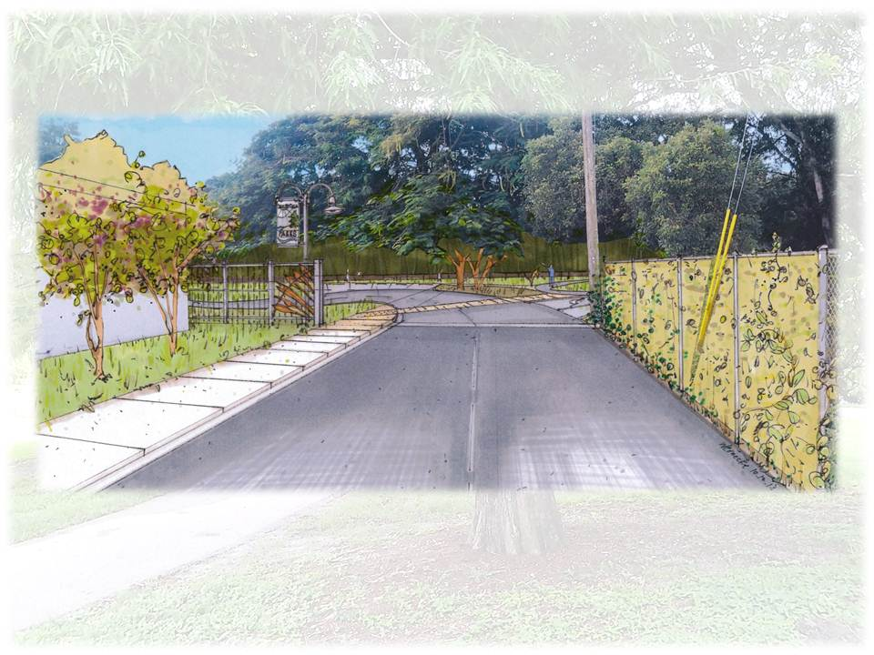
Hollywood Blvd. Conceptual Perspective
Stan Goldman Memorial Park
Park Center Entrance

Slide 14
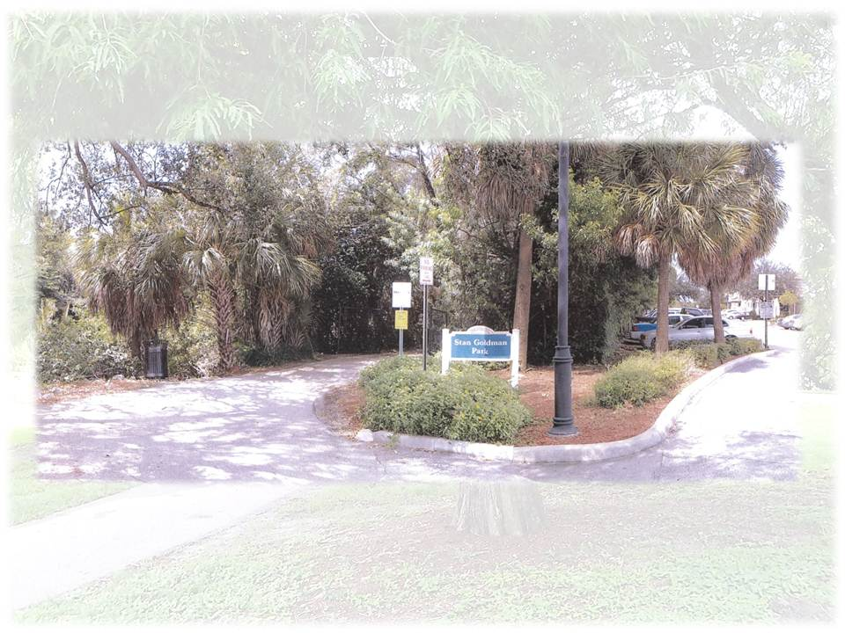
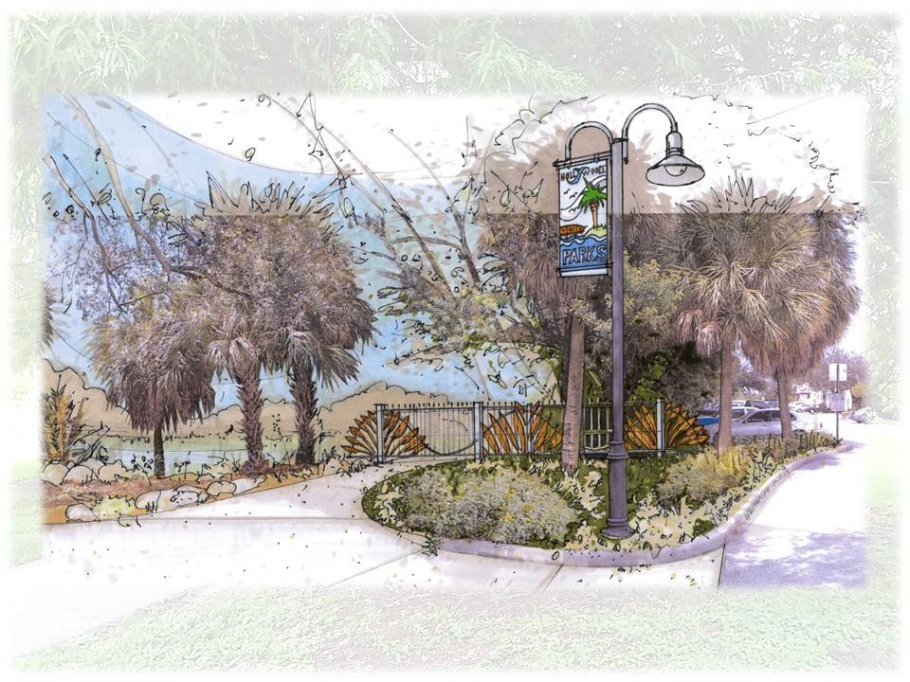
Stan Goldman Memorial Park
Tri-Rail Station Entrance

Slide 15
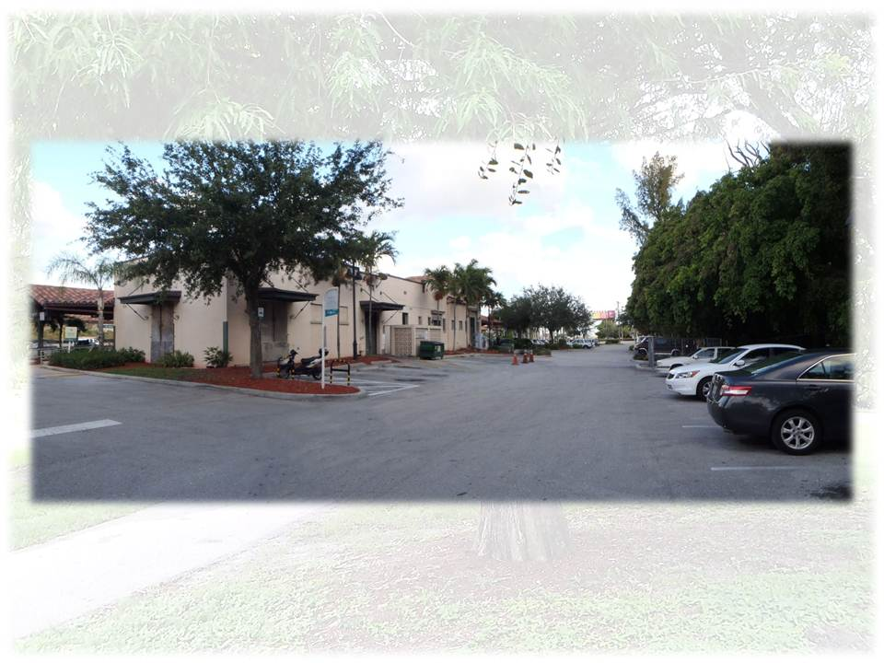
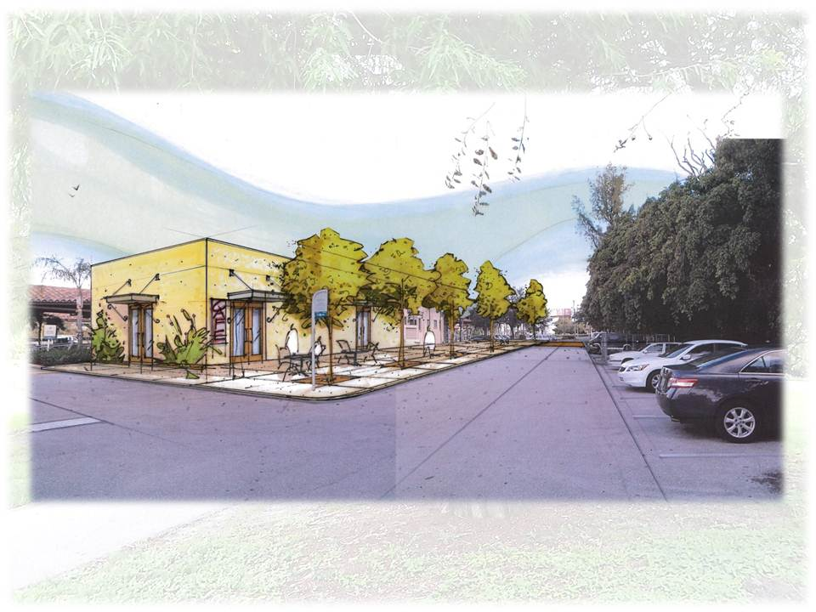
Stan Goldman Memorial Park
Tri-Rail Station

Slide 16
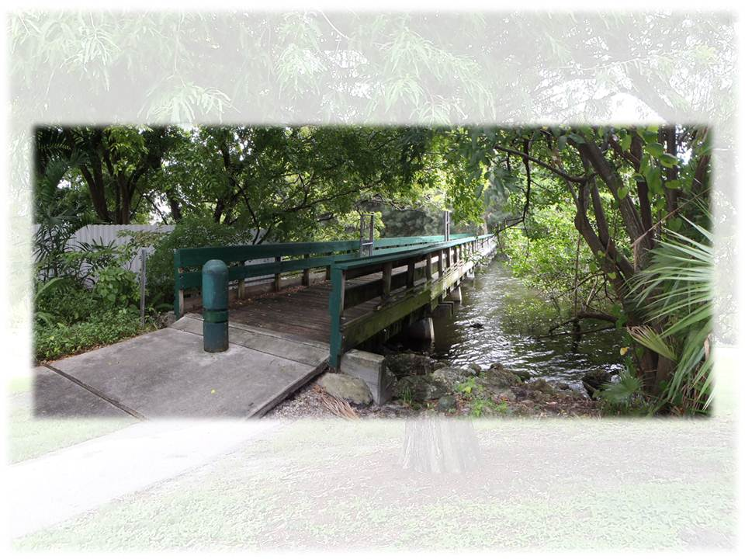
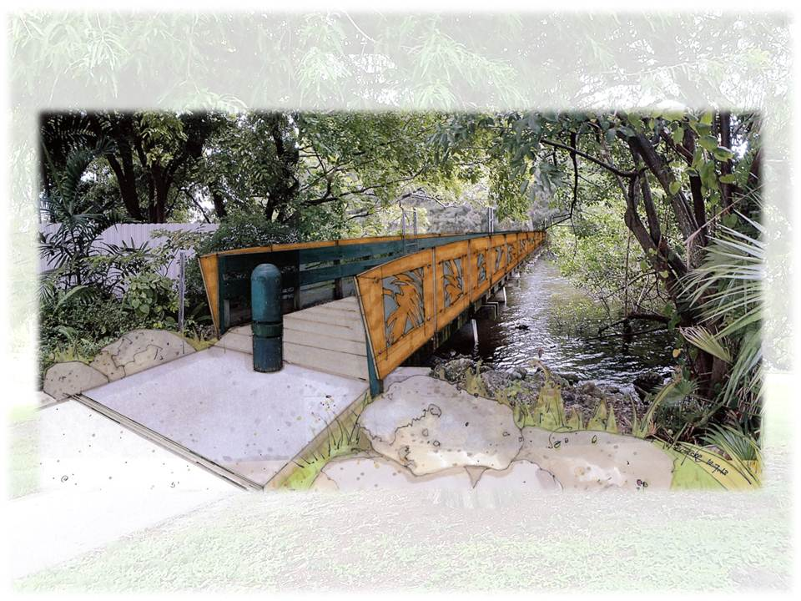
Stan Goldman Memorial Park
Lyons Park Entrance

Slide 17
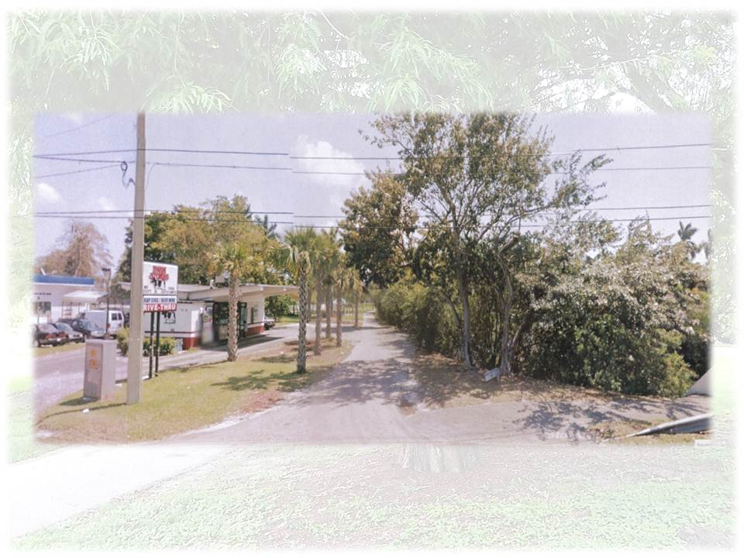
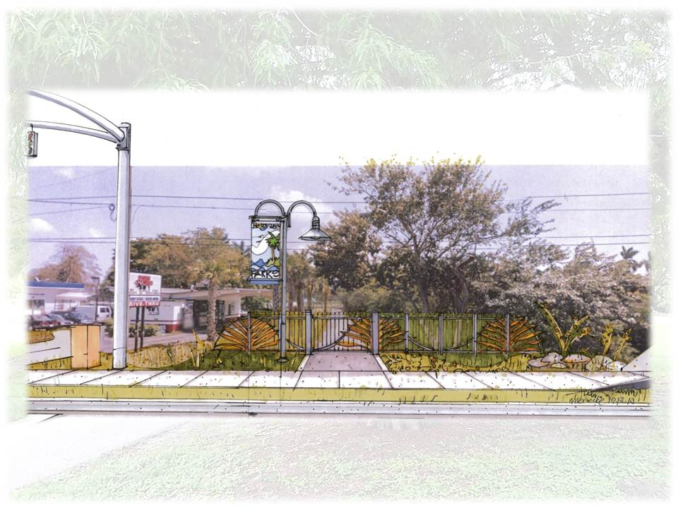
Stan Goldman Memorial Park
Johnson St. Pedestrian Entrance

Slide 18
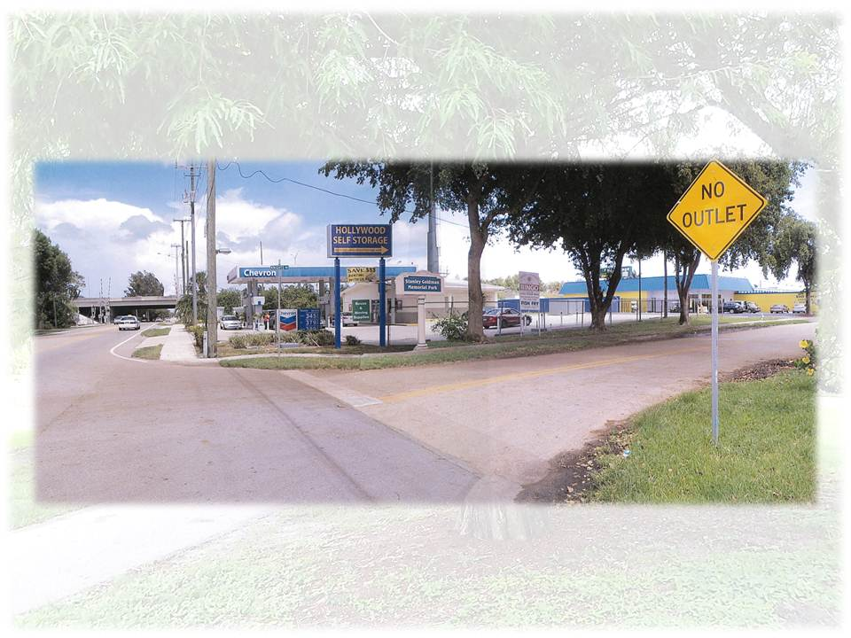
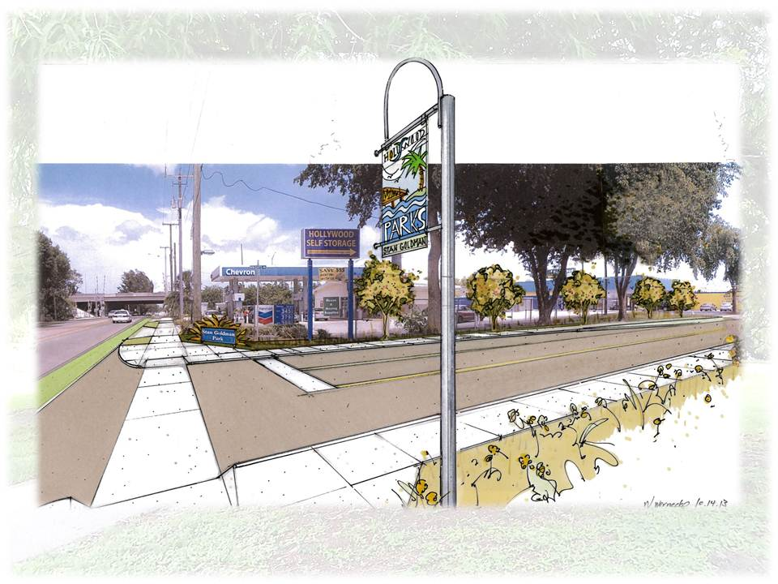
Stan Goldman Memorial Park
Johnson St. Vehicular Entrance

Slide 19
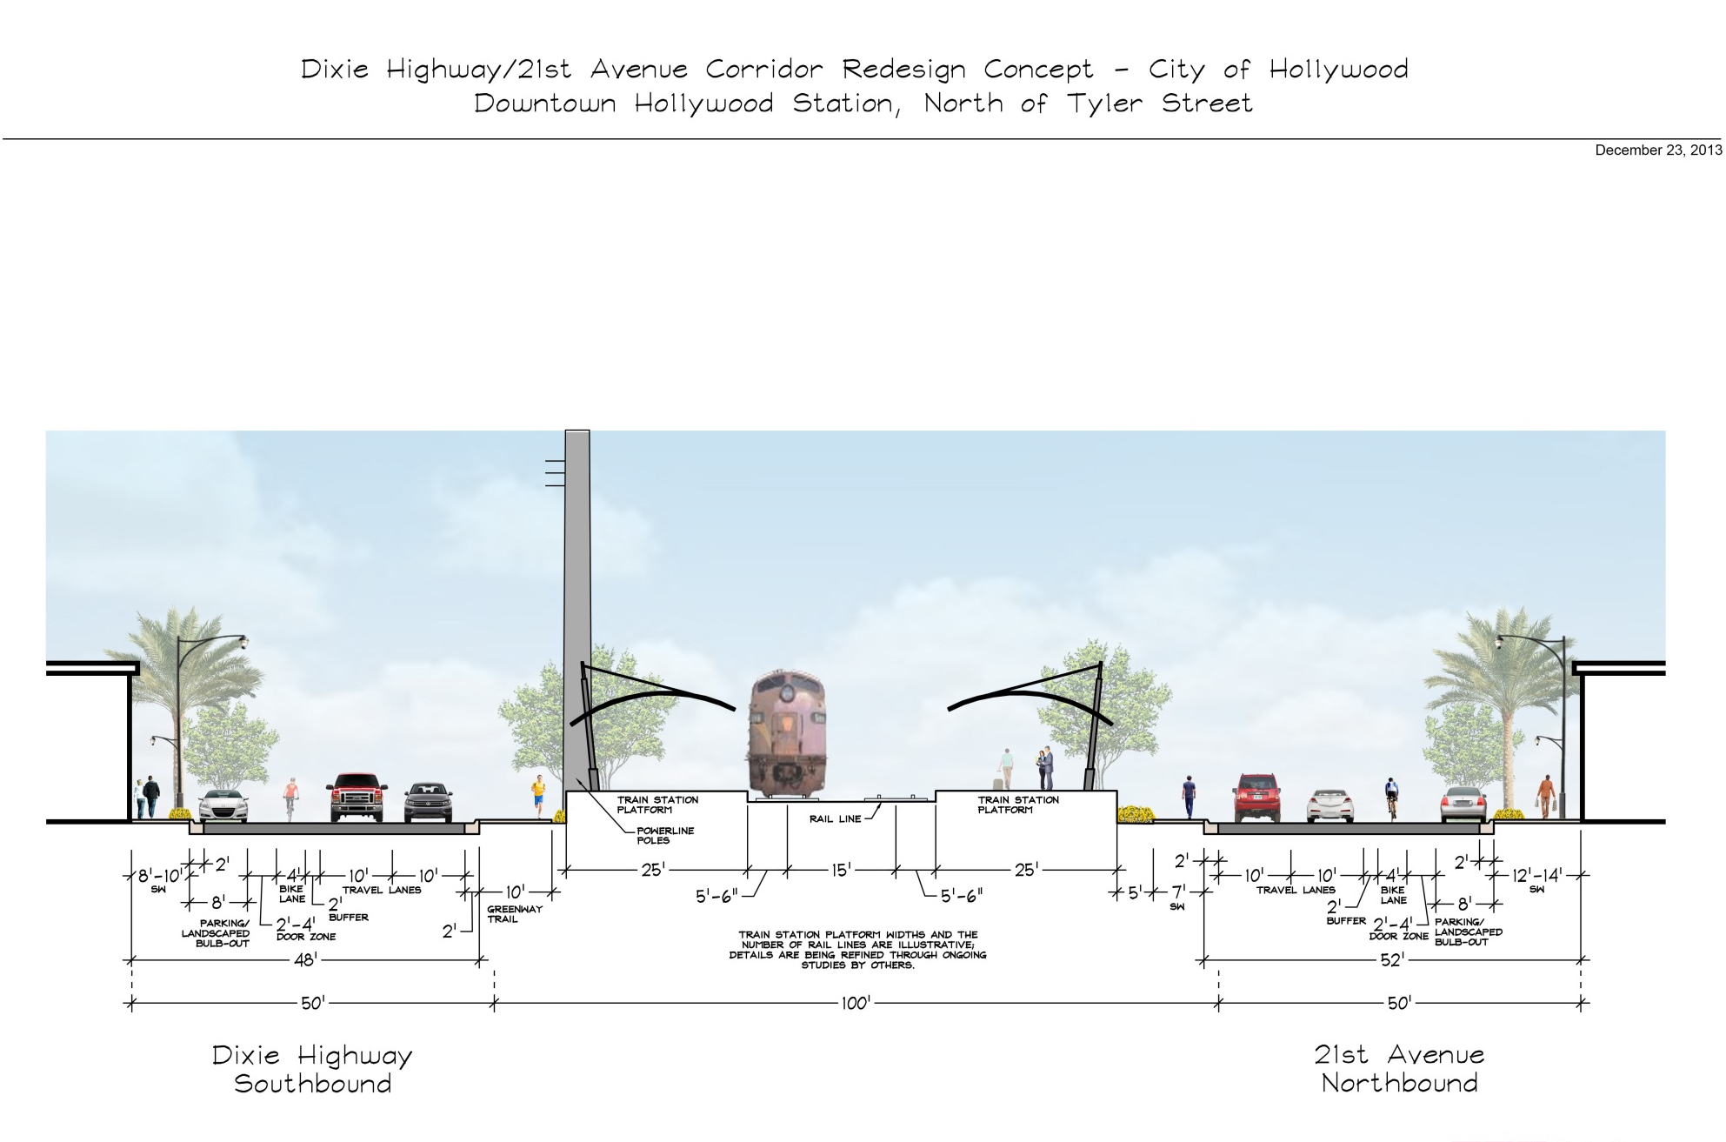
Dixie Highway/FEC Corridor Conceptual Design

Slide 20
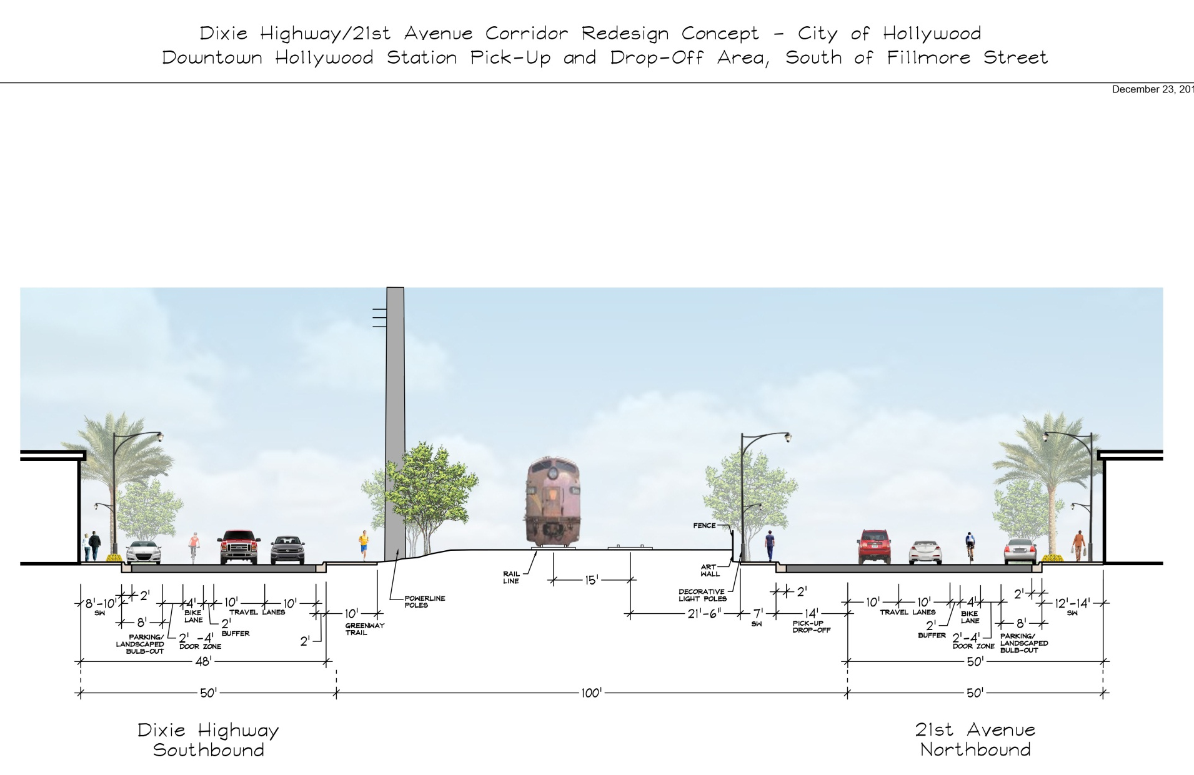
Dixie Highway/FEC Corridor Conceptual Design

Slide 21
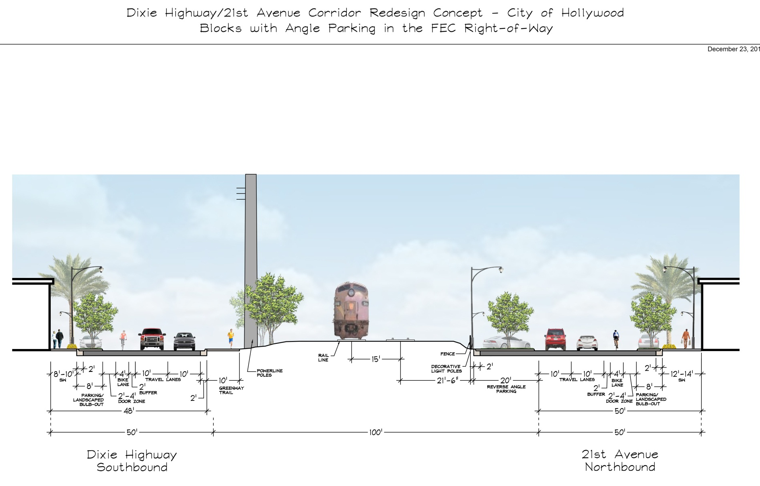
Dixie Highway/FEC Corridor Conceptual Design

Slide 22
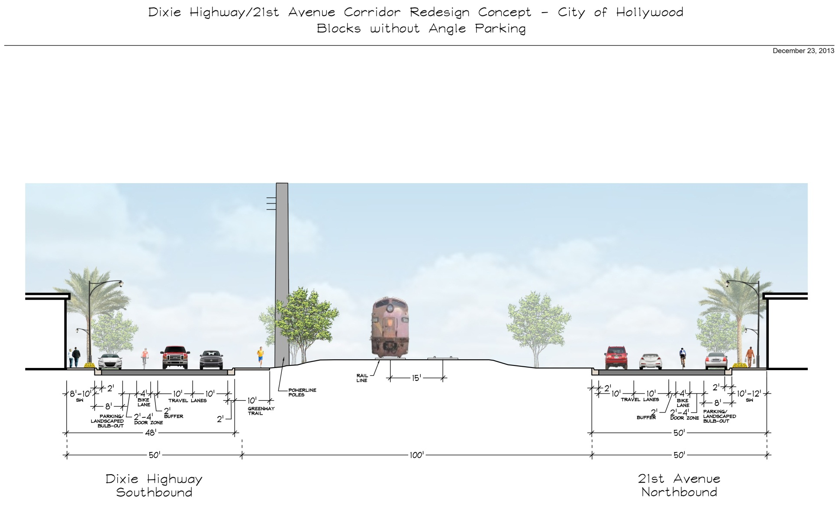
Dixie Highway/FEC Corridor Conceptual Design

Slide 23
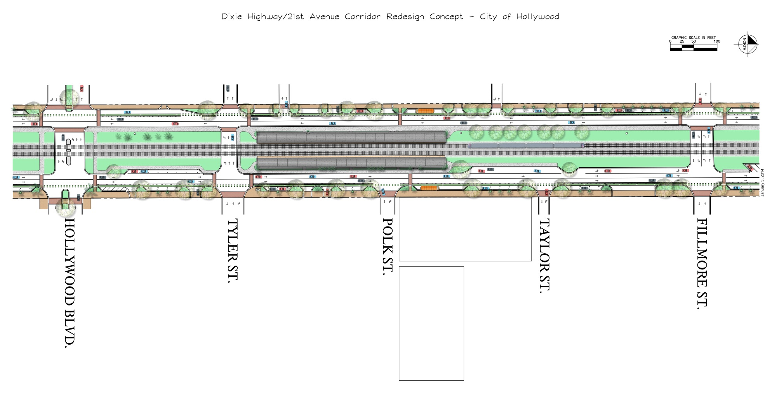
Dixie Highway/FEC Corridor Conceptual Design

Slide 24
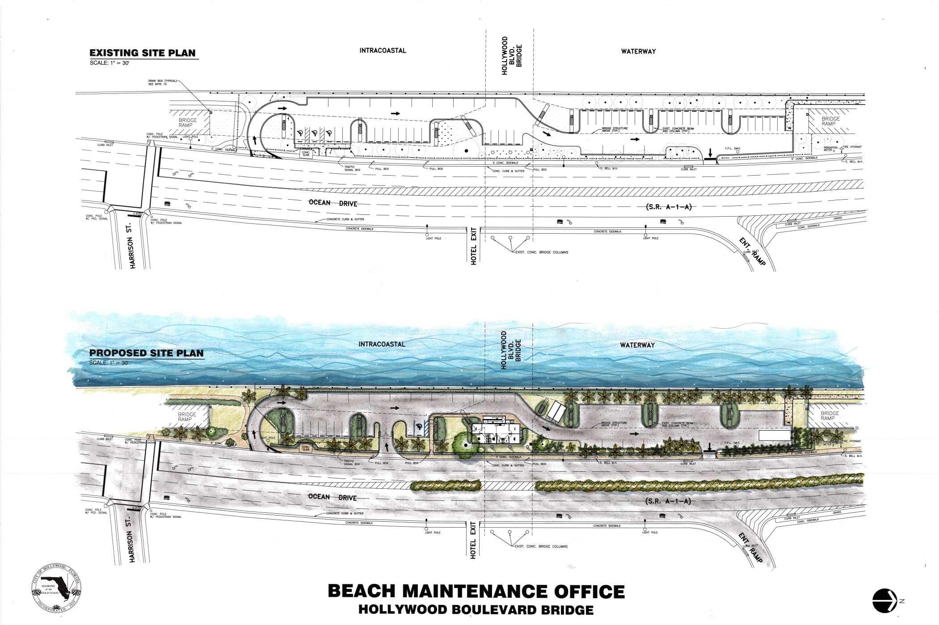
Beach Maintenance Facility Conceptual Studies

Slide 25
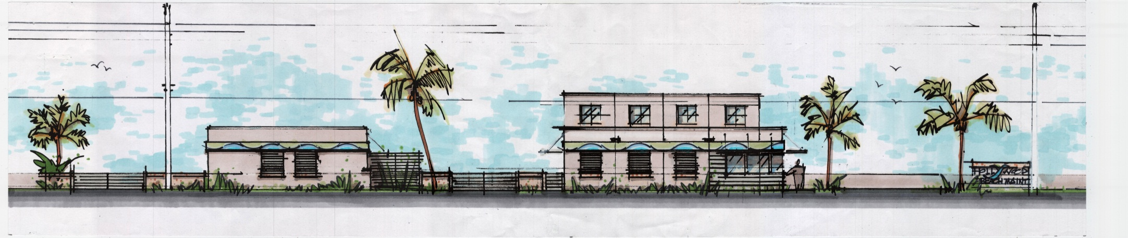
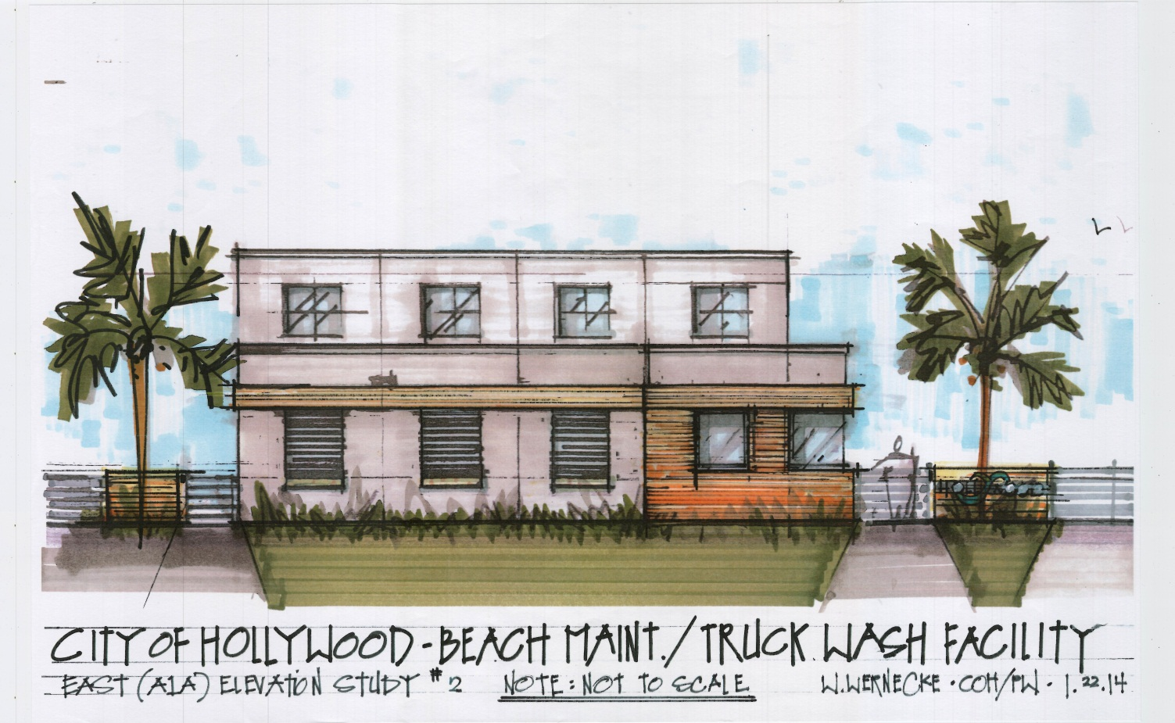
Beach Maintenance Facility Conceptual Studies

Slide 26
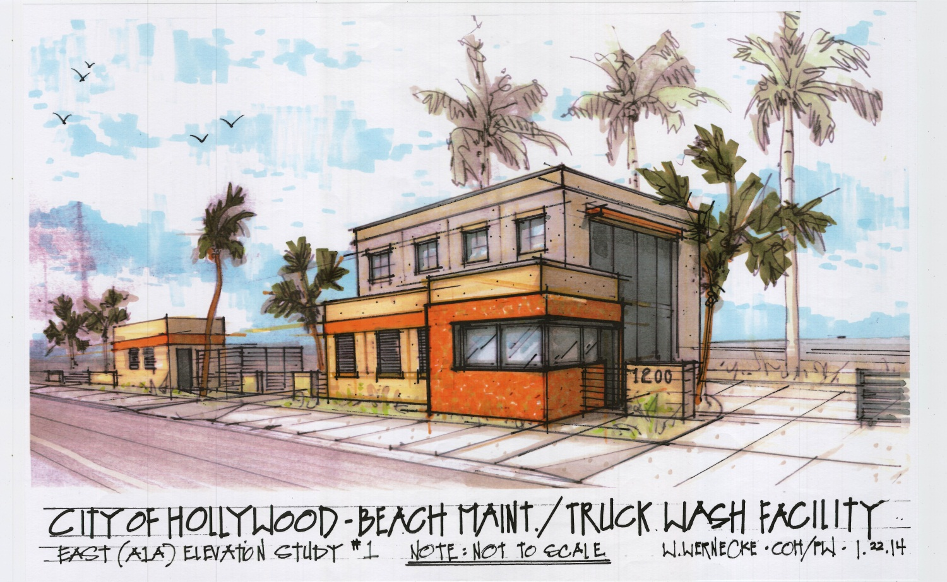
Beach Maintenance Facility Conceptual Studies

Slide 27
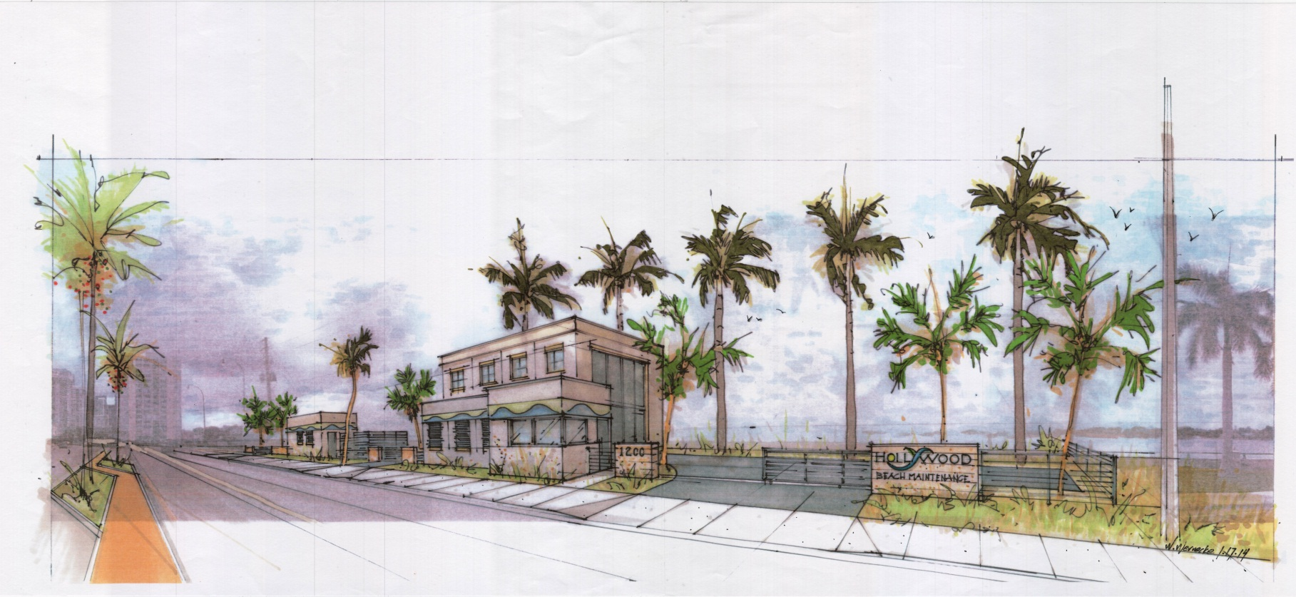
Beach Maintenance Facility Conceptual Studies

Slide 28
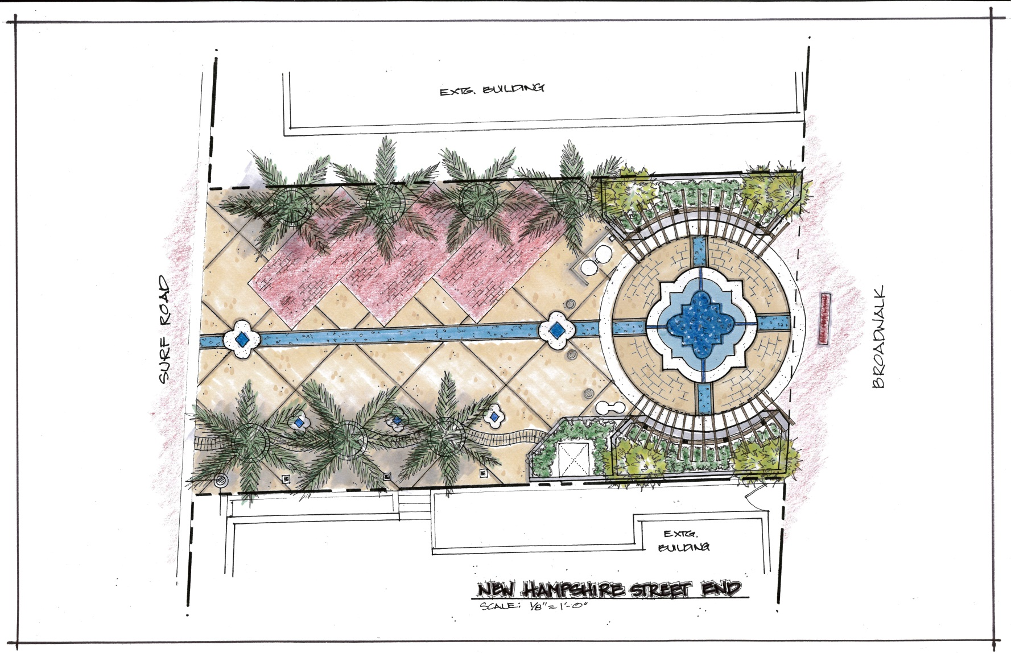
Beach Street End Designs
MEDJOOL DATE PALM ALLEE
WOOD SHADE STRUCTURE OVER RAISED PLANTER SEATING
DELINEATED PARKING SPACES
10’x10’ DELINEATED PAVING PATTERN
PRECAST CONCRETE/UNIT PAVER FOUNTAIN MOTIF INSET INTO PAVING
PRECAST WATER RILL MOTIF WITH ORNAMENTAL INSETS
PRECAST INSET STREET NAME PLAQUE
ORNAMENTAL PLANTINGS AND UTILITY SCREEN
SHADED PEDESTRIAN WAY

Slide 29
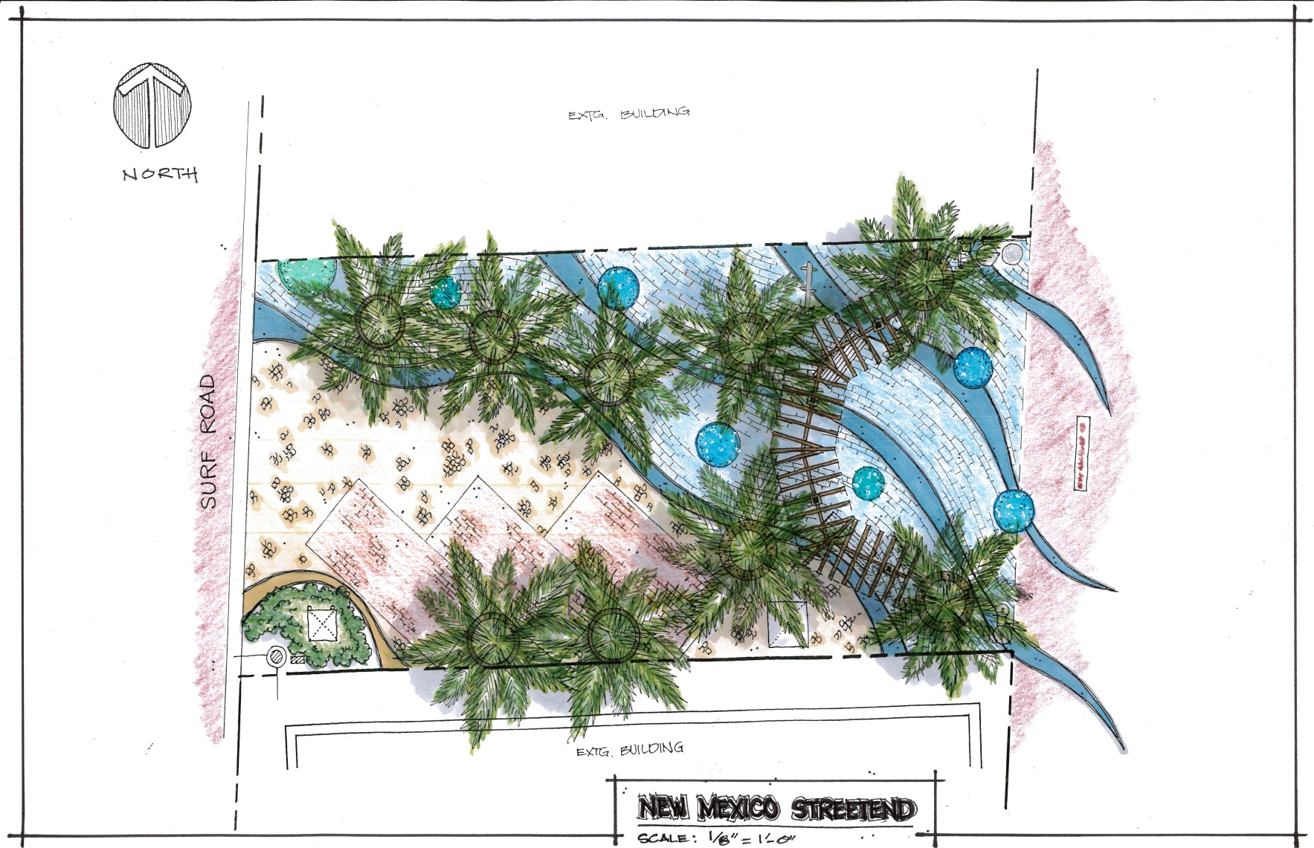
Beach Street End Designs
INTEGRALLY COLORED CONCRETE WAVE BANDS
CIRCULAR RAISED SEAT PLANTER ‘ISLANDS’
‘OCEAN’-THEMED PEDESTRIAN AREA
WOOD SHADE STRUCTURE WITH SEATING BELOW
PRECAST CONCRETE/UNIT PAVER FOUNTAIN MOTIF INSET INTO PAVING
‘BEACH’-THEMED VEHICULAR APPROACH
PRECAST BLUE CONCRETE MEDALLIONS WITH BLUE RECYCLED GLASS CHIPS
ORNAMENTAL PLANTING UTILITY SCREEN
DELINEATED PARKING SPACES

Slide 30
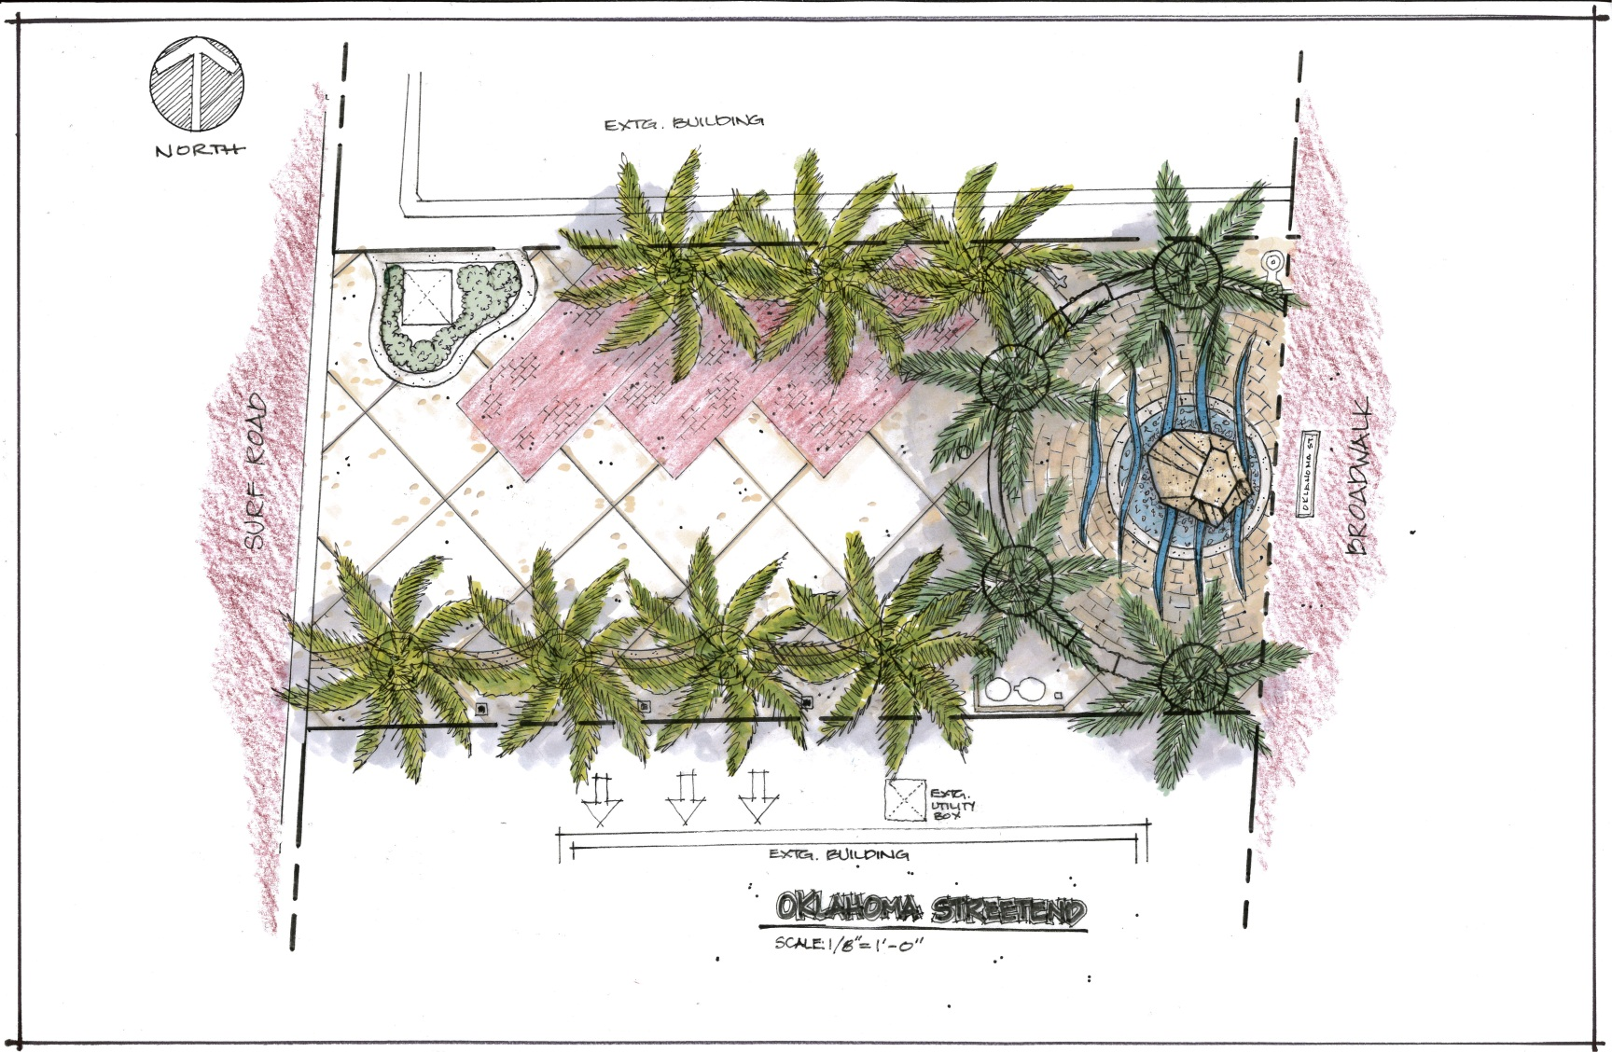
Beach Street End Designs
DELINEATED PARKING SPACES
MULTI-LEVEL CONCRETE SEATWALL
ORNAMENTAL PLANTINGS AND UTILITY SCREEN
‘CORAL REEF’ INTERACTIVE CLIMBING SCULPTURE CENTERPIECE
10’x10’ DELINEATED PAVING PATTERN
PRECAST INSET STREET NAME PLAQUE
SHADED PEDESTRIAN WAY
REFUSE/RECYCLE CORRAL

Slide 31
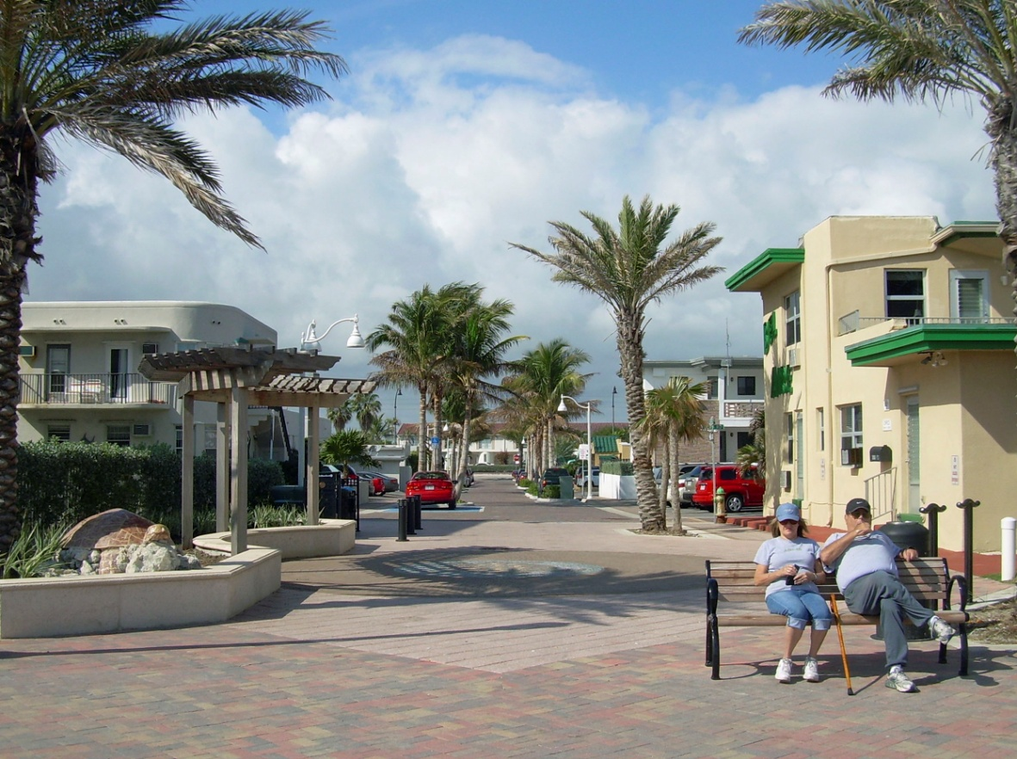
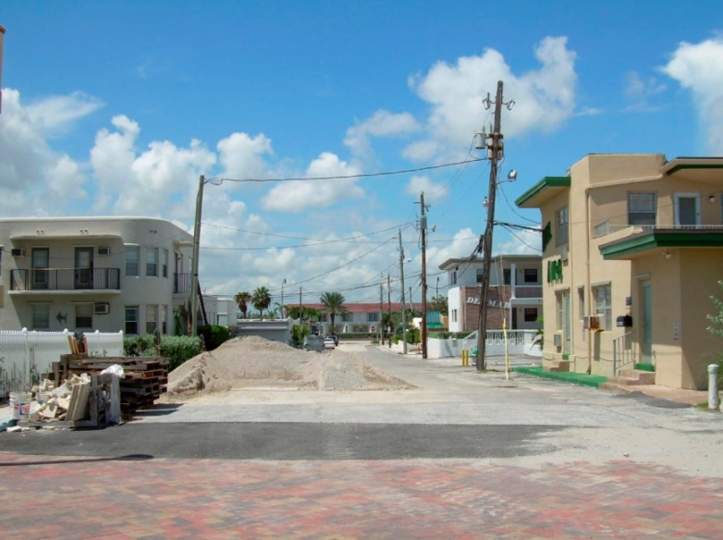
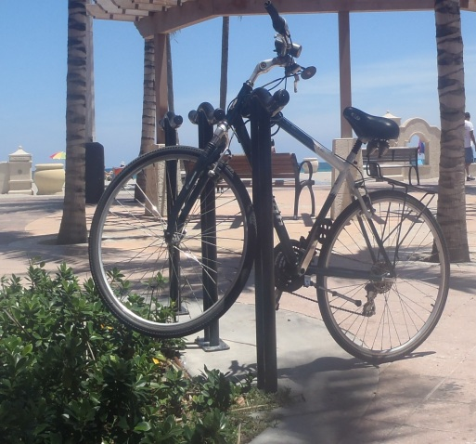
Beach Street End Designs
Arthur St. Before
Arthur St. After

Slide 32
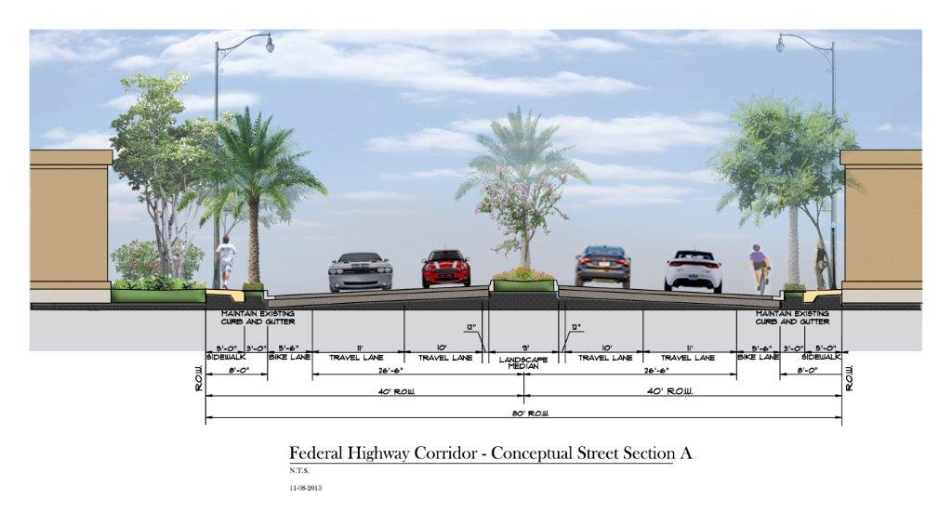
U.S. 1 Corridor Study

Slide 33
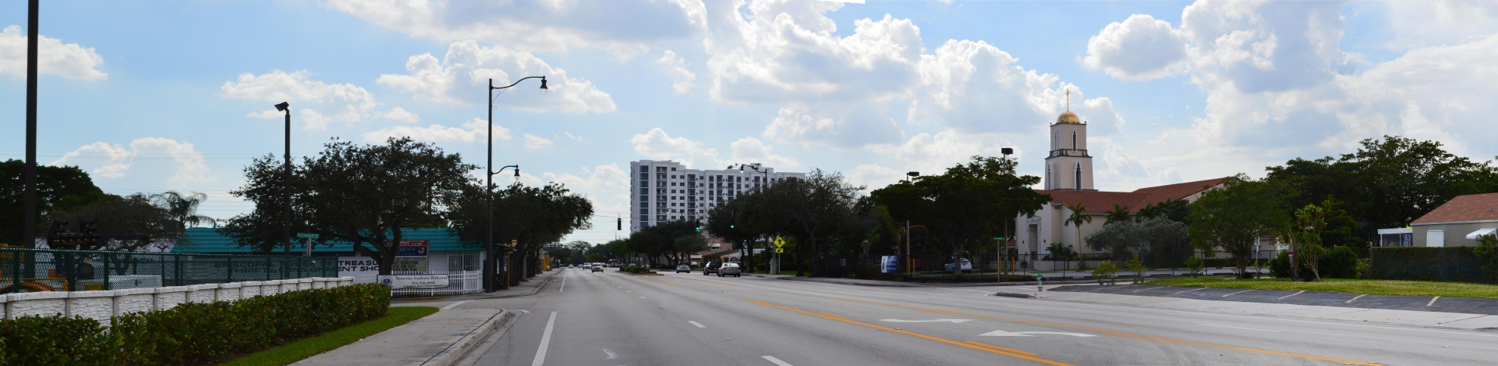

U.S. 1 Corridor Study
Existing Conditions
Draft Conceptual Rendering

Slide 34



A1A Corridor Study
Draft 3-Lane Configuration
Existing Conditions
Draft 4-Lane Configuration

Slide 35

A1A Corridor Study
Draft 3-Lane Configuration

Slide 36






Implementing Vision for A1A
A1A at Missouri St. Looking North - Illustration

