Slide 1
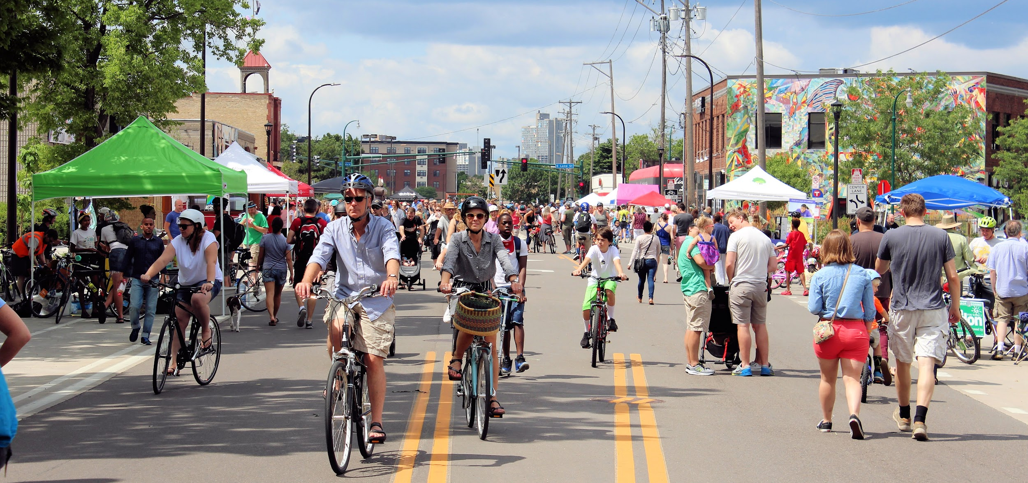

Slide 2
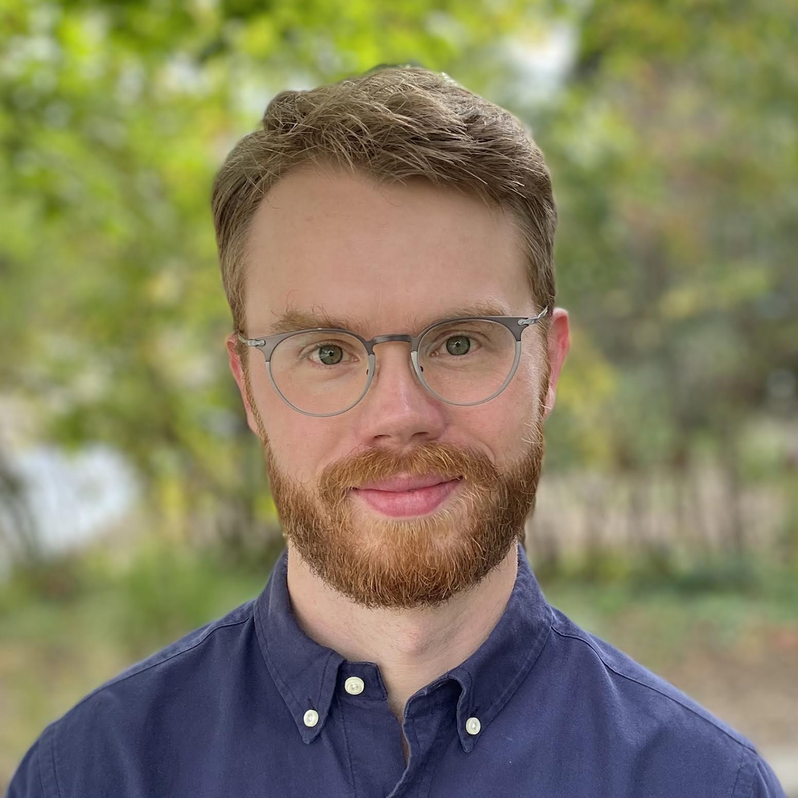

Nick Ray Olson (he/him)
Deputy Director, Event and Program Director
Our Streets Minneapolis
2016 – May 2021
nickrayolson@gmail.com
About me

Slide 3
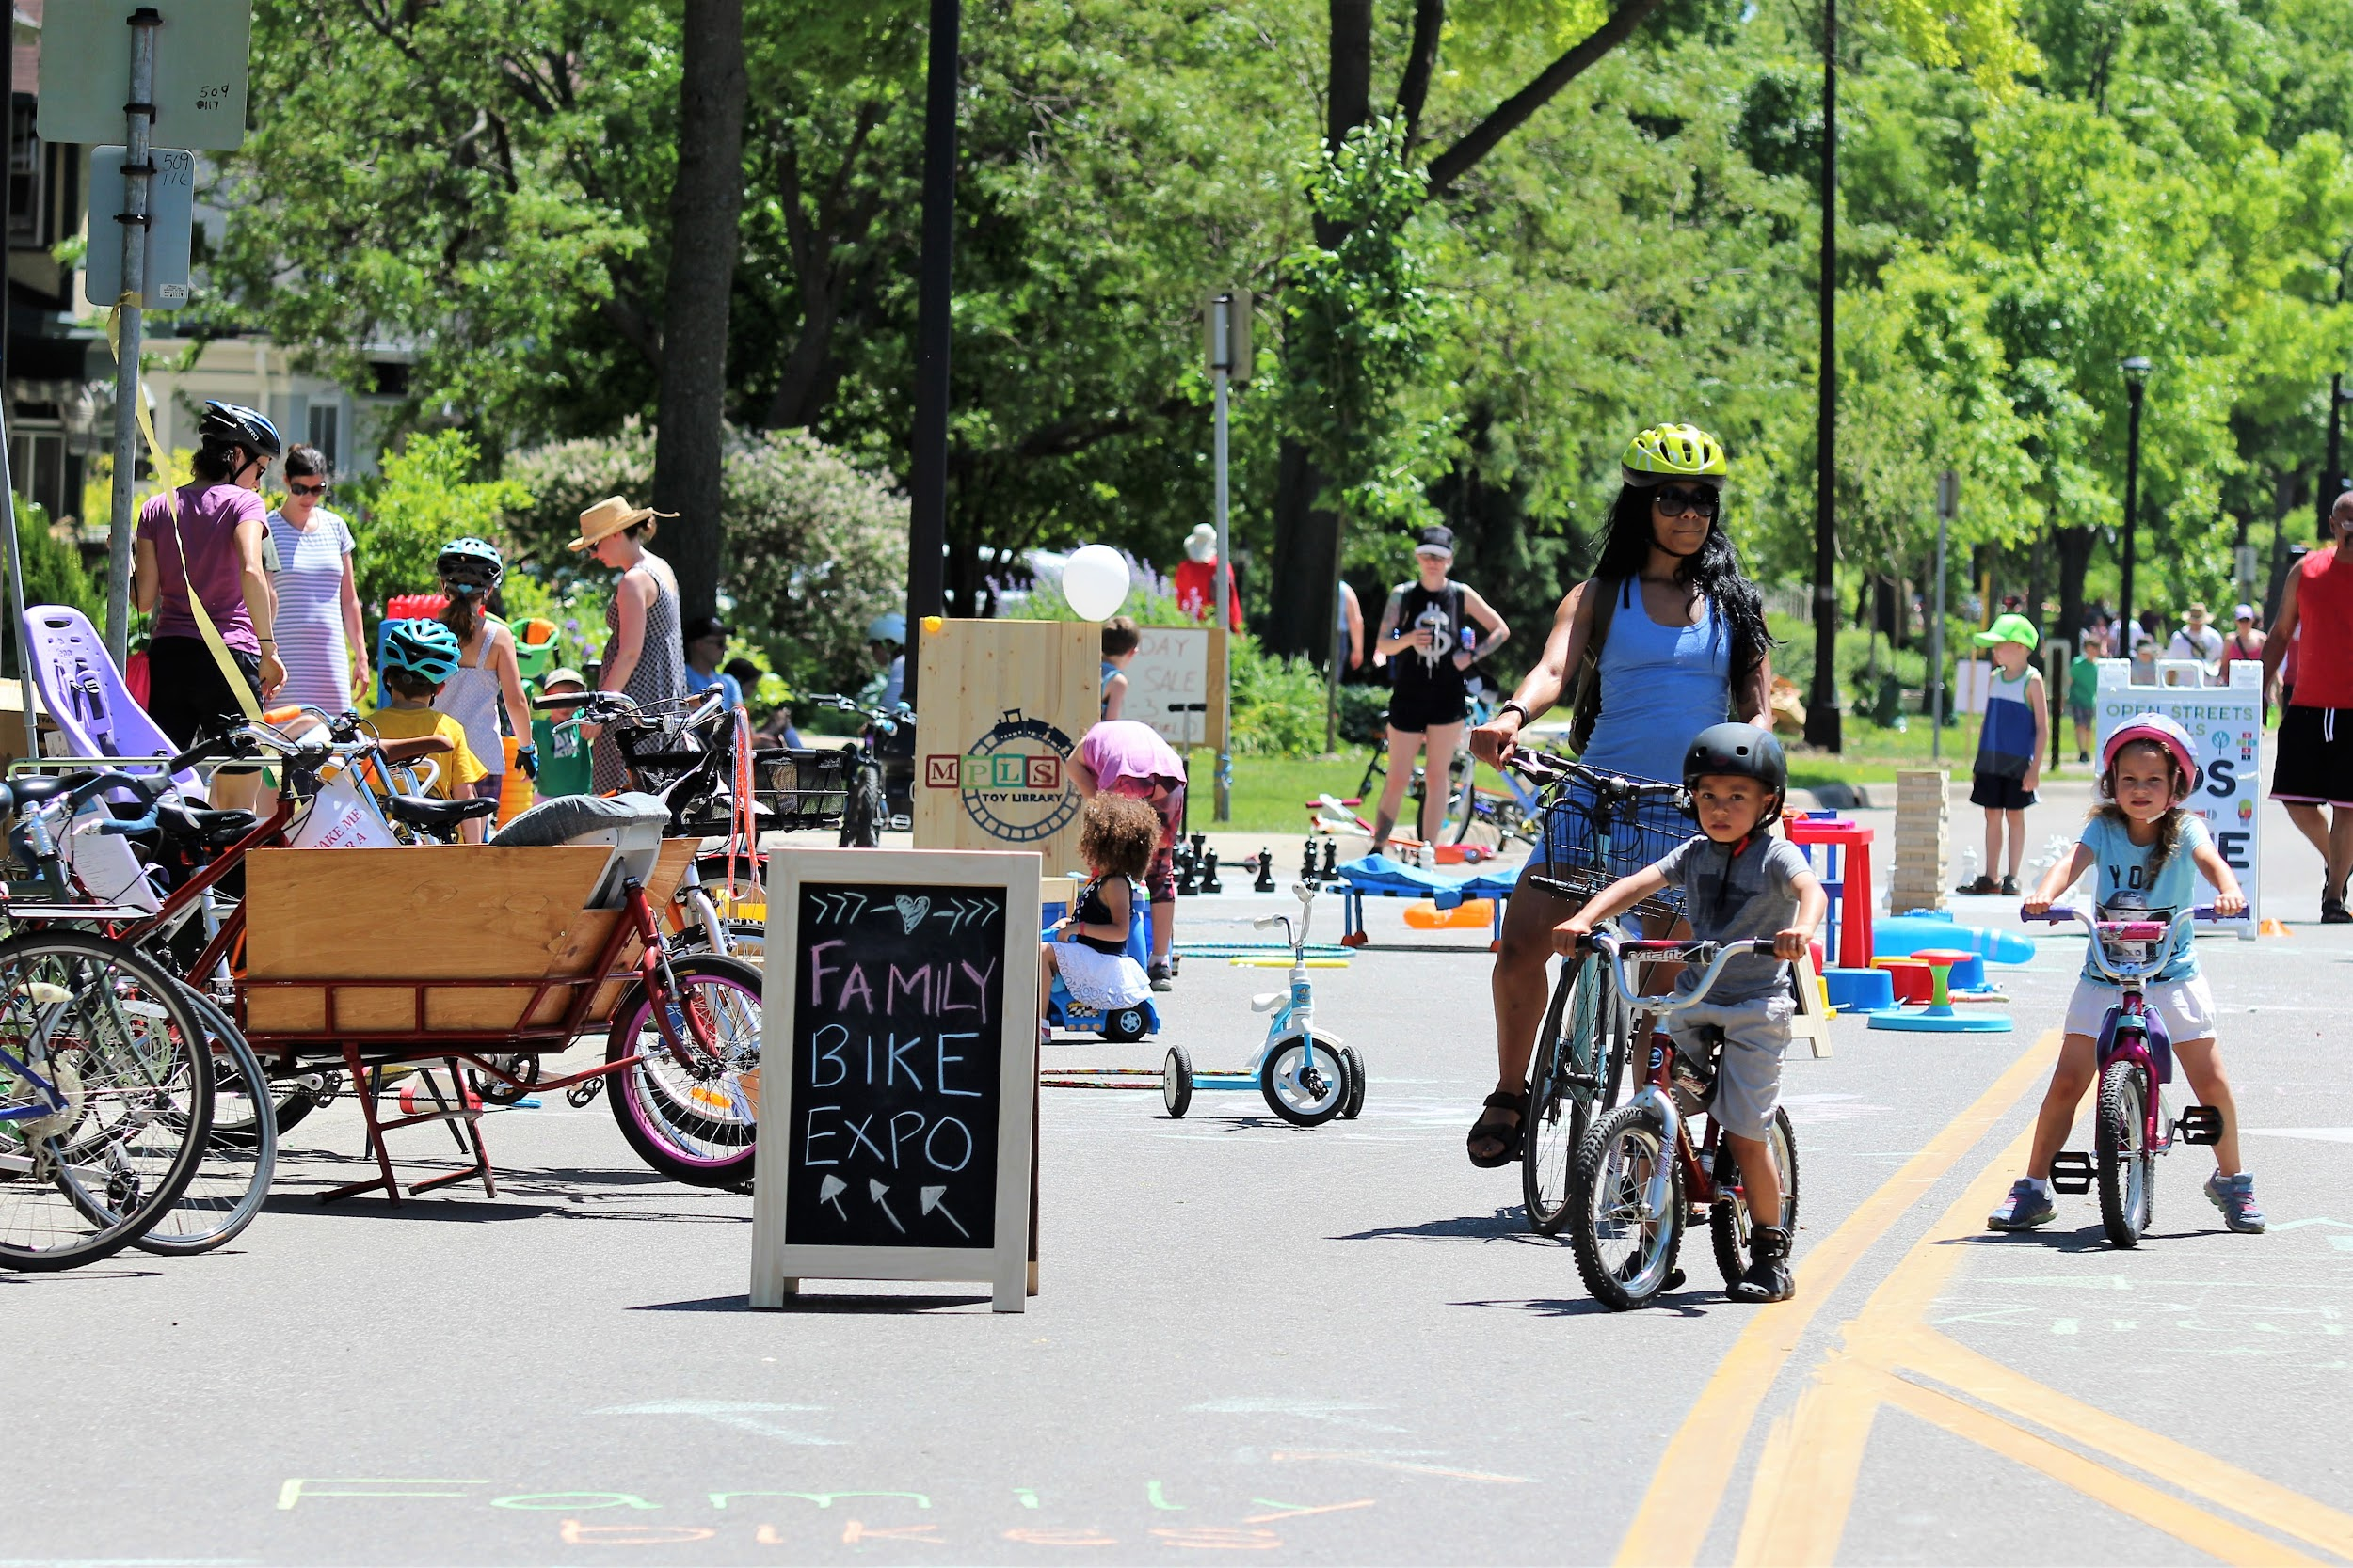
Open Streets Minneapolis is a program that temporarily closes major thoroughfares to car traffic, opening them to people biking, walking, rolling, and connecting with neighbors and local businesses. Part of a global movement to make streets places that put people first, these free, family-friendly events help us experience streets as public spaces where communities thrive and spark transformative changes in how people think about streets.
Open Streets program goals
Grow community connections,
civic pride, and community
engagement
Celebrate the diversity
of Minneapolis
Inspire healthy living
Stimulate local business
Promote active transportation
About the program

Slide 4
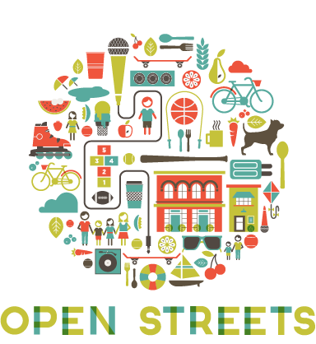


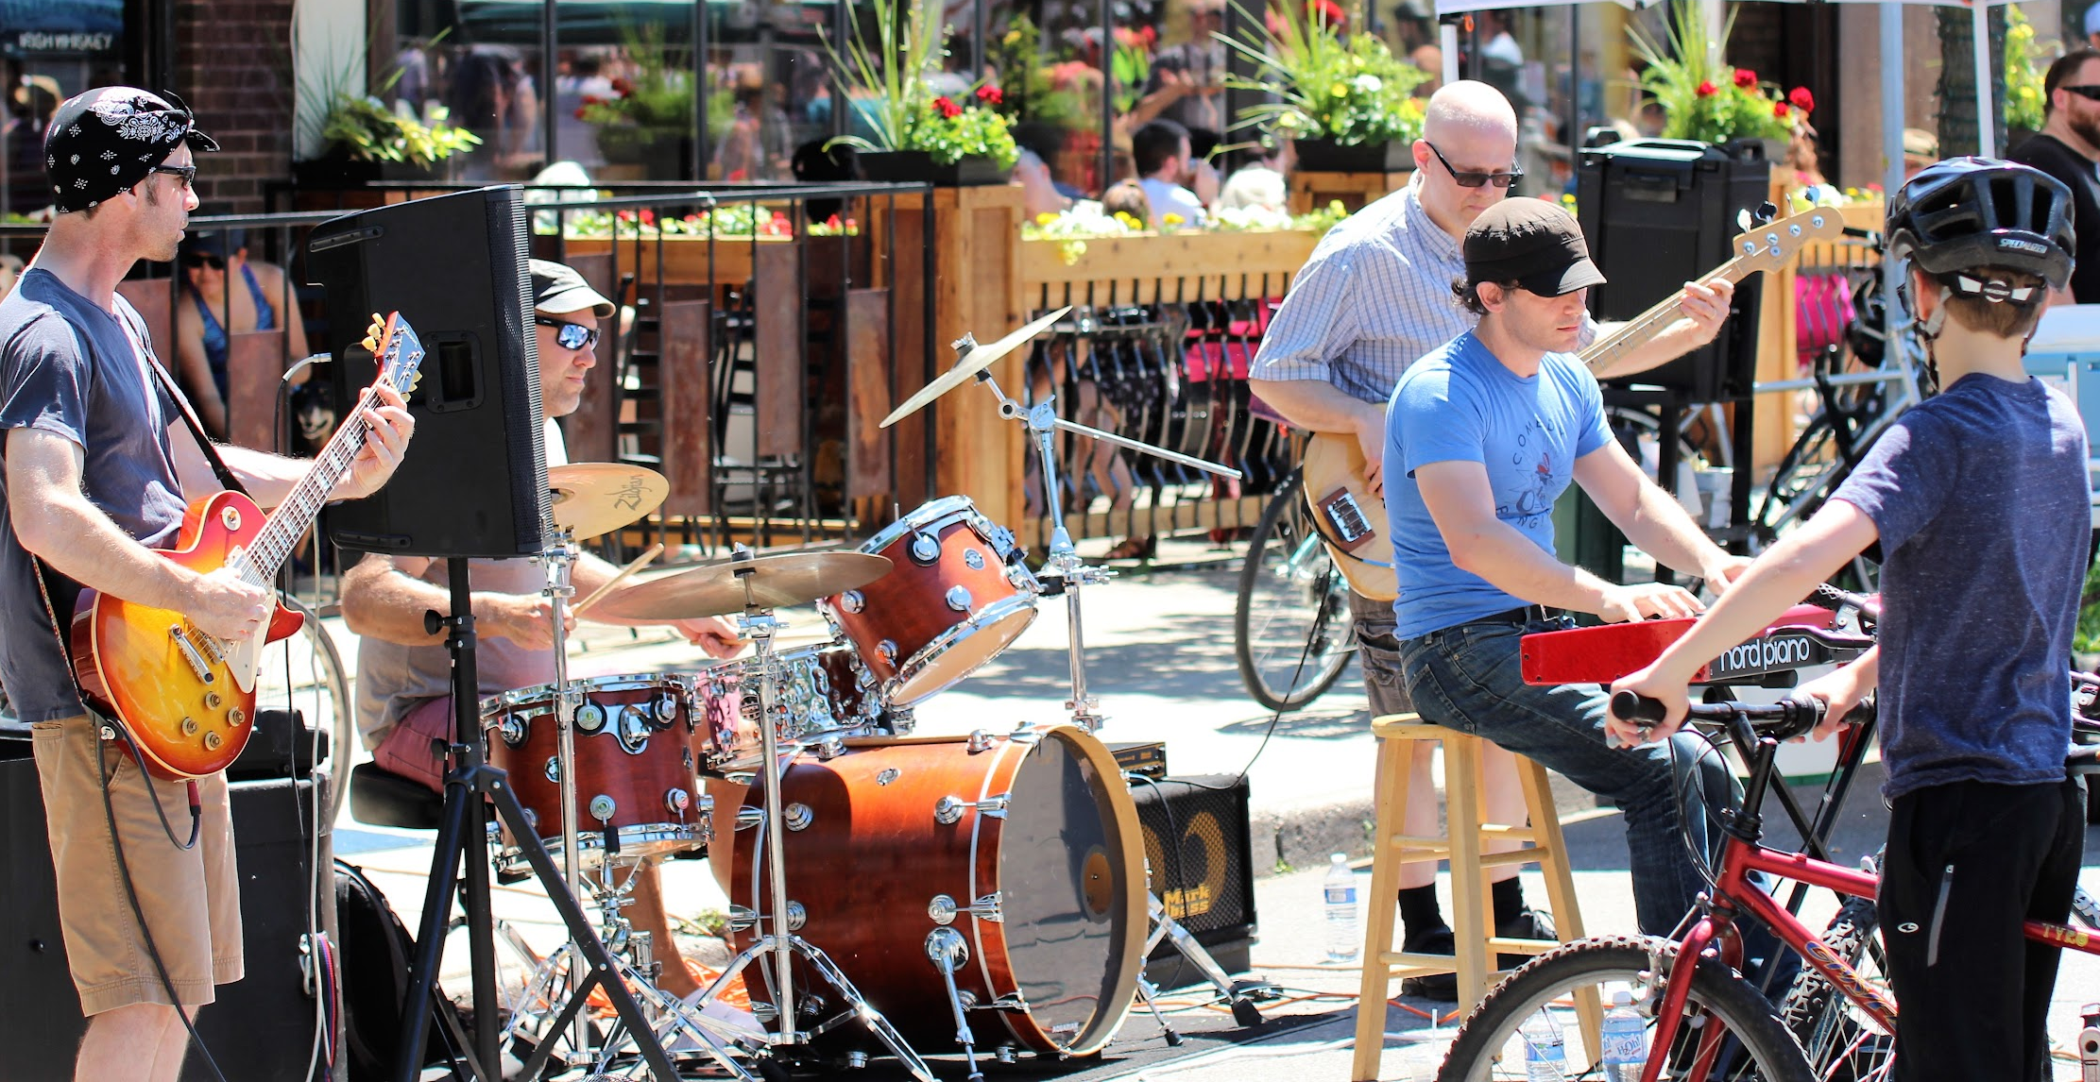
Presenting organization:
Host (organizer):
About the program
Event production:
Route selection, community engagement, event organization, operational oversight, etc.
Operations:
road closures, traffic control, police, operational costs, etc.
Community partners:
Local businesses and community organizations
Volunteers
Sponsors

Slide 5
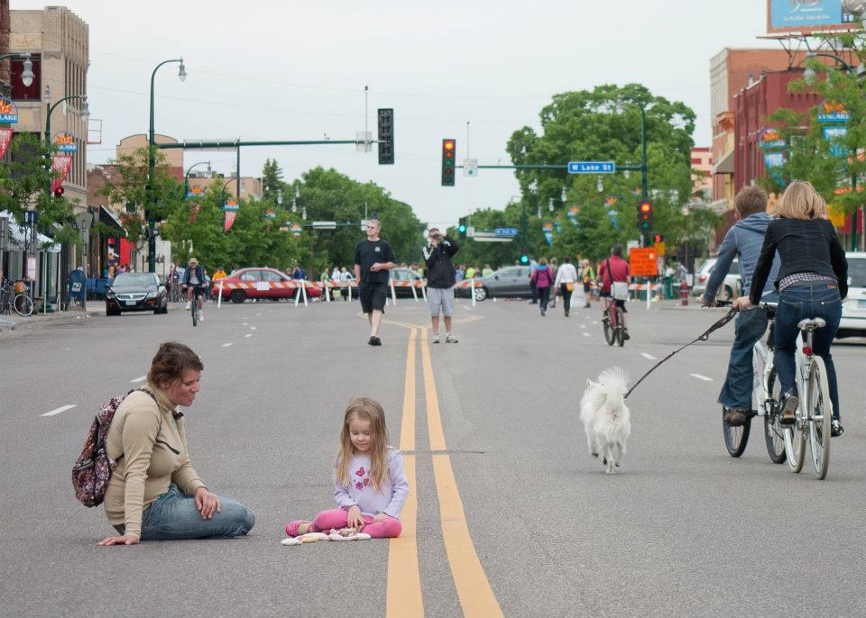
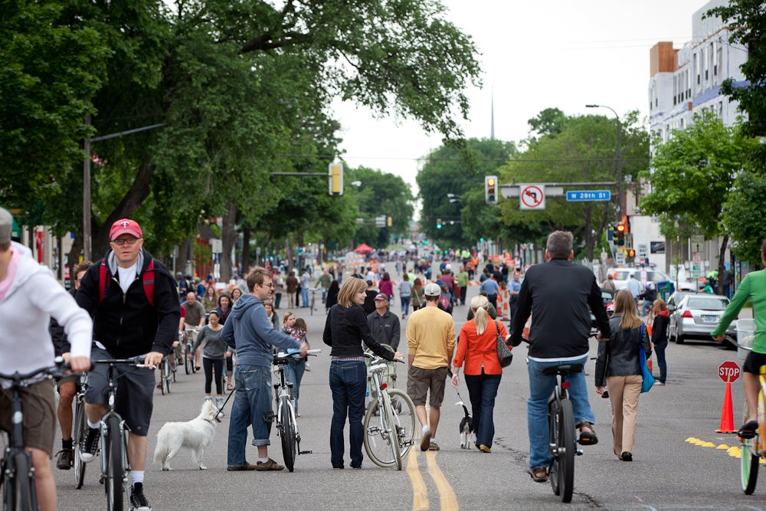
2011: First Open Streets Minneapolis
2-mile route on 4-lane, mixed-use corridor with residential and business nodes
Developed, organized, and run day-of by volunteers
Funded by one presenting sponsor and local businesses and orgs; no formal City support
Attendance: 5000
An experiment deemed a success
History
Jennifer Simonson Photography

Slide 6
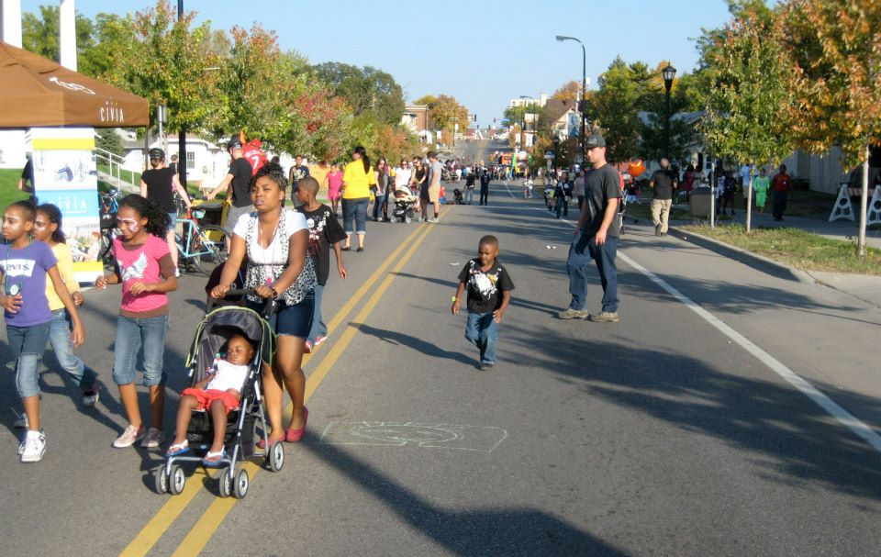
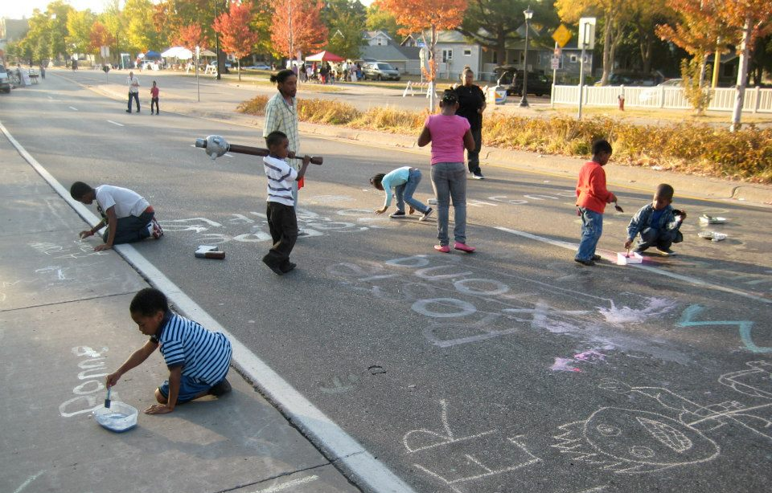
2012-2014: Building on success
With the concept proven, we added new events each year in new parts of the city
Each new route was an experiment
Worked deeply with communities along each corridor to shape each event
Success for us looked different on different routes
Persistent challenges
Funding
Business hesitancy
Traffic and parking concerns
Safety concerns regarding car violence
General skepticism of of program
History

Slide 7
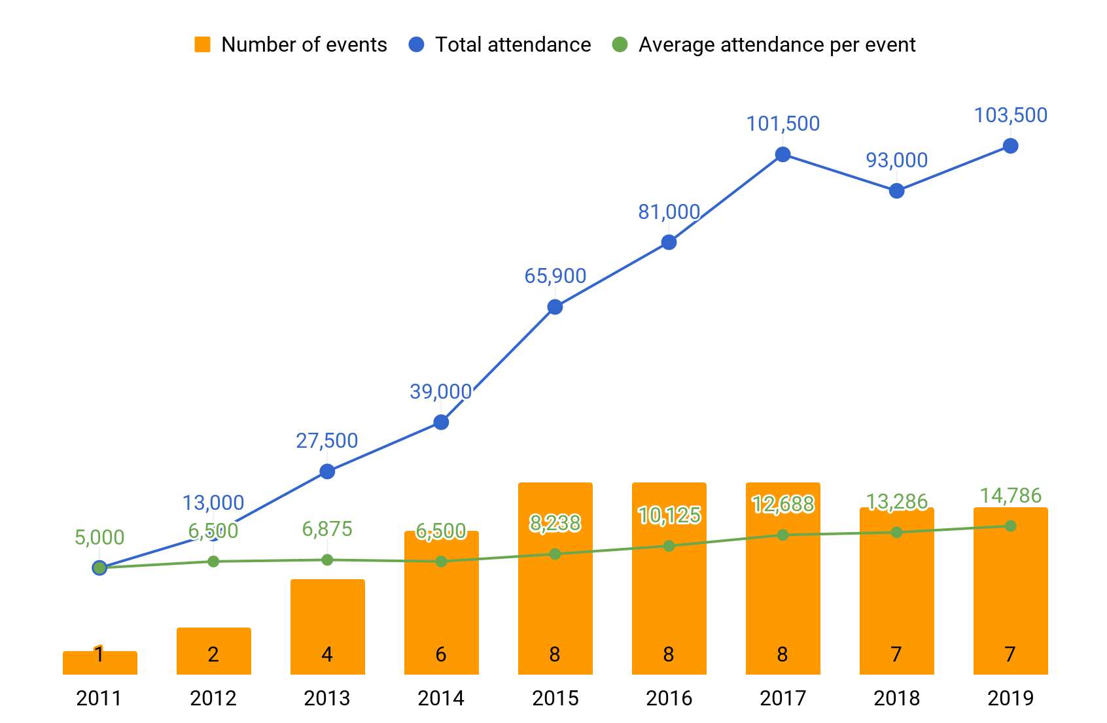
History

Slide 8
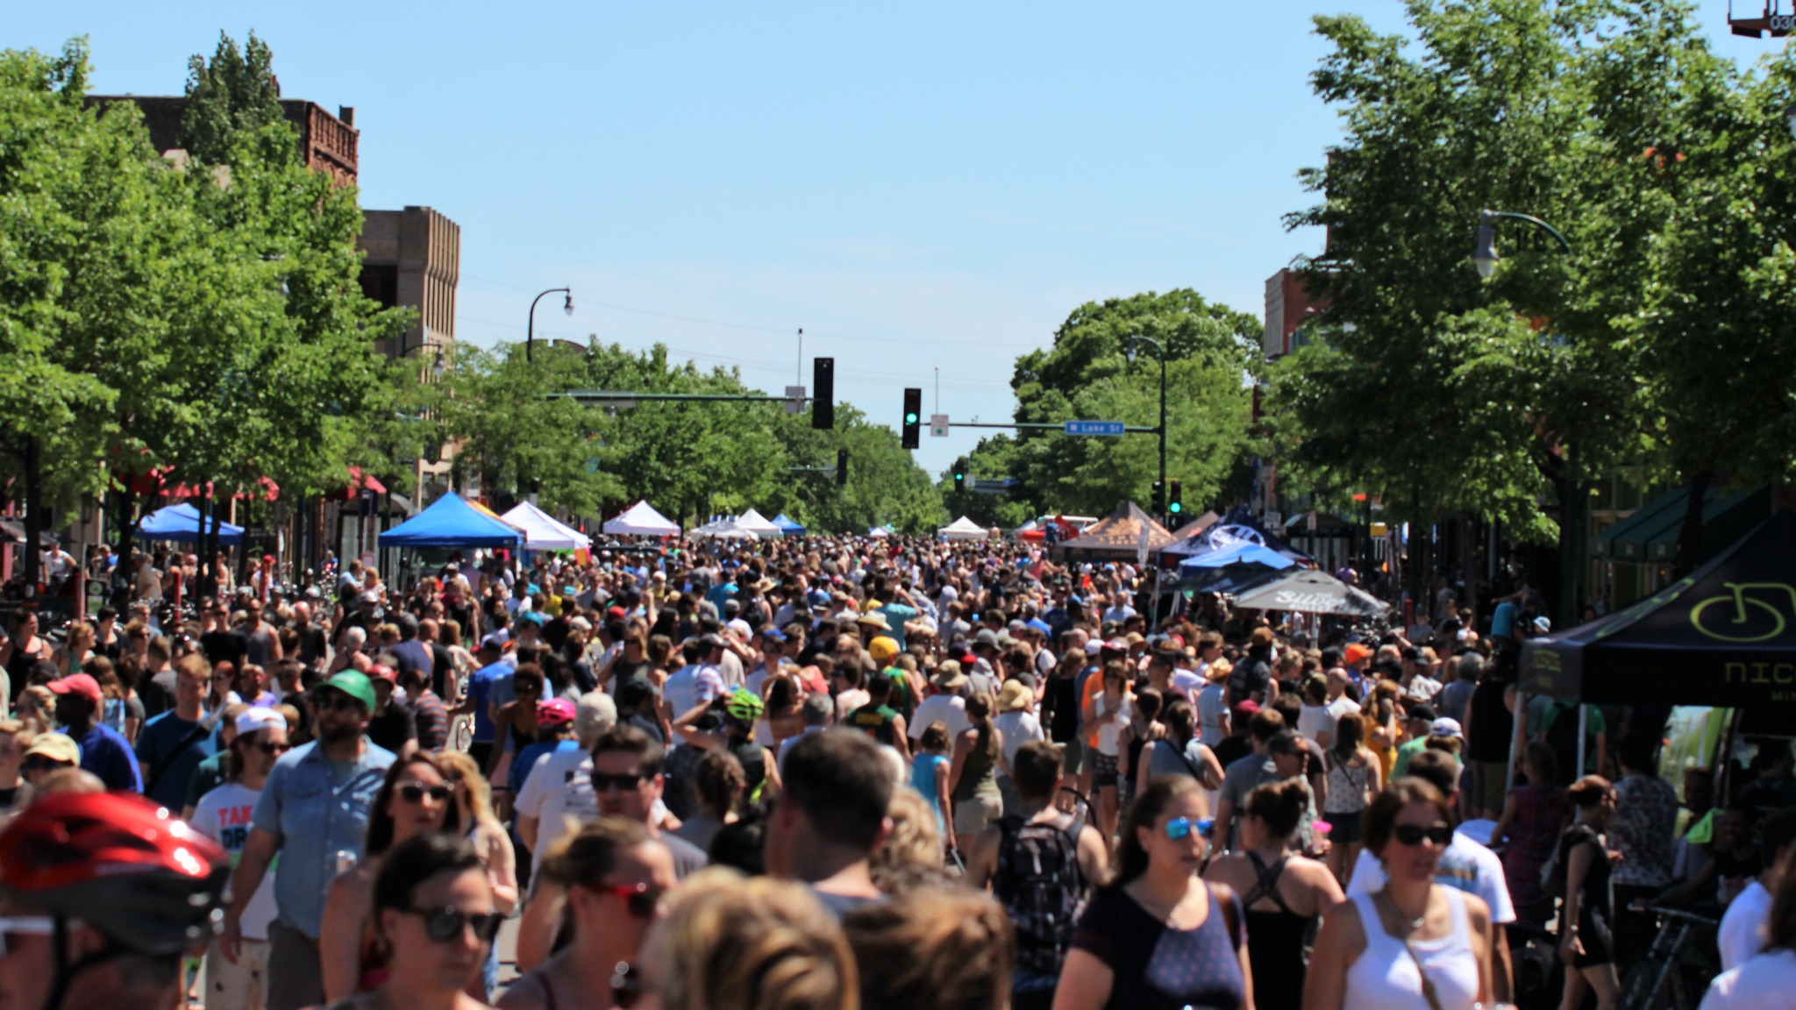
Building attendance takes time
History
2011
5,000 attendees
2017
45,000 attendees

Slide 9
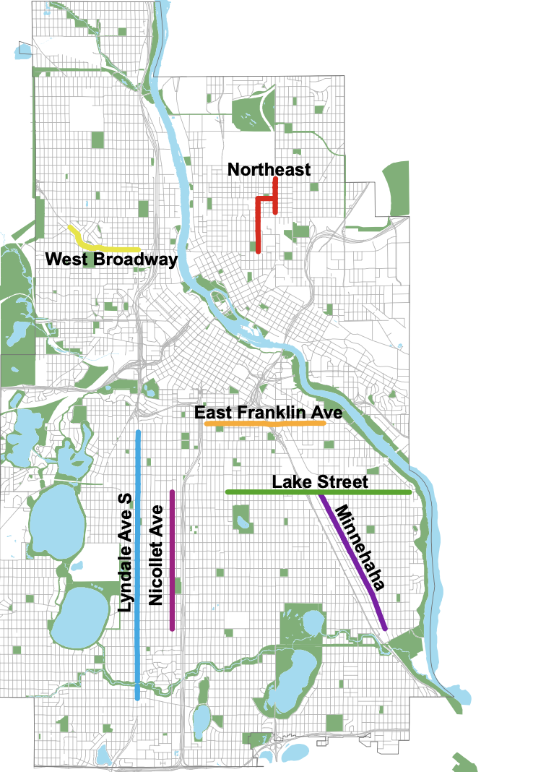
Open Streets Minneapolis route characteristics
Occur on major urban corridors that primarily serve motorized traffic, which typically include streets that act as business and commercial corridors
Connect multiple neighborhoods, especially neighborhoods that may feel isolated from each other based on land use patterns and high-volume roadways
Encourage the discovery of businesses along the route and support local economic vitality
Have strong destinations such as parks, major businesses, areas of programming
Ideally over two miles in length
Are designed in different configurations, including: linear, in a loop, or in a configuration that combines a loop with a linear street extension
2021 Open Streets Routes
Planning: route selection
Program context
Route selection

Slide 10
Each year Open Streets works with
community to select up to 8 event routes
June - Aug
Sep - Oct
Nov - Jan
Feb - March
Public submits route ideas
Engage local route stakeholders
Evaluate route feasibility
Approval and announcement
Route selection
Collect and review route ideas from the general public. Established historical routes are automatically considered.
Engage local business, organizations, and community leaders along each potential route to determine interest level and support
Explore route logistics, scheduling, budget, and community impact
Minneapolis City Council approves list of event routes and the final selection is publicly announced

Slide 11
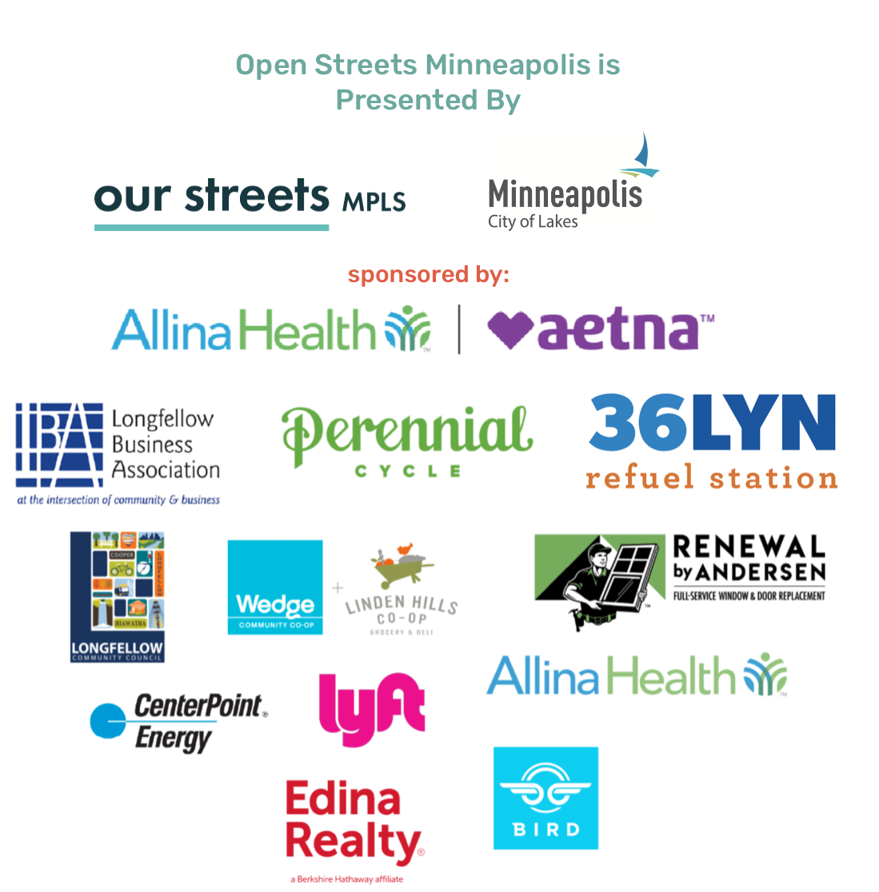
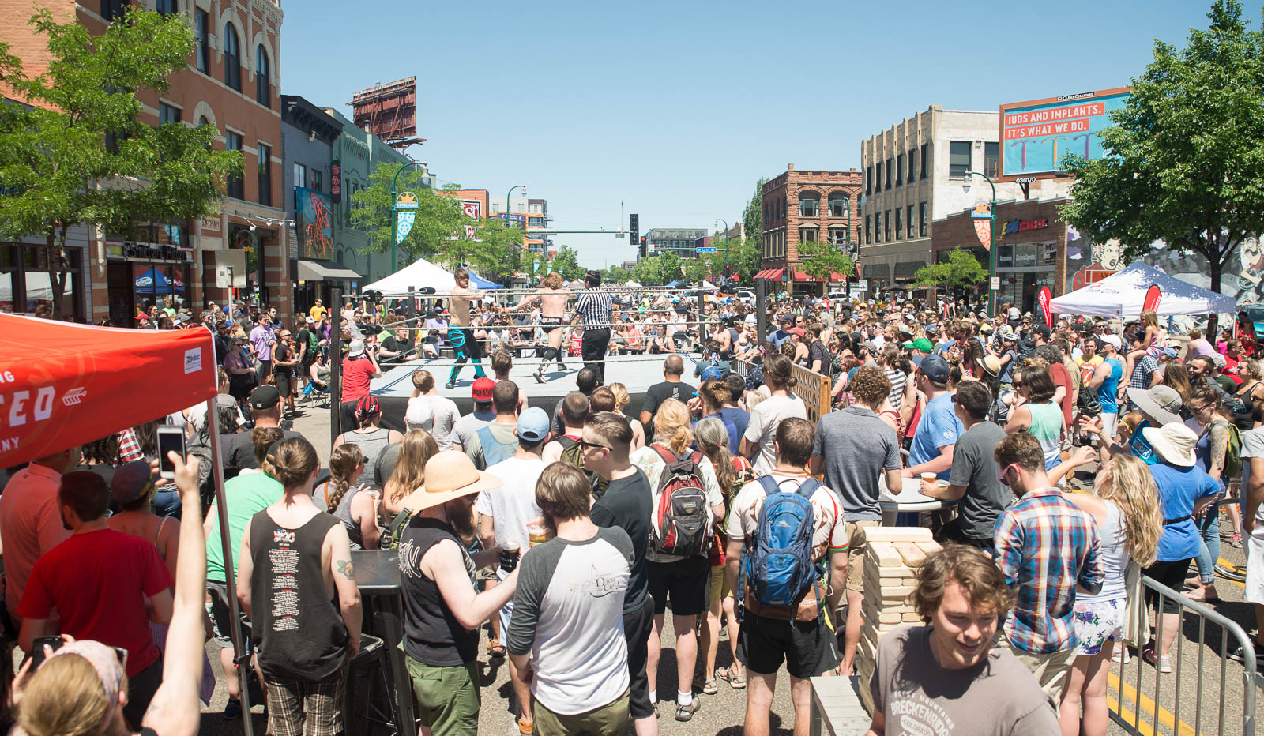
Sponsorship
Programming
Invite and incentivize programming that appropriate for goals and vision
Consider cost to participate for different types of programming
Explore ways to support programmers: covering permit costs, participation cost
Planning: event layout
Sponsors and programming
Sponsors and programmers

Slide 12
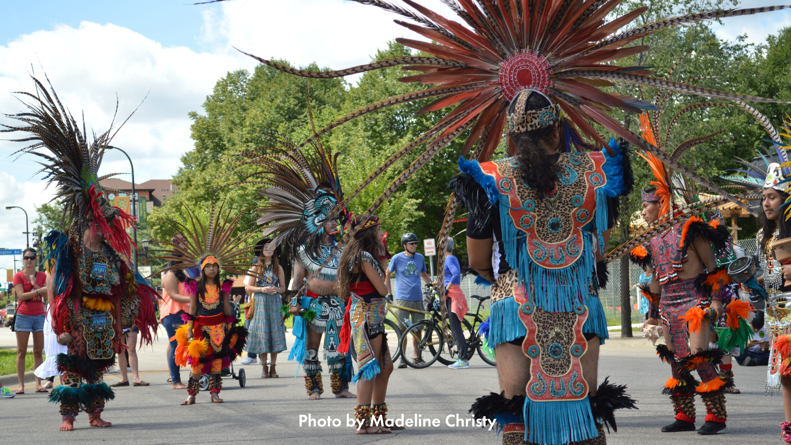
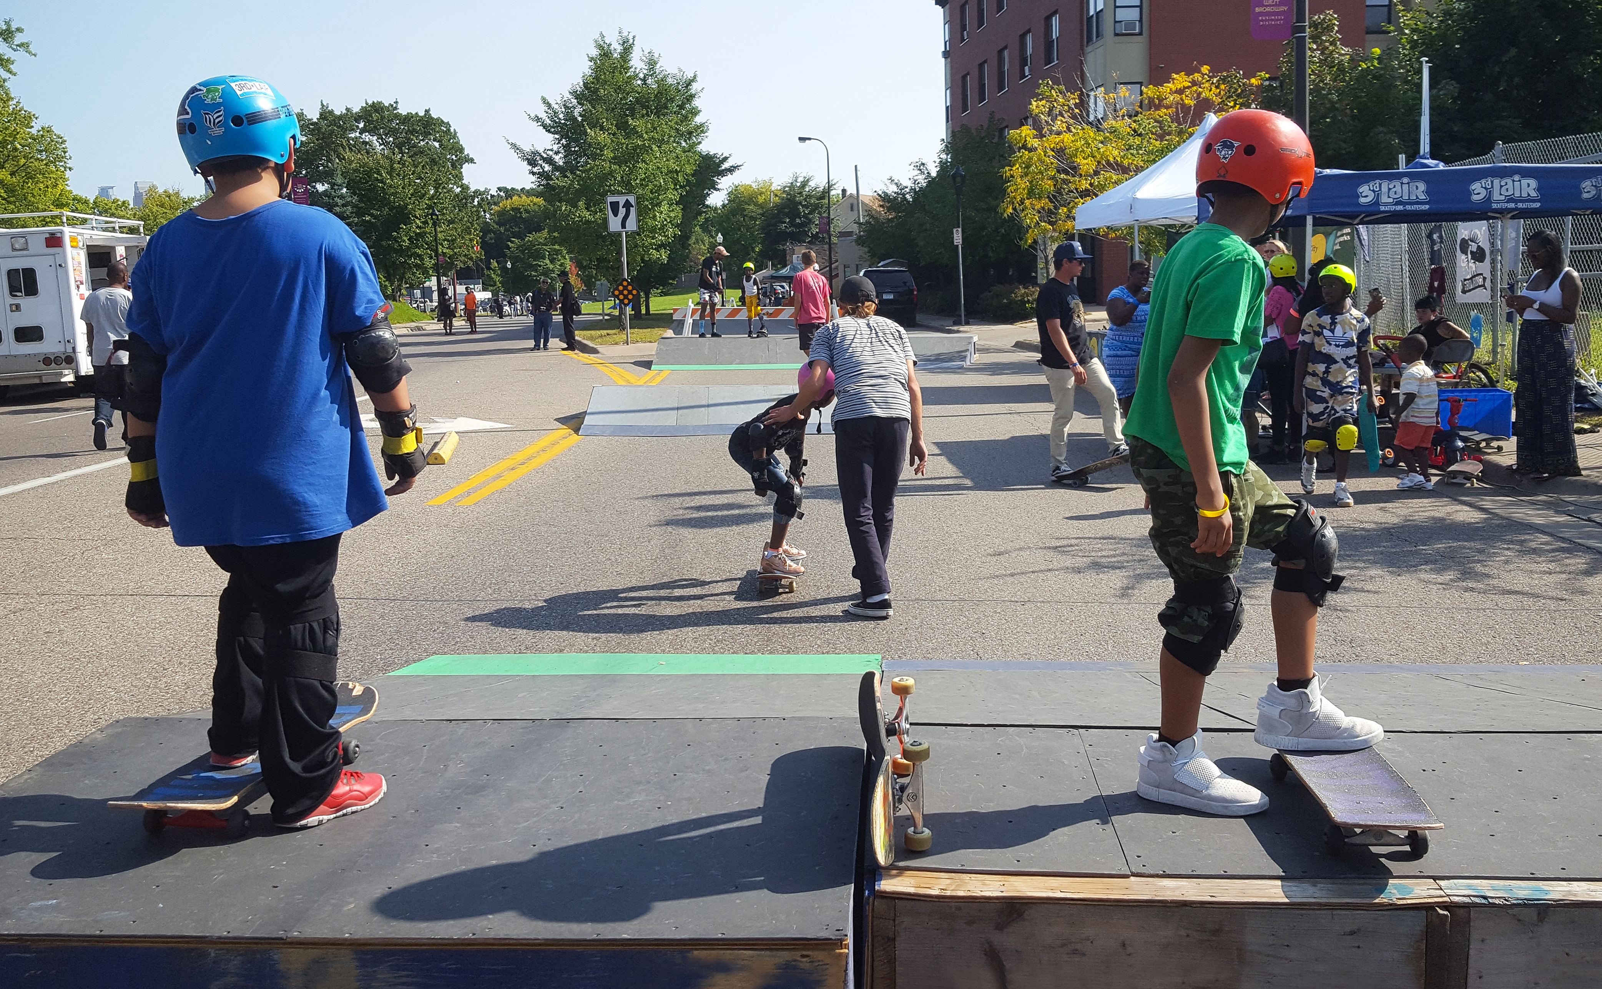
Growing community connections and civic pride
Authentically reflect corridors through community empowerment
Planning groups shape each unique event
Smaller organizers shape specific sections of each route
2019 participant survey results:
84% rated their experience as “excellent” or “good”
46% live < 1 mile from event
23% live 1 - 3 miles from event
12% live 3 - 5 miles from event
20% live > 5 miles from event
“Love seeing many members of the community all in one place, enjoying the food, the music, and each other.”
"I loved seeing the people enjoy others’ company. Felt like I was part of a community."
Impact
Impact

Slide 13
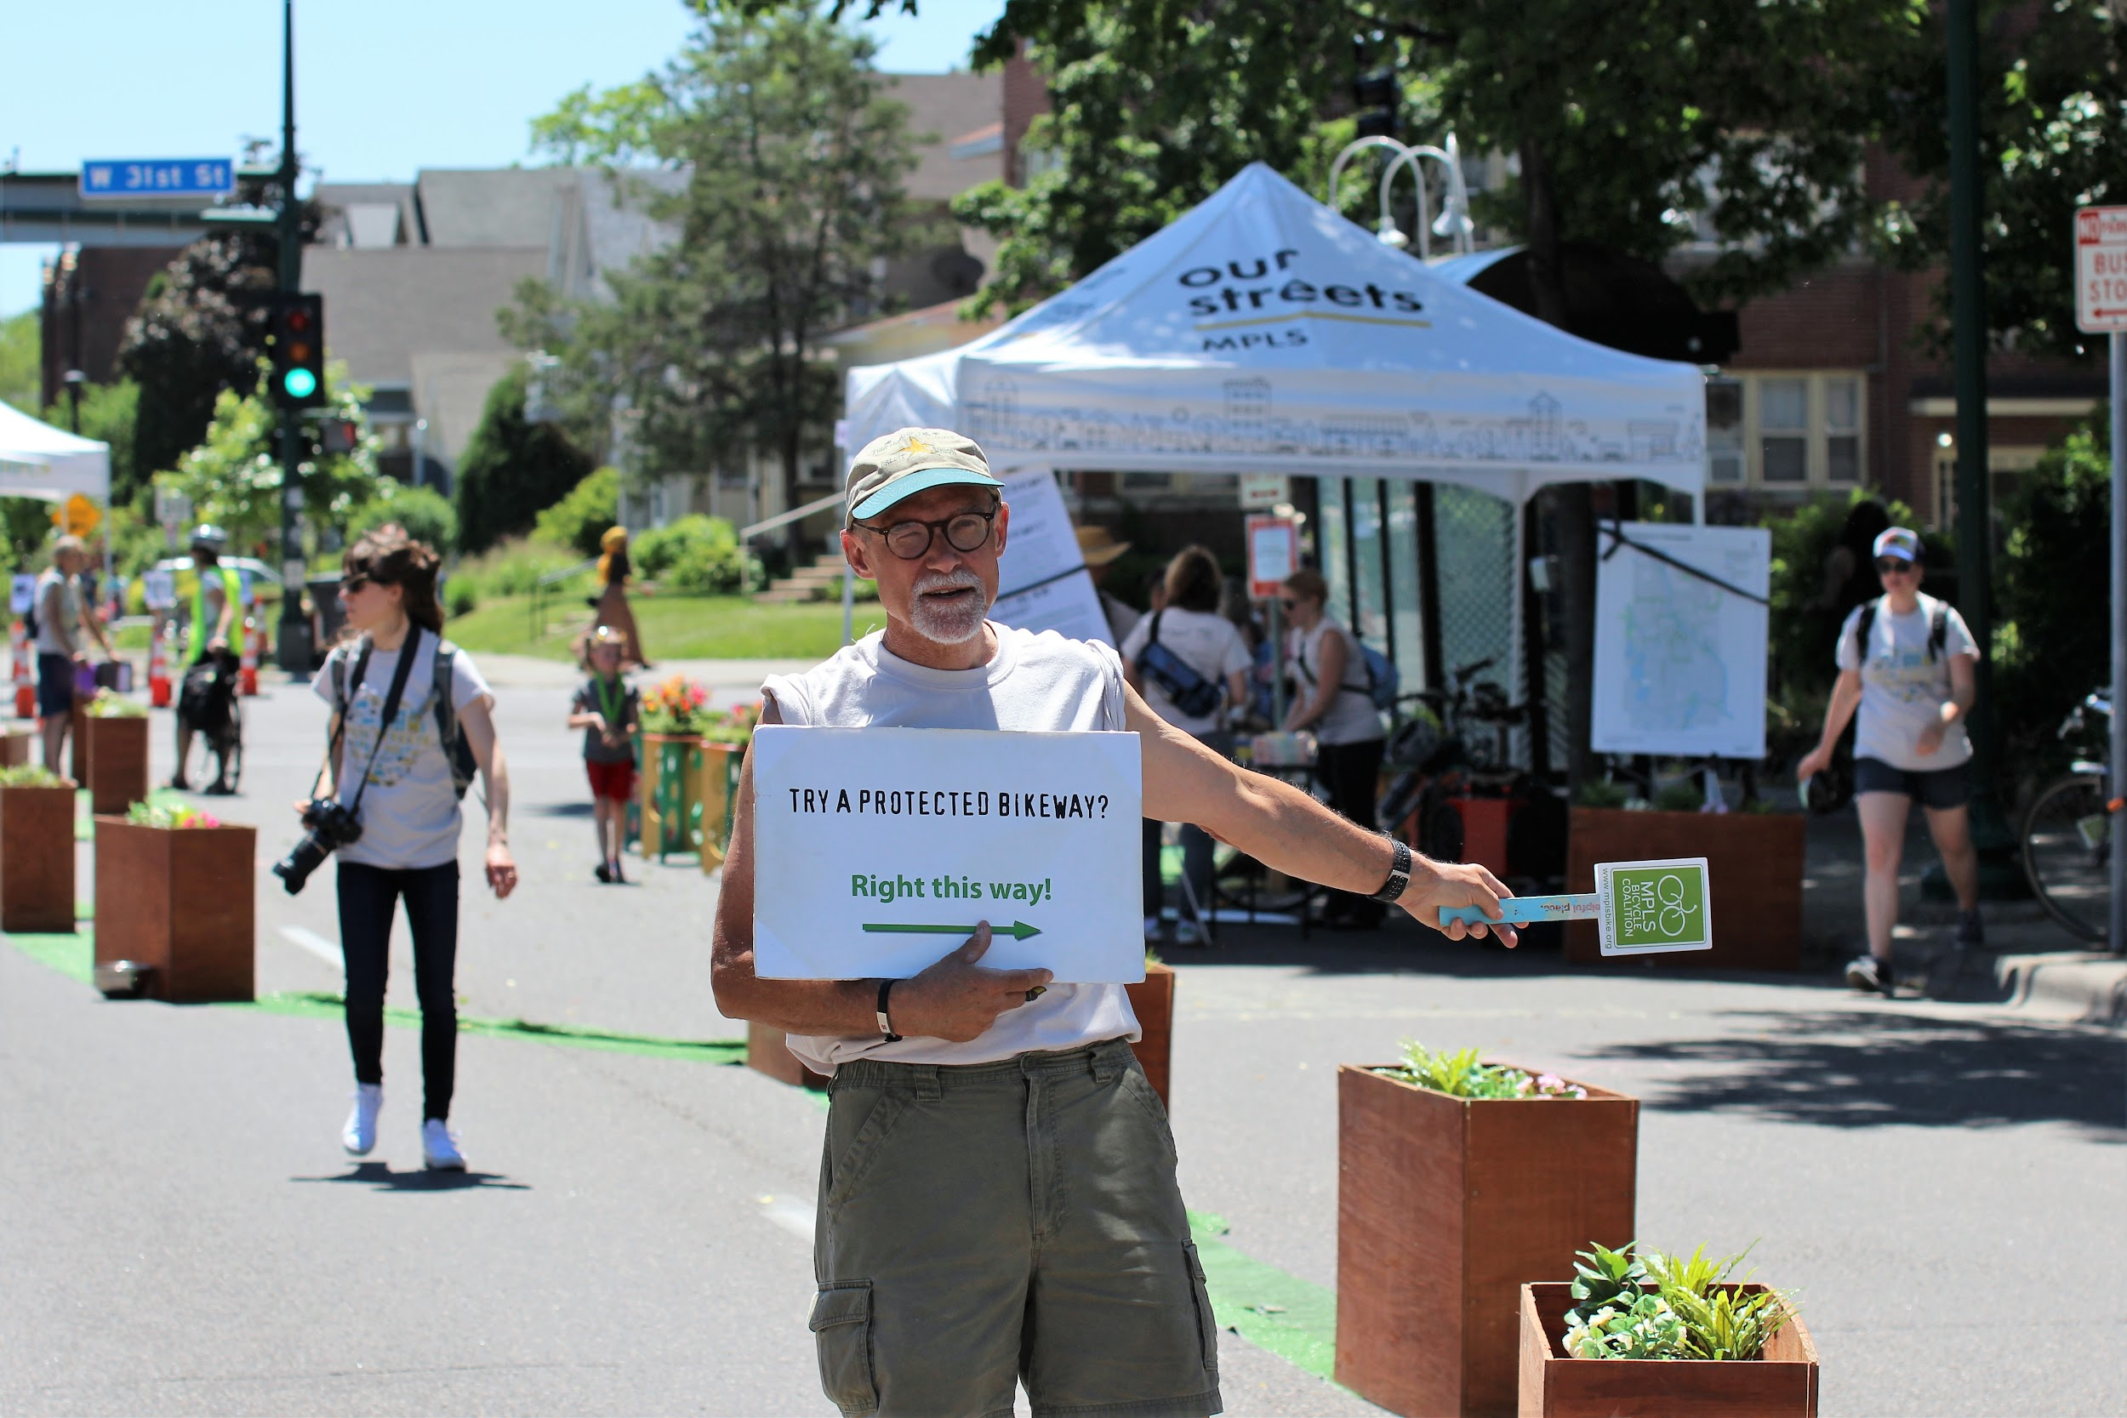
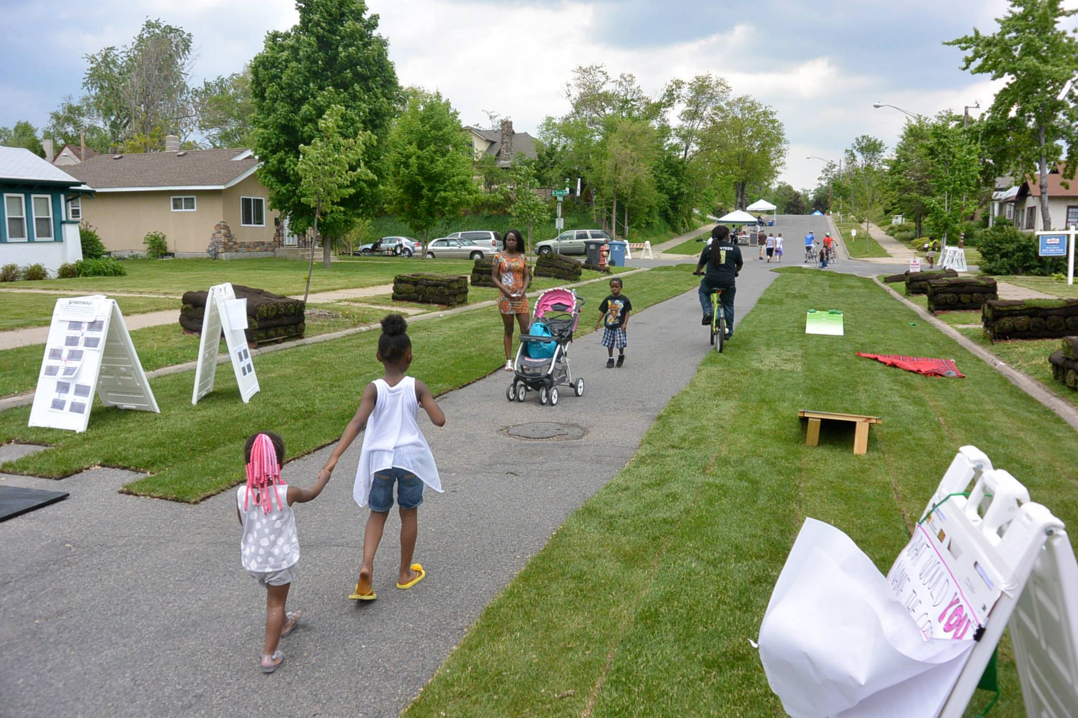
Open Streets as a unique opportunity to inspire real change
70% of attendee survey respondents agreed Open Streets inspired them to bike and walk more in their community
New and improved bicycle infrastructure
New and improved pedestrian infrastructure, including bump outs and crosswalks
Paint the pavement crosswalk installations
Commitment to 4-to-3 lane conversion on most popular event route
Conversations about how we can make more livable streets that work for everyone
Impact
Photo by Mike Beck
Photo by Mike Beck

Slide 14
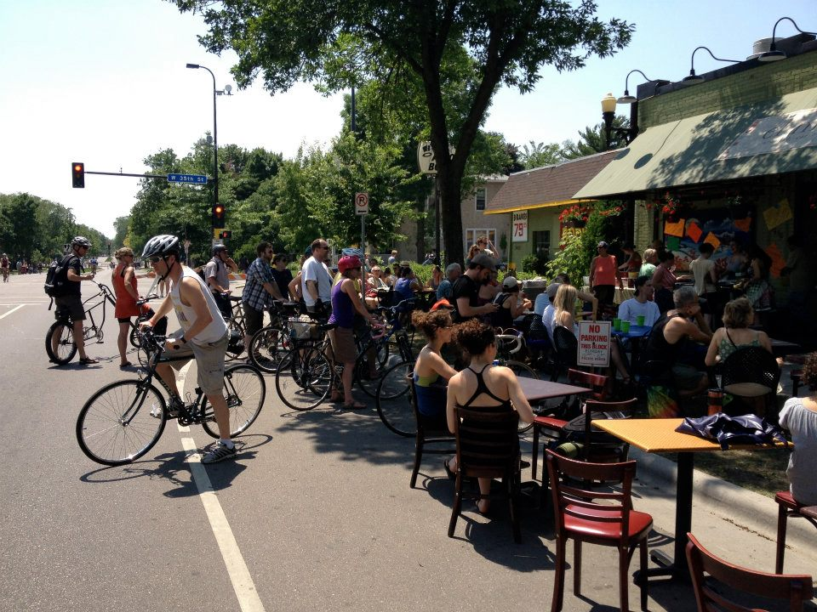
Businesses love Open Streets
Of the 215 participating businesses and organizations that completed a post-event survey about their experience in 2018:
82% rated their overall experience as “excellent” or “good”
85% said Open Streets provided more visibility or awareness for their organization
86% said they would recommend other businesses or organizations in the area participate in Open Streets
Grand openings
“Best day of the year”
Impact: community
Impact
Wonderful way to connect with the
community and increase brand awareness
Incredibly impressed with the
organization. Blown away by the amount
of people that attended with what seemed
like a minimum advertising campaign.
Love this event! Thanks!!

Slide 15
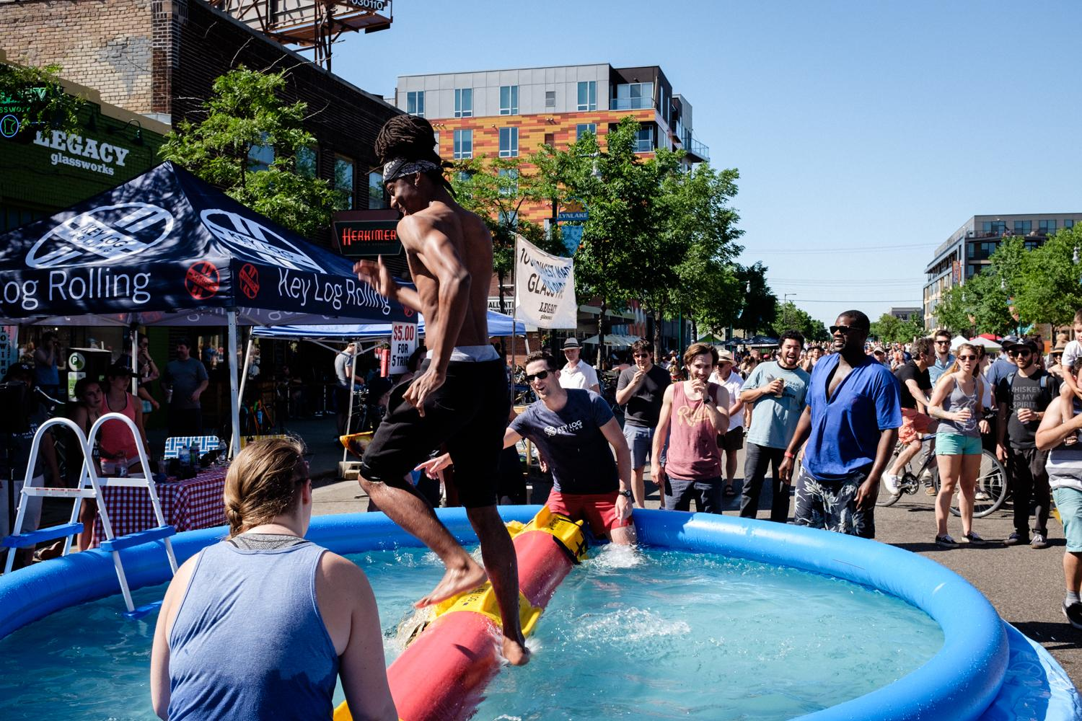
Cultural importance
Open Streets Minneapolis went from an obscure idea championed by a small group of dedicated volunteers to one of the largest signature cultural events of the city in a few years. With more than 100,000 attendees and 800 programmers annually (pre-pandemic), Open Streets brings together community in a meaningful and durable way.
Impact: community
Impact

Slide 16
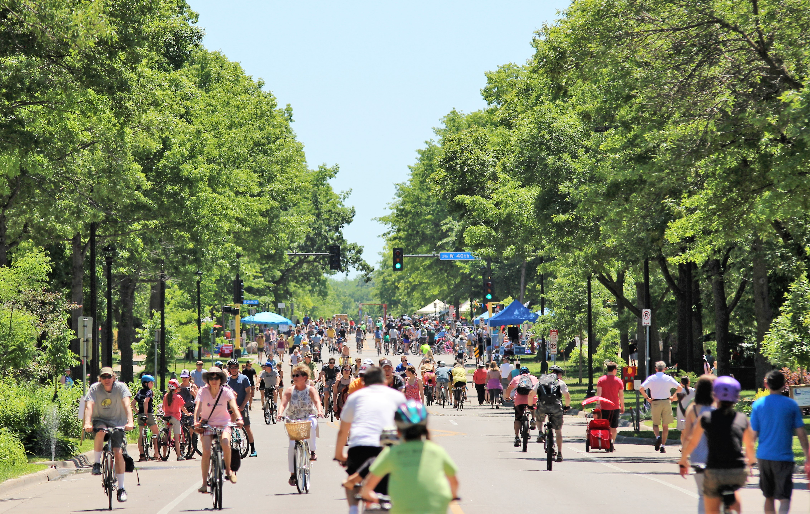
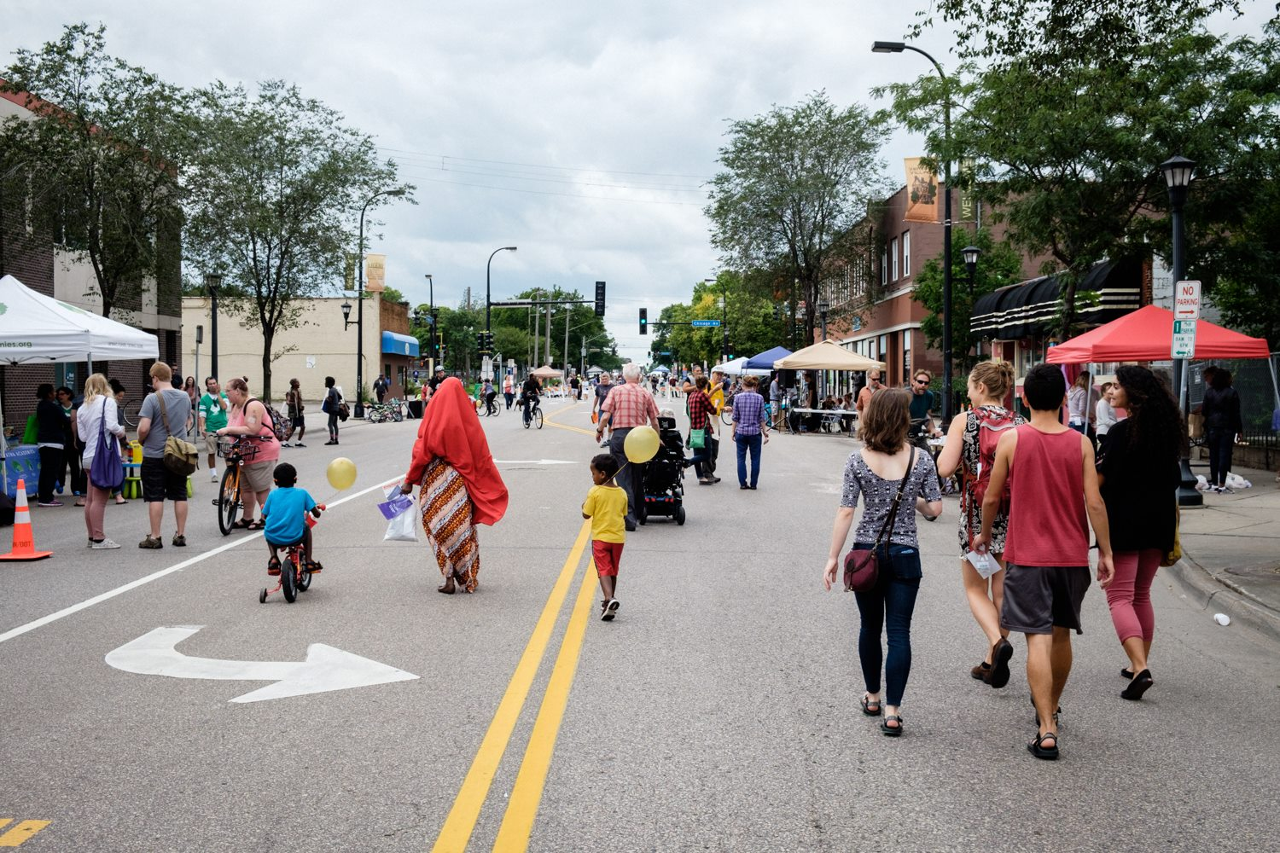
Parting thoughts for new Open Streets programs
Participating in this worldwide movement will require bravery and ambition at first
Work collaboratively with community to created shared goals and vision authentic to your community
Ensure stakeholders are meaningfully involved from ideation to implementation
Know there will always be skeptics
Be bold with route selection
Large-scale attendance may take a few years
Final thoughts
Photo by Jacob Albright

