Slide 1
Transportation Demand Management (TDM) Study
1

Slide 2
Evolution
The Downtown Fort Lauderdale Transportation Management Association (DFLTMA) has been providing community transportation services in the City of Fort Lauderdale since 1992.
Various transit services have been provided throughout the years, including Sun Trolley and Water Trolley.
In January 2022, the DFLTMA revised by-laws to become the Greater Ft. Lauderdale TMA to provide transportation demand management on a countywide level.
2

Slide 3
The “New” TDM
The role of Transportation Management Associations (TMAs) is changing due to “smart” technologies and changes in attitudes toward telecommuting.
  Partnerships
  Advocacy
  Equity
  Environmental/Resiliency
  Emergency Response
  Social Connections
  Quality of life
“As population and tourism continues to grow and the roadway network approaches capacity, …… we need to focus on strategies to manage transportation demand and assure safe and equitable access to transportation.”
– Broward TDM Implementation Plan
3

Slide 4
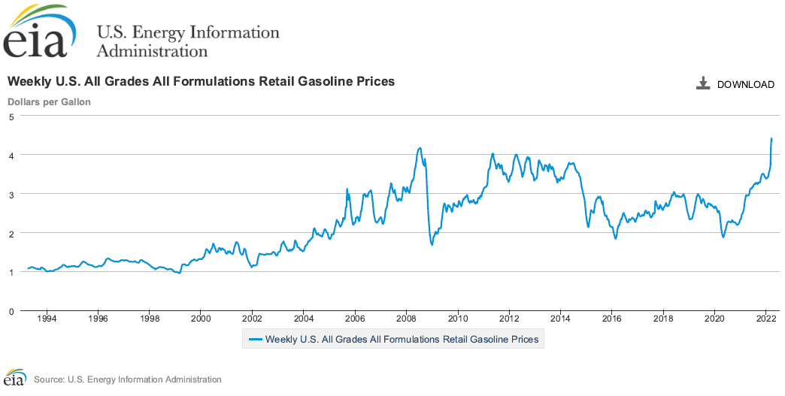
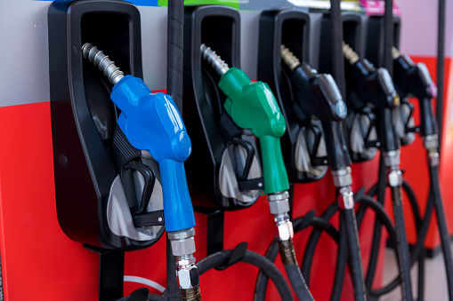
Current Events – The Time is Now
Gas prices are up
Car prices are up
4

Slide 5
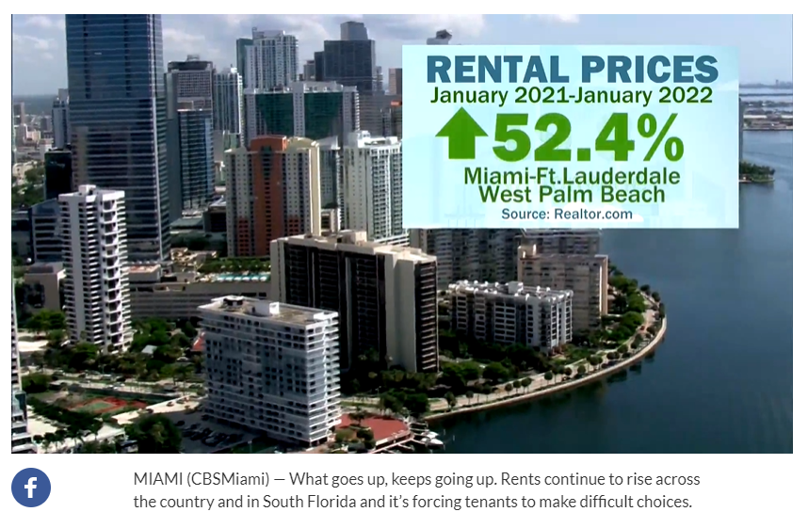
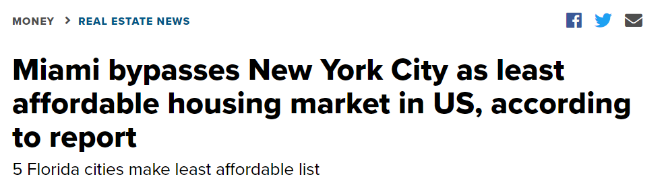
Current Events – The Time is Now
Housing costs are up
South Florida is ranked highest cost of living
5

Slide 6
TDM Study Process
Data driven, year-long effort
Stakeholder interviews
National best practice peer TMA reviews
Workshop forums
Coordination with the MPO’s Congestion Management Process (CMP)
Implementation Plan
6

Slide 7
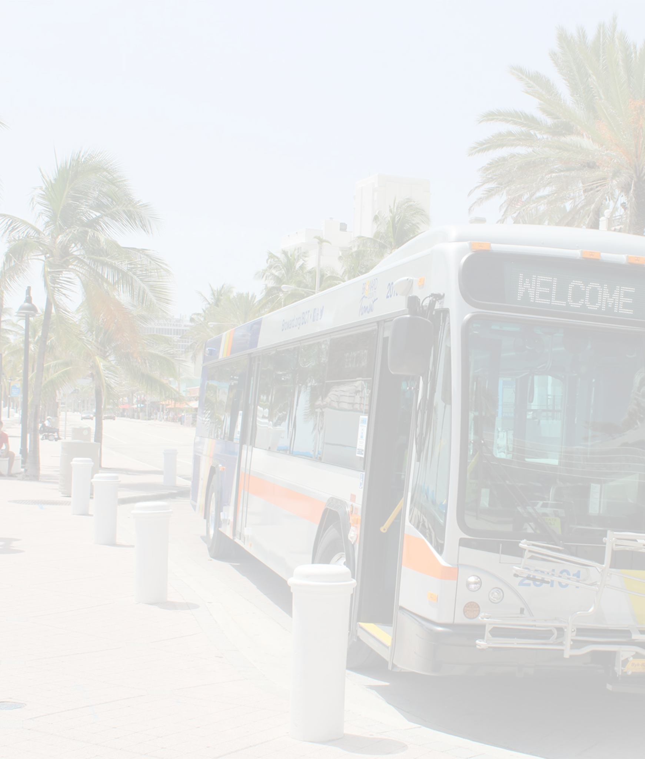
Mission and Vision
MISSION STATEMENT
[ Why the Plan Exists ]
To optimize Broward’s transportation network through collaborative strategies that support economic development and community prosperity.
VISION STATEMENT
[ What the Plan Strives For ]
Advancing commuting solutions for an improved quality of life in Broward.
7

Slide 8

Local Interviewees
Transportation Service Providers
Private Sector/
Stakeholders
Community Sector User Group
Florida Department of Transportation (FDOT) Central Office Commuter Assistance Program
FDOT District 4 Office of Modal Development
South Florida Commuter Services (SFCS)
USF Center for Urban Transportation Research
Broward County Transit
Broward County Mobility Advancement Program
SFRTA/Tri-Rail
Brightline
Area Agency on Aging of Broward County
South Florida Vanpool Program
Uber
BCycle
Broward Workshop Transportation Committee
Broward County Lodging and Restaurant Association
Greater Fort Lauderdale Chamber of Commerce
Downtown Development Authority (DDA) Fort Lauderdale
Visit Lauderdale / Convention & Visitor’s Bureau
Uptown Urban Village/Uptown Business District
Hooper Construction
Plantation Midtown Advisory Board
The Galleria at Fort Lauderdale
FAU Student Services & Campus Life, Academic Affairs, Broward Campuses
Broward District Schools, Transportation Operations, Student Transportation and Fleet Services
Broward Health
Career Source Broward
Seminole Tribe of Florida
South Florida Education Center TMA
AARP
Local Coordinating Board for the Transportation Disadvantaged
Bicycle, Transit, and Drive-Alone Commuters
Greater Fort Lauderdale Chamber of Commerce Equity Council (pending)
NAACP (pending)
Urban League of Broward (pending)

Slide 9
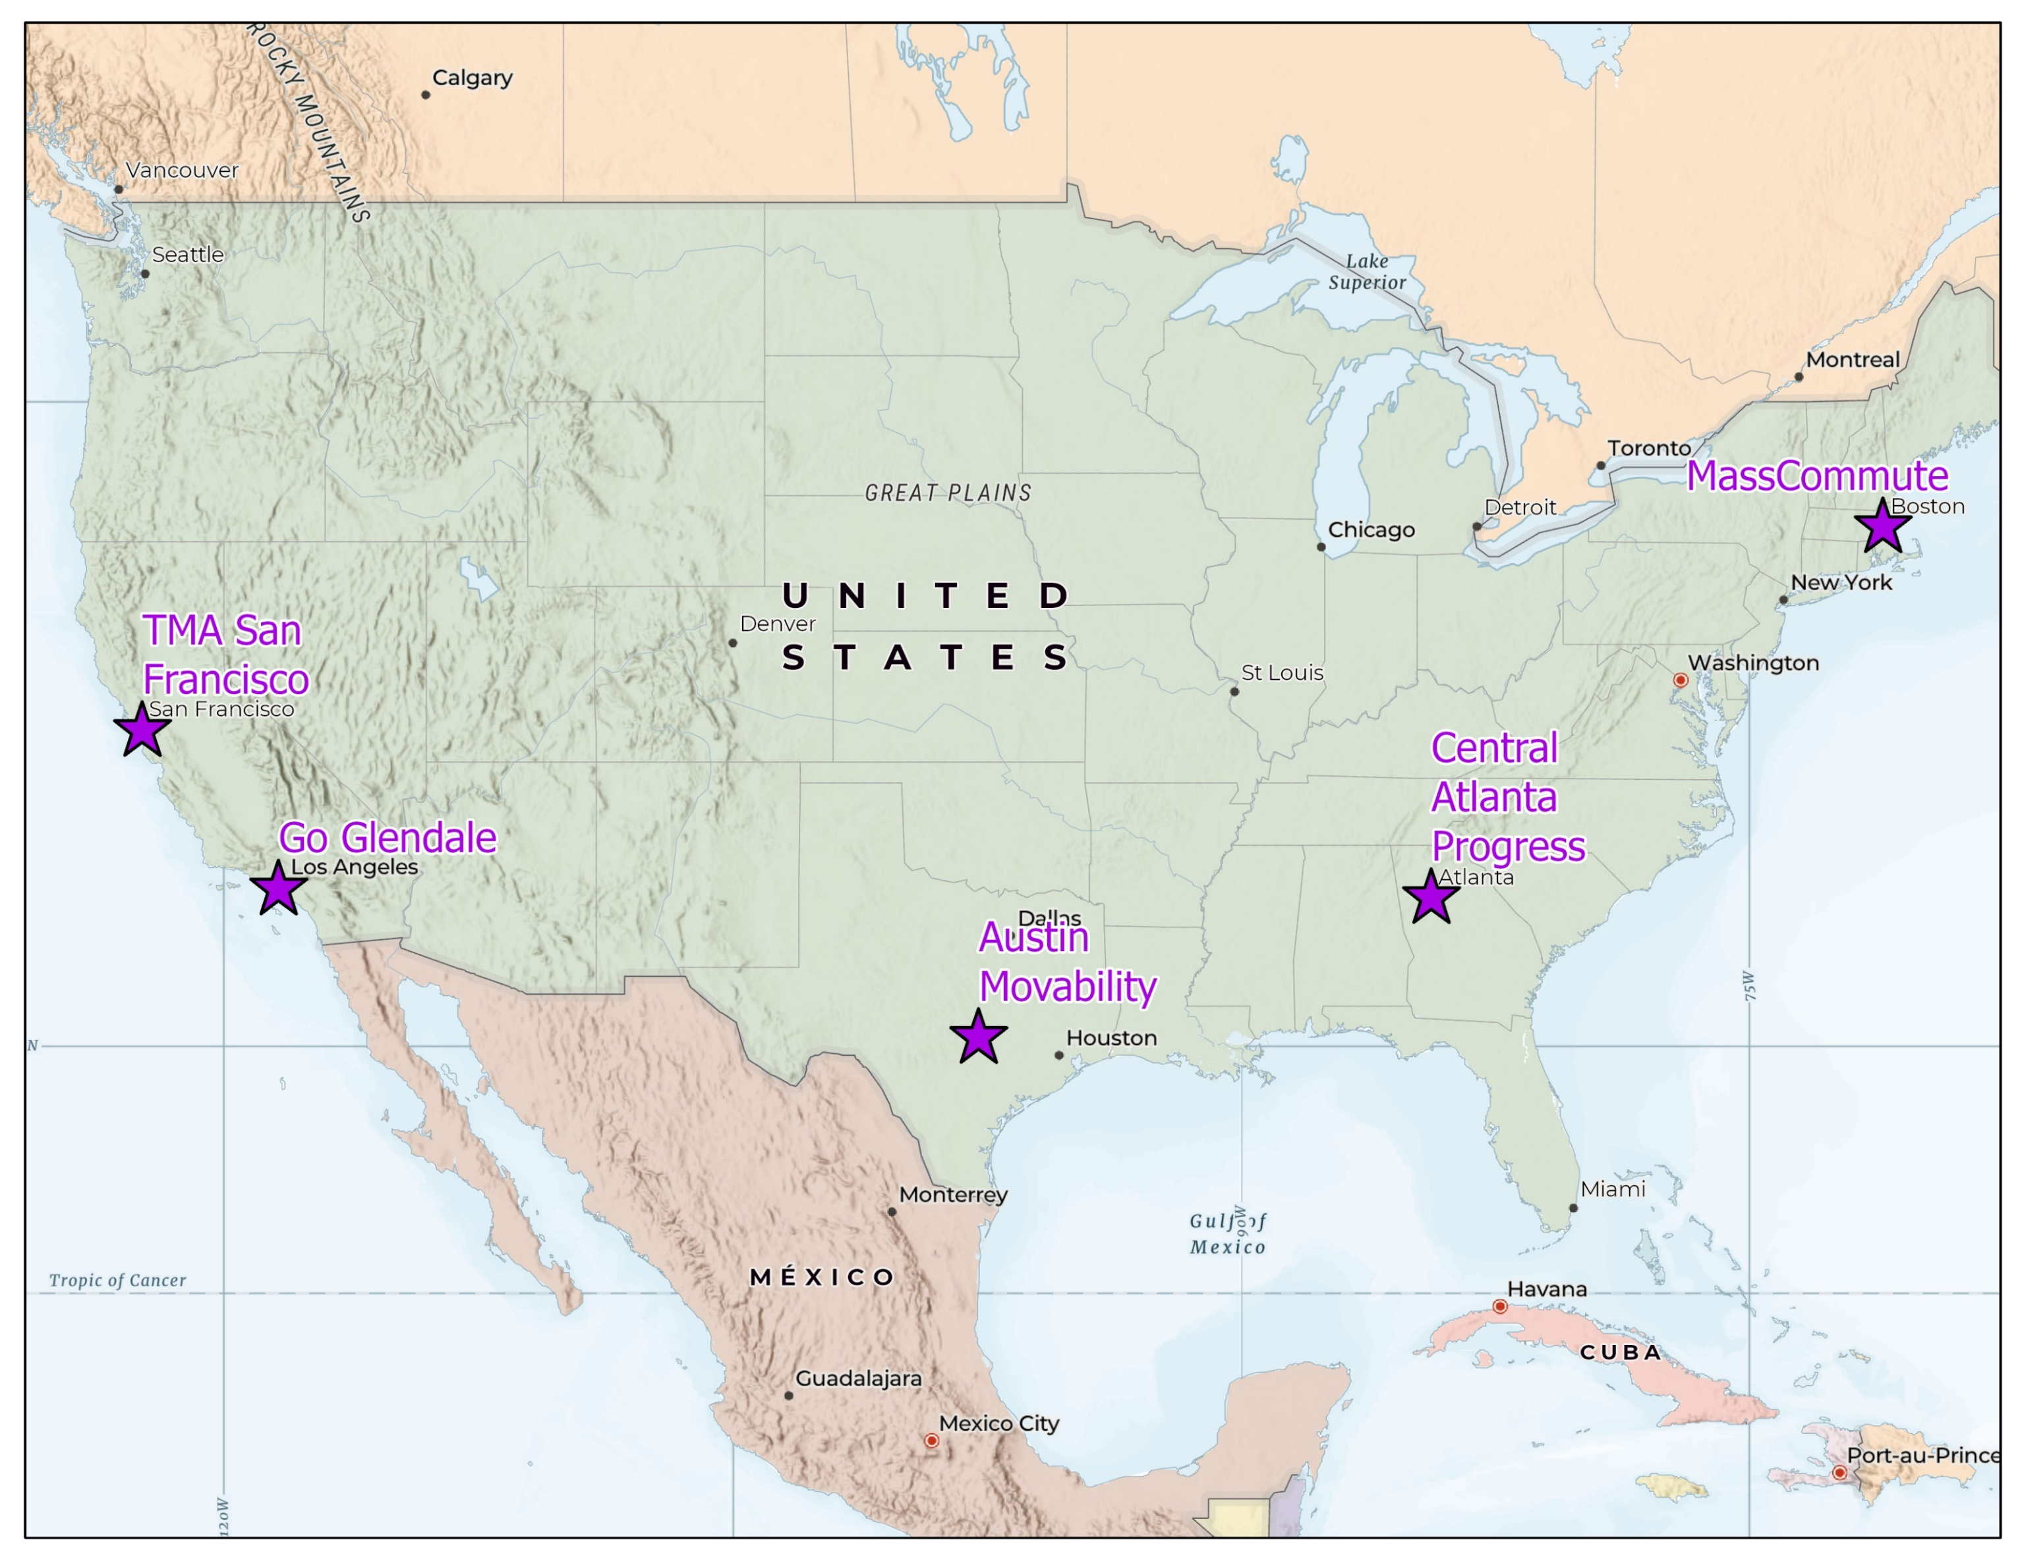
Peer TMAs

Slide 10
Stakeholder Workshop Forums
Four (4) workshops held at key milestones
Focused on conversations and hearing from stakeholders
Interactive exercises at each meeting
  Prioritization score directly informed the Implementation Plan
10

Slide 11












TDM Vision Plan Categories
A. ADVOCACY FOR TDM PROGRAMS
Corridor TDM Plans, Events, Grants, Cities, Transit Advocate, SFCS, Forum
G. FOCUSED TDM PROGRAMS FOR MAJOR TRIP GENERATORS
(Colleges/ Universities, Hospitals, Office Buildings, Business Centers, Residential, Airports, Seaports, Etc.)
B. COMPREHENSIVE PLAN/ORDINANCES BEST PRACTICES
Trip Reduction Incentives/Ordinances, Micro-Transit Accommodation and Permitting, Workforce Housing
H. MARKETING SUPPORT FOR PILOT/EMERGING PROGRAMS (CURRENT EXAMPLES)
BCT, Tri-Rail, Brightline, Rideshare Companies, Vanpool, SFCS, others
C. COUNTYWIDE TOURIST CONNECTIVITY TDM PLANS
Airports, Port Everglades, Convention Center, Special Events, Intercity Rail
I. METRIC REPORTING
Showing Results Each Year, Biennial Survey
D. INFORMATION/TECHNOLOGY
Transportation Info Center, Complete Trip Payment App, Big Data Tools
J. PROMOTE AND EXPAND MICRO-MOBILITY
Bike Share, Trams, Rideshare Companies, Scooters
E. ENVIRONMENTAL/SUSTAINABILITY
Promoting Green Practices, TDM=Environmental Benefits
K. SCHOOL POOLS
Carpooling Incentives, Safe and Healthy Biking and Walking, Safe Routes to School Grants, Community Bus Connections
F. EQUITY
Internet Access, Health, Connect Workforce Housing/Frontline Workers to Jobs, Incentives
L. TRANSIT/INFRASTRUCTURE EXPANSION SUPPORT
Provide a Mechanism to Champion Major Investments
11

Slide 12
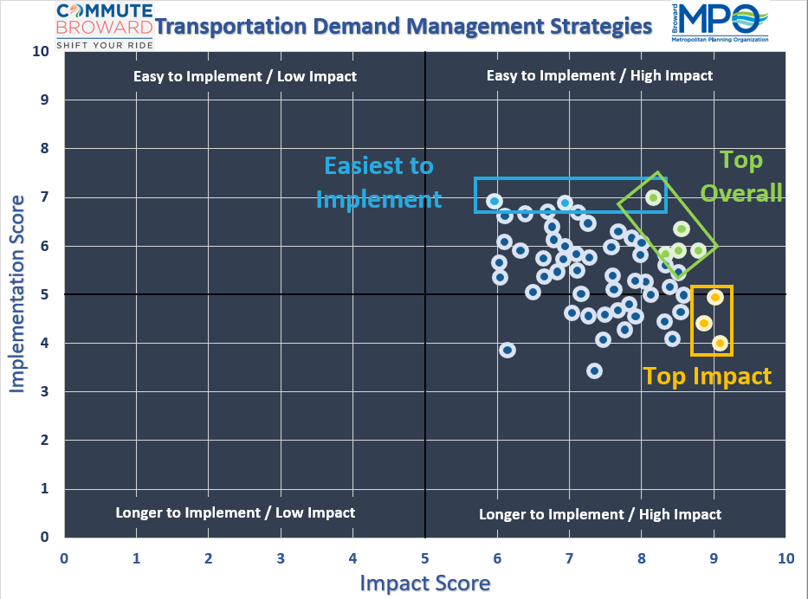
Survey
Results
12

Slide 13
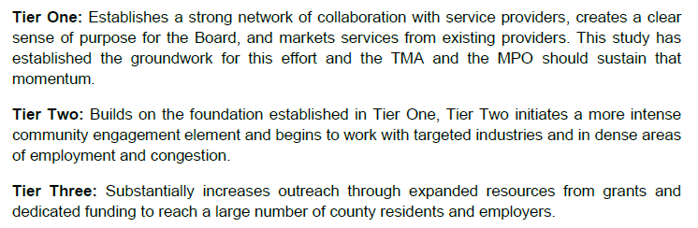
Tiered Implementation Plan
13

Slide 14
Top 5 Implementation Plan Activities
Grant Research and Writing
Collaborate with South Florida Commuter Services
Develop an Employee Transportation Coordinator (ETC) Network
TDM Education and Encouragement Services
General Management
14

Slide 15
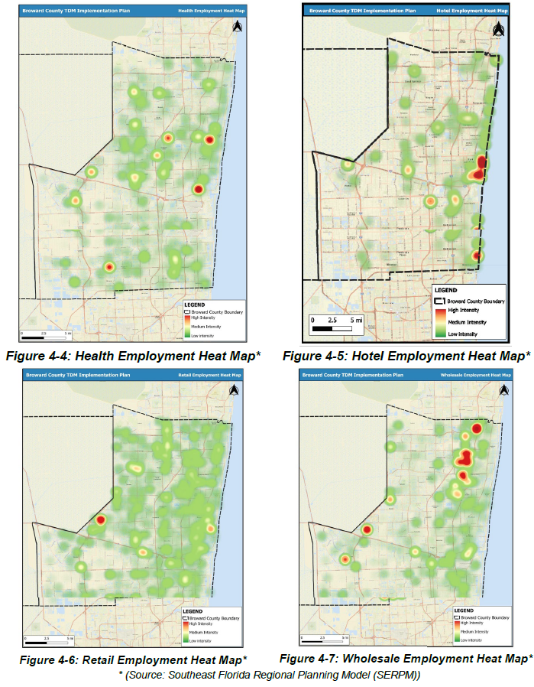
Employment Heat Maps

Slide 16
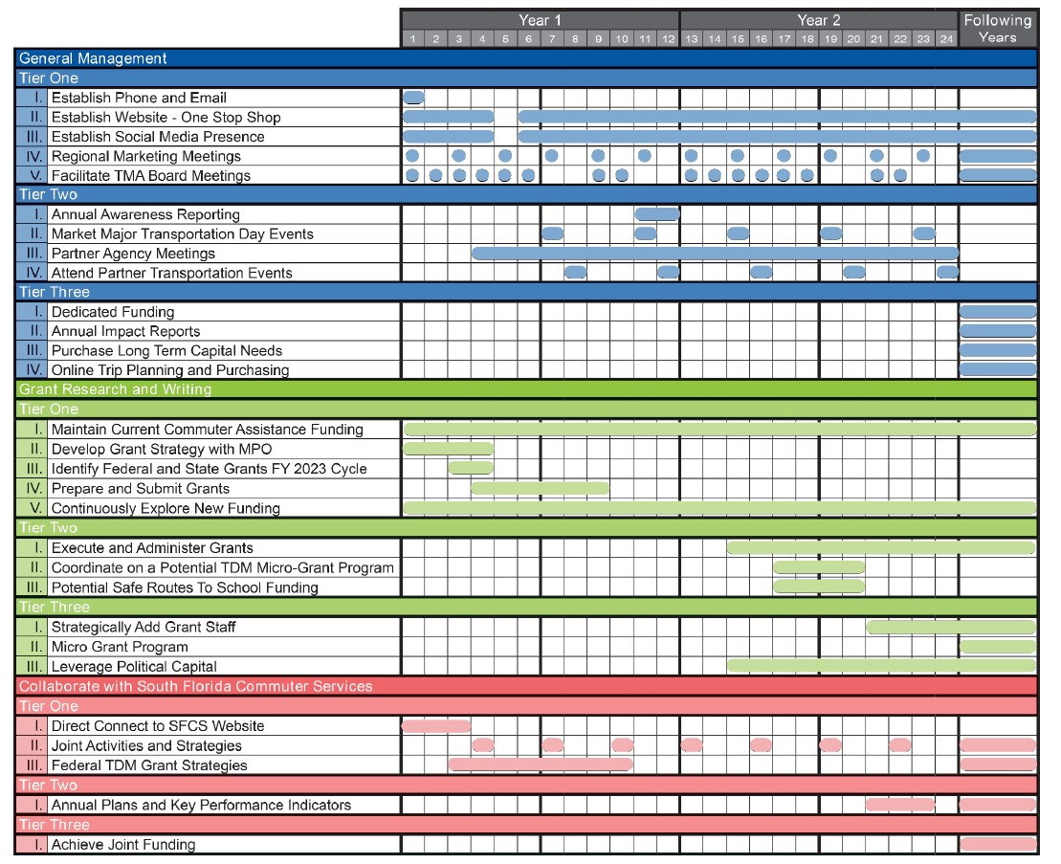
Next Steps

Slide 17
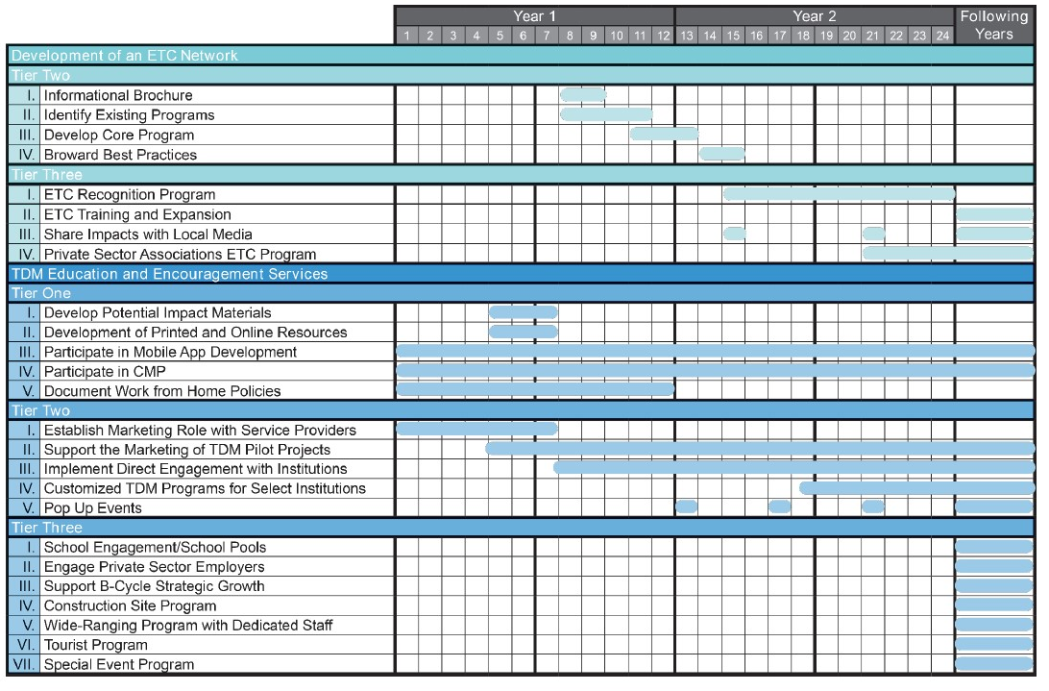
Next Steps

Slide 18
Thank you!

