Slide 1


Slide 2


Broward Complete Streets Advisory Committee (CSAC) Meeting
Monday, November 11, 2019

Slide 3
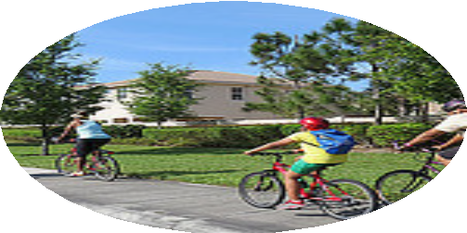
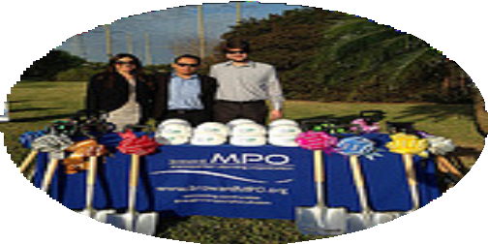
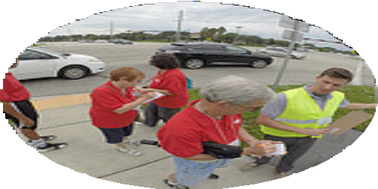
HOUSEKEEPING
Please make sure you have signed in and have an agenda.
This meeting is being recorded.
Please introduce yourself and the organization(s) you represent.

Slide 4
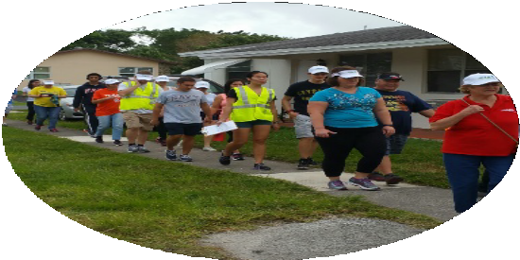
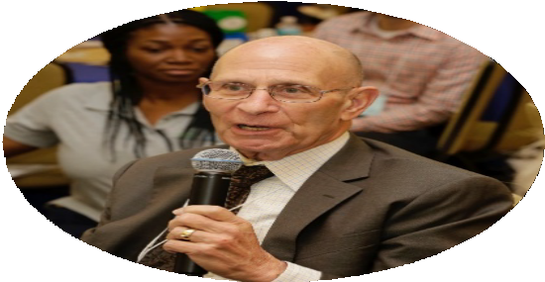
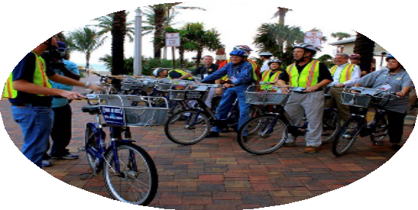
MPO CURRENT EFFORTS
FHWA Bikeway Selection Guide Workshop
Let’s Go Walking to School 2019
  Tactical Urbanism Activity
  Let’s Go Walking Event
7th Annual Safe Streets Summit - February 6 and 7, 2010

Slide 5

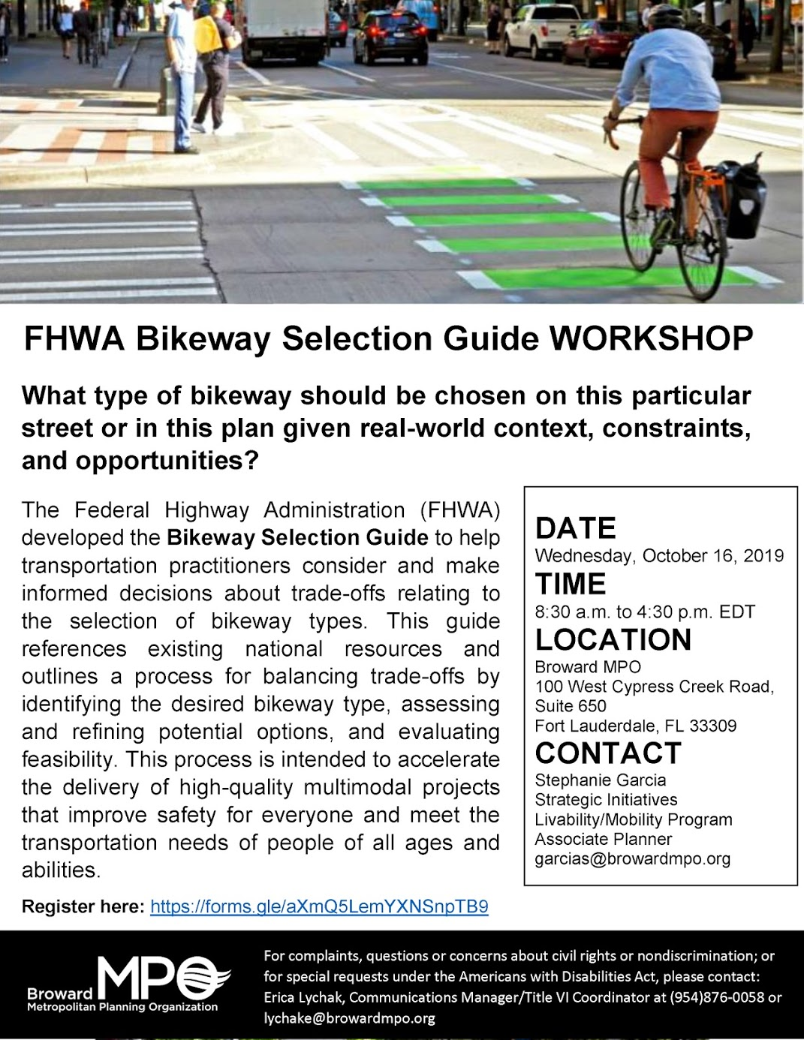
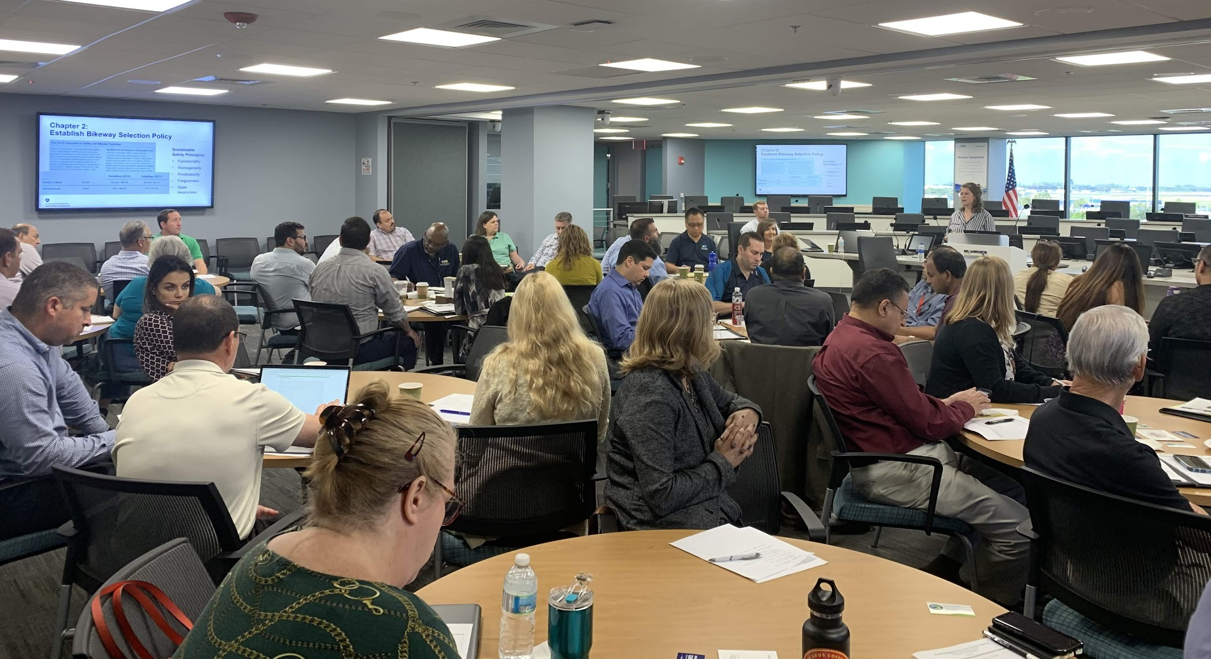
Bikeway Selection Guide Workshop
FHWA Technical Experts
Wednesday, October 16th, 2019
50 participants
  Engineers
  Planners
Local Examples

Slide 6

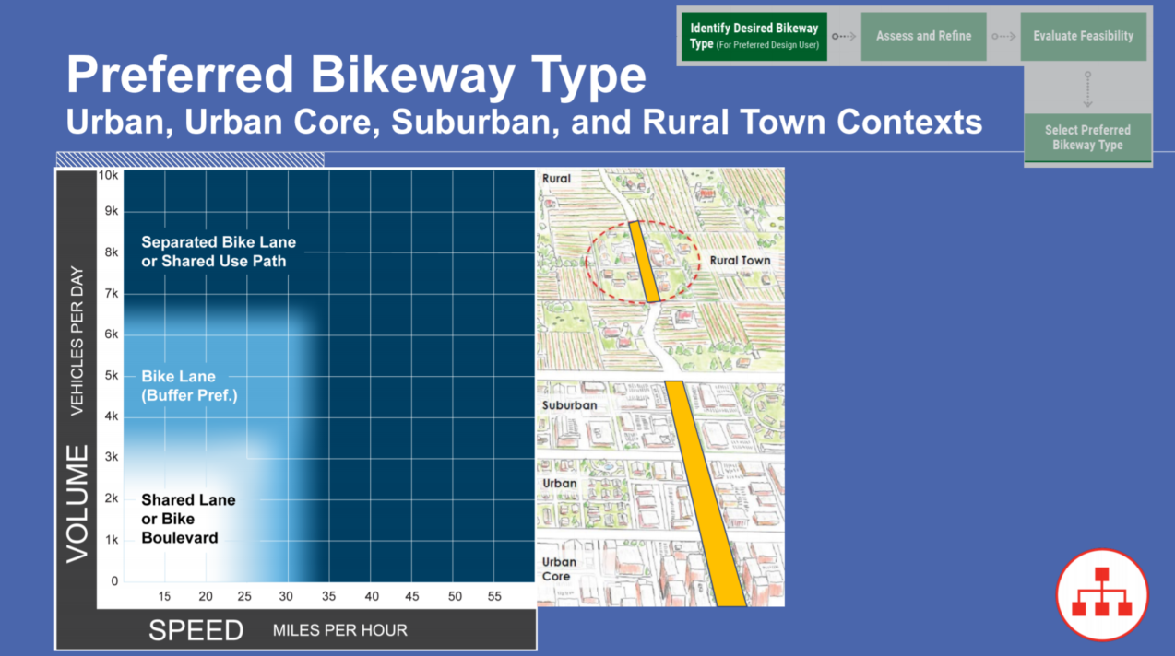

Slide 7
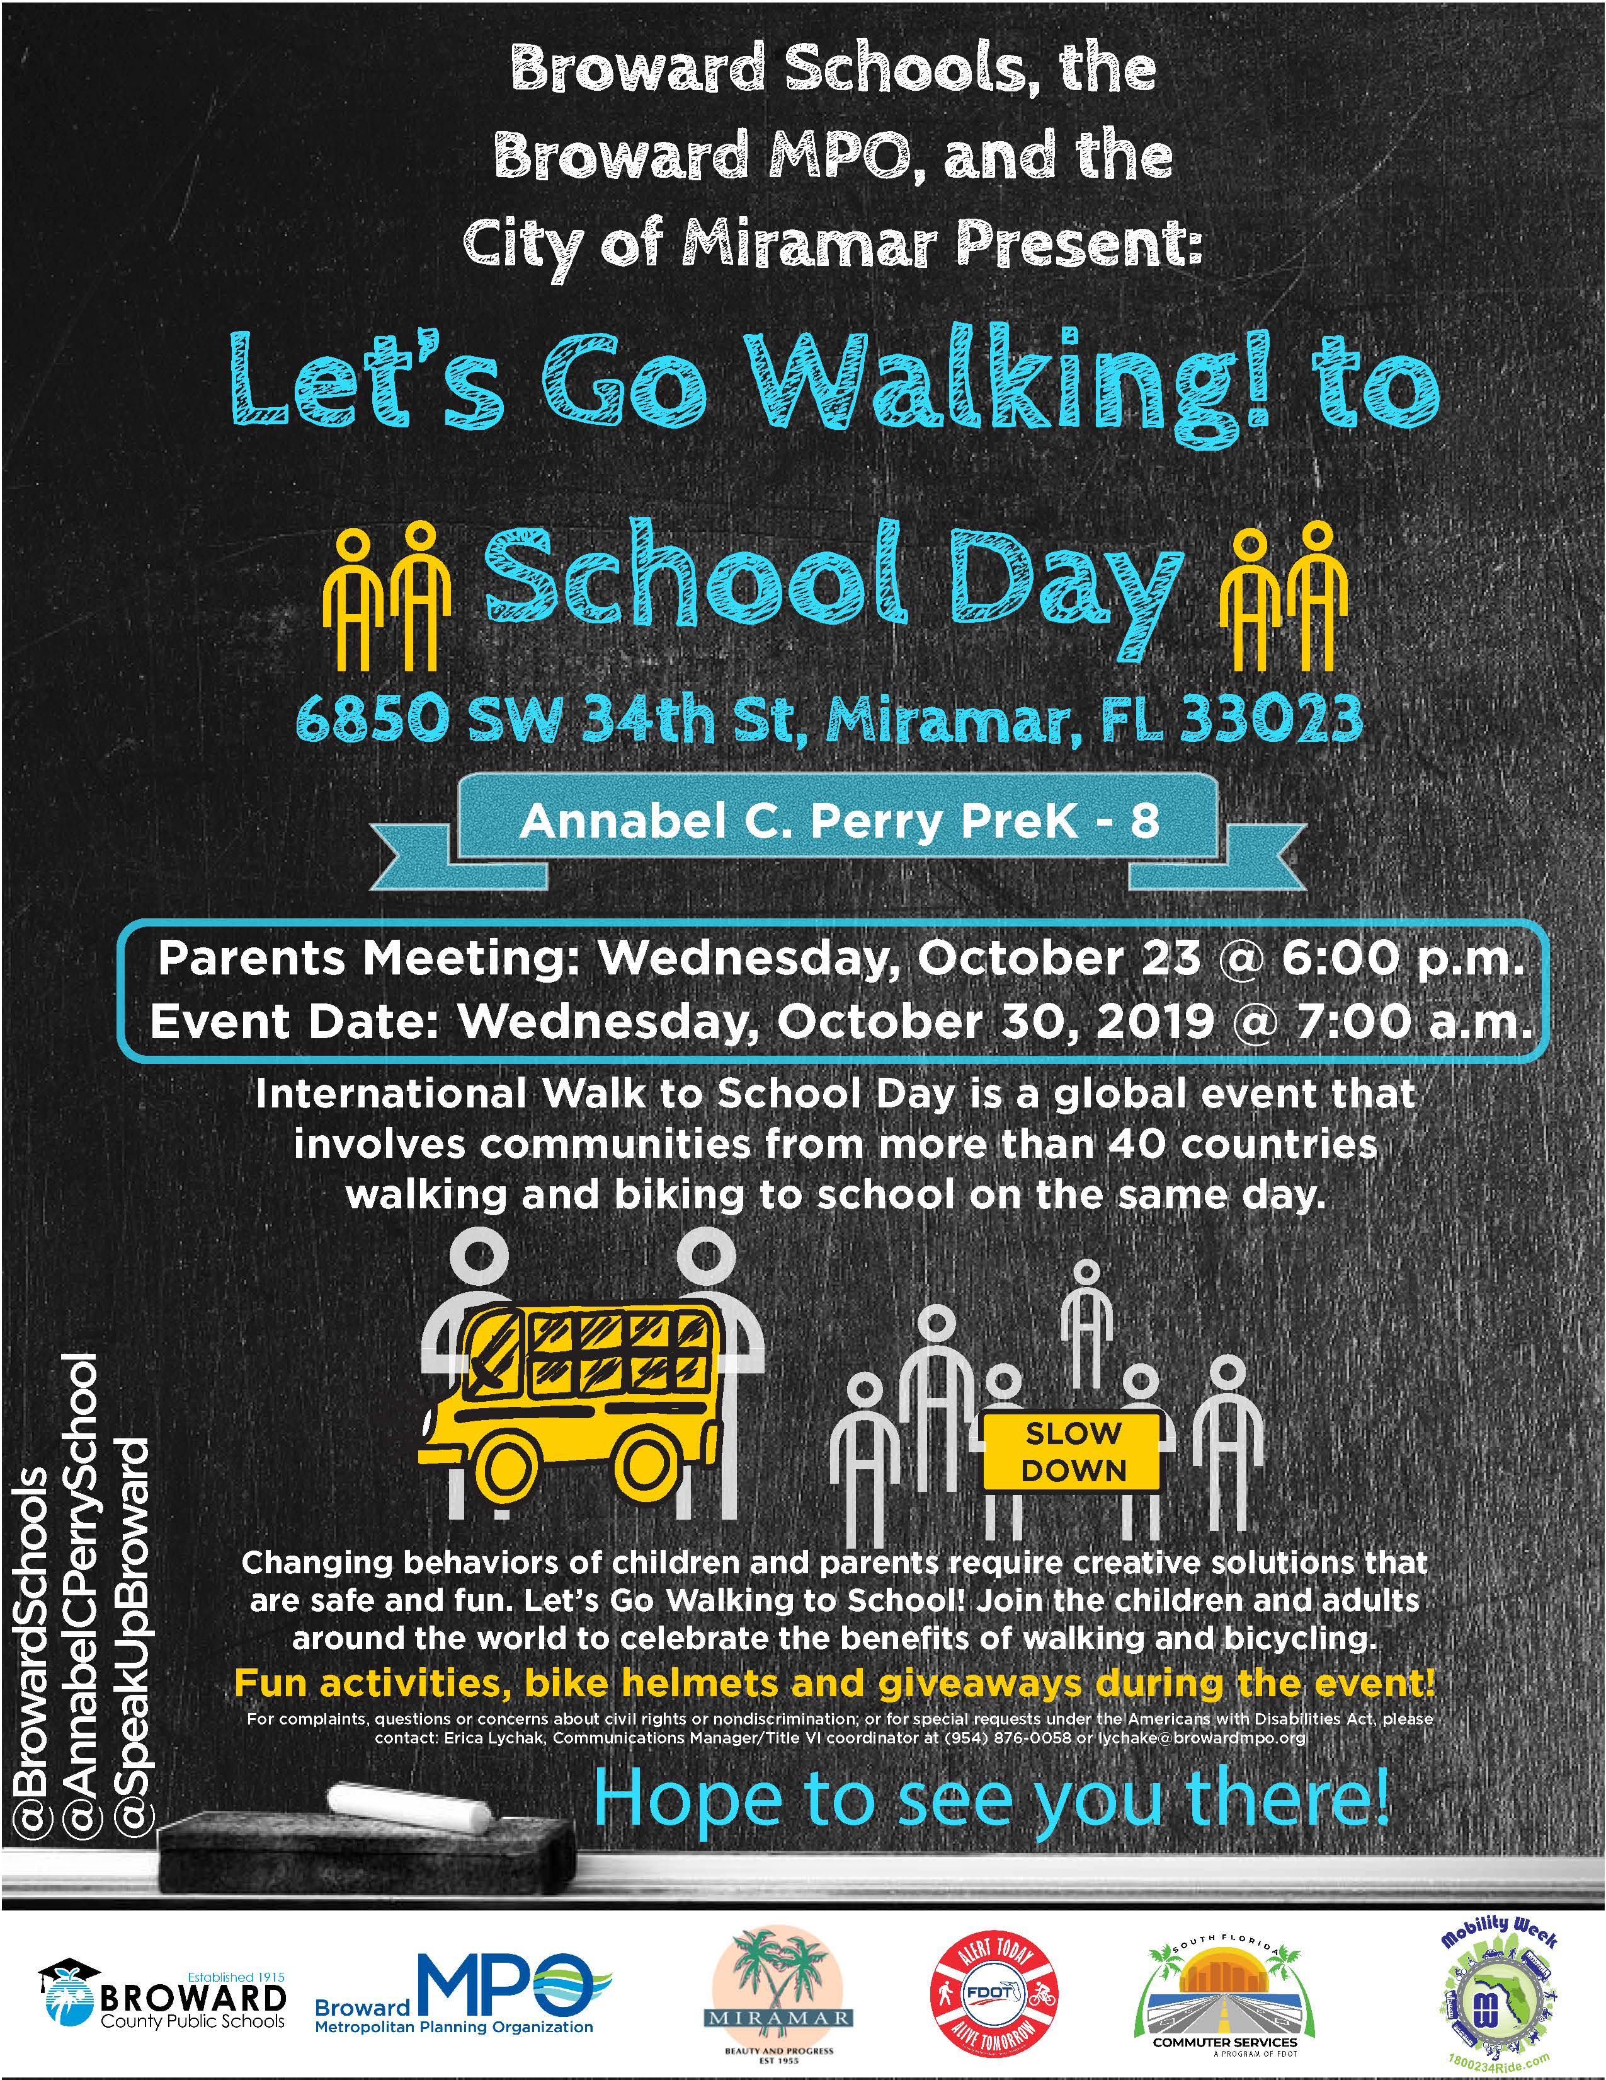

Every year, the Broward MPO hosts the Let’s Go Walking! Event to promote Walking, Safety and the Health benefits of active transportation.
Great participation from Broward MPO, FDOT, School, Students, transportation partners and City of Miramar

Slide 8
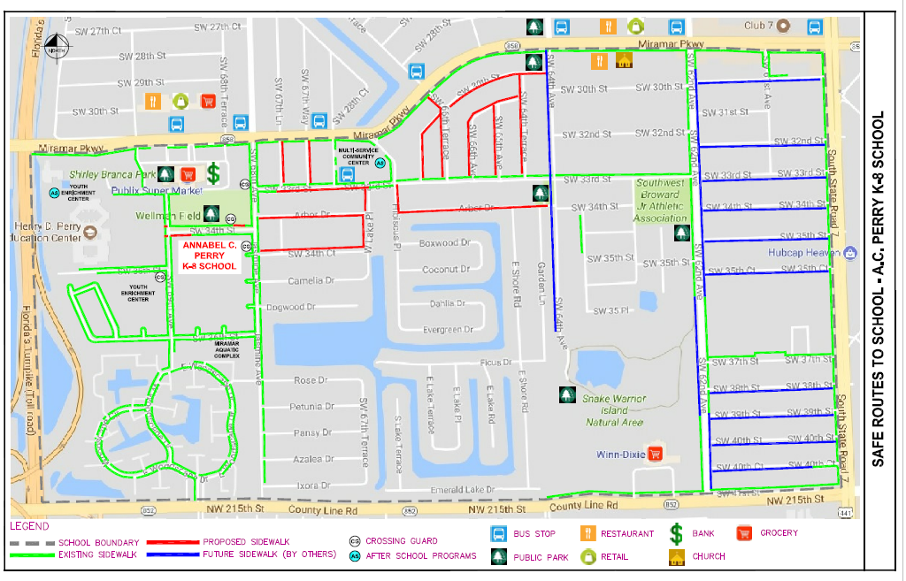
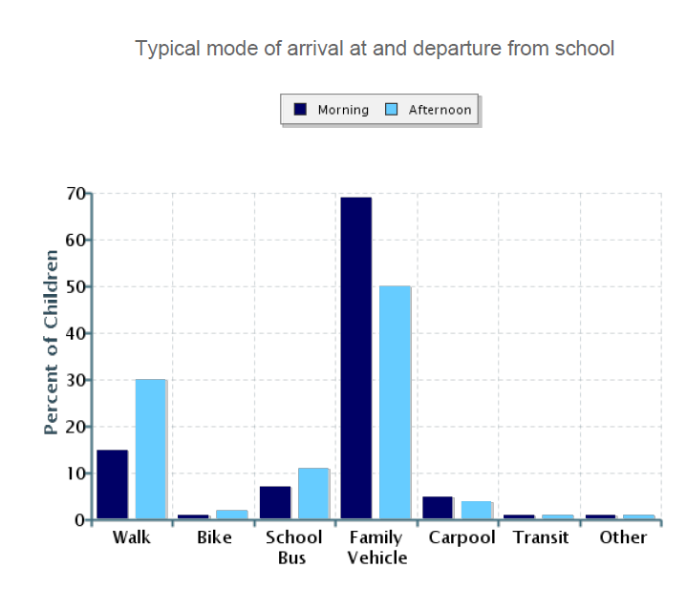
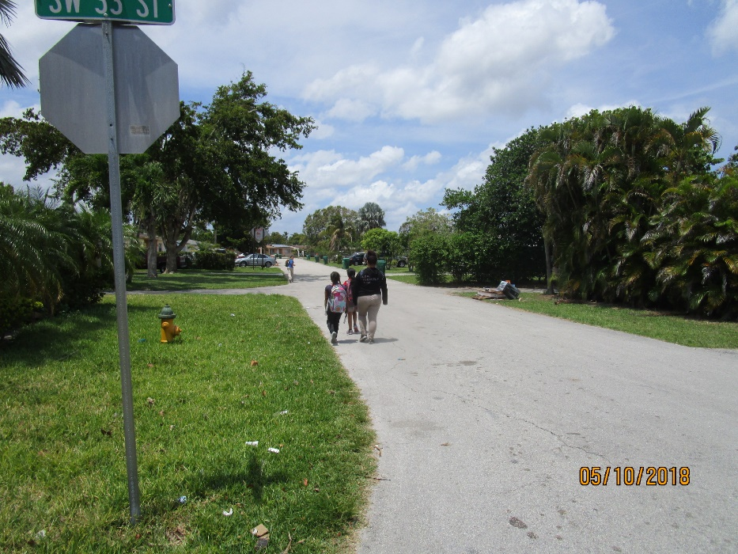

Let’s Go Walking -Safe Route to School Program
2019
City of Miramar
Student Loses 115 Lbs. by Walking to High School Every Day
May 17, 2019
Notes:
Parent estimate of distance from child's home to school 1 to 2 miles (25%), Less than ¼ mile (22%), 1/4 mile to 1 mile (35%). Survey link \\bmpocolofs1\MPOFiles\GroupShared\- UPWP Sect 3\3.9 Mobility Options\BikePed\Safe Routes to School\2018 Application Review\Miramar. Better amenities and environment , bike rack , lockers

Slide 9
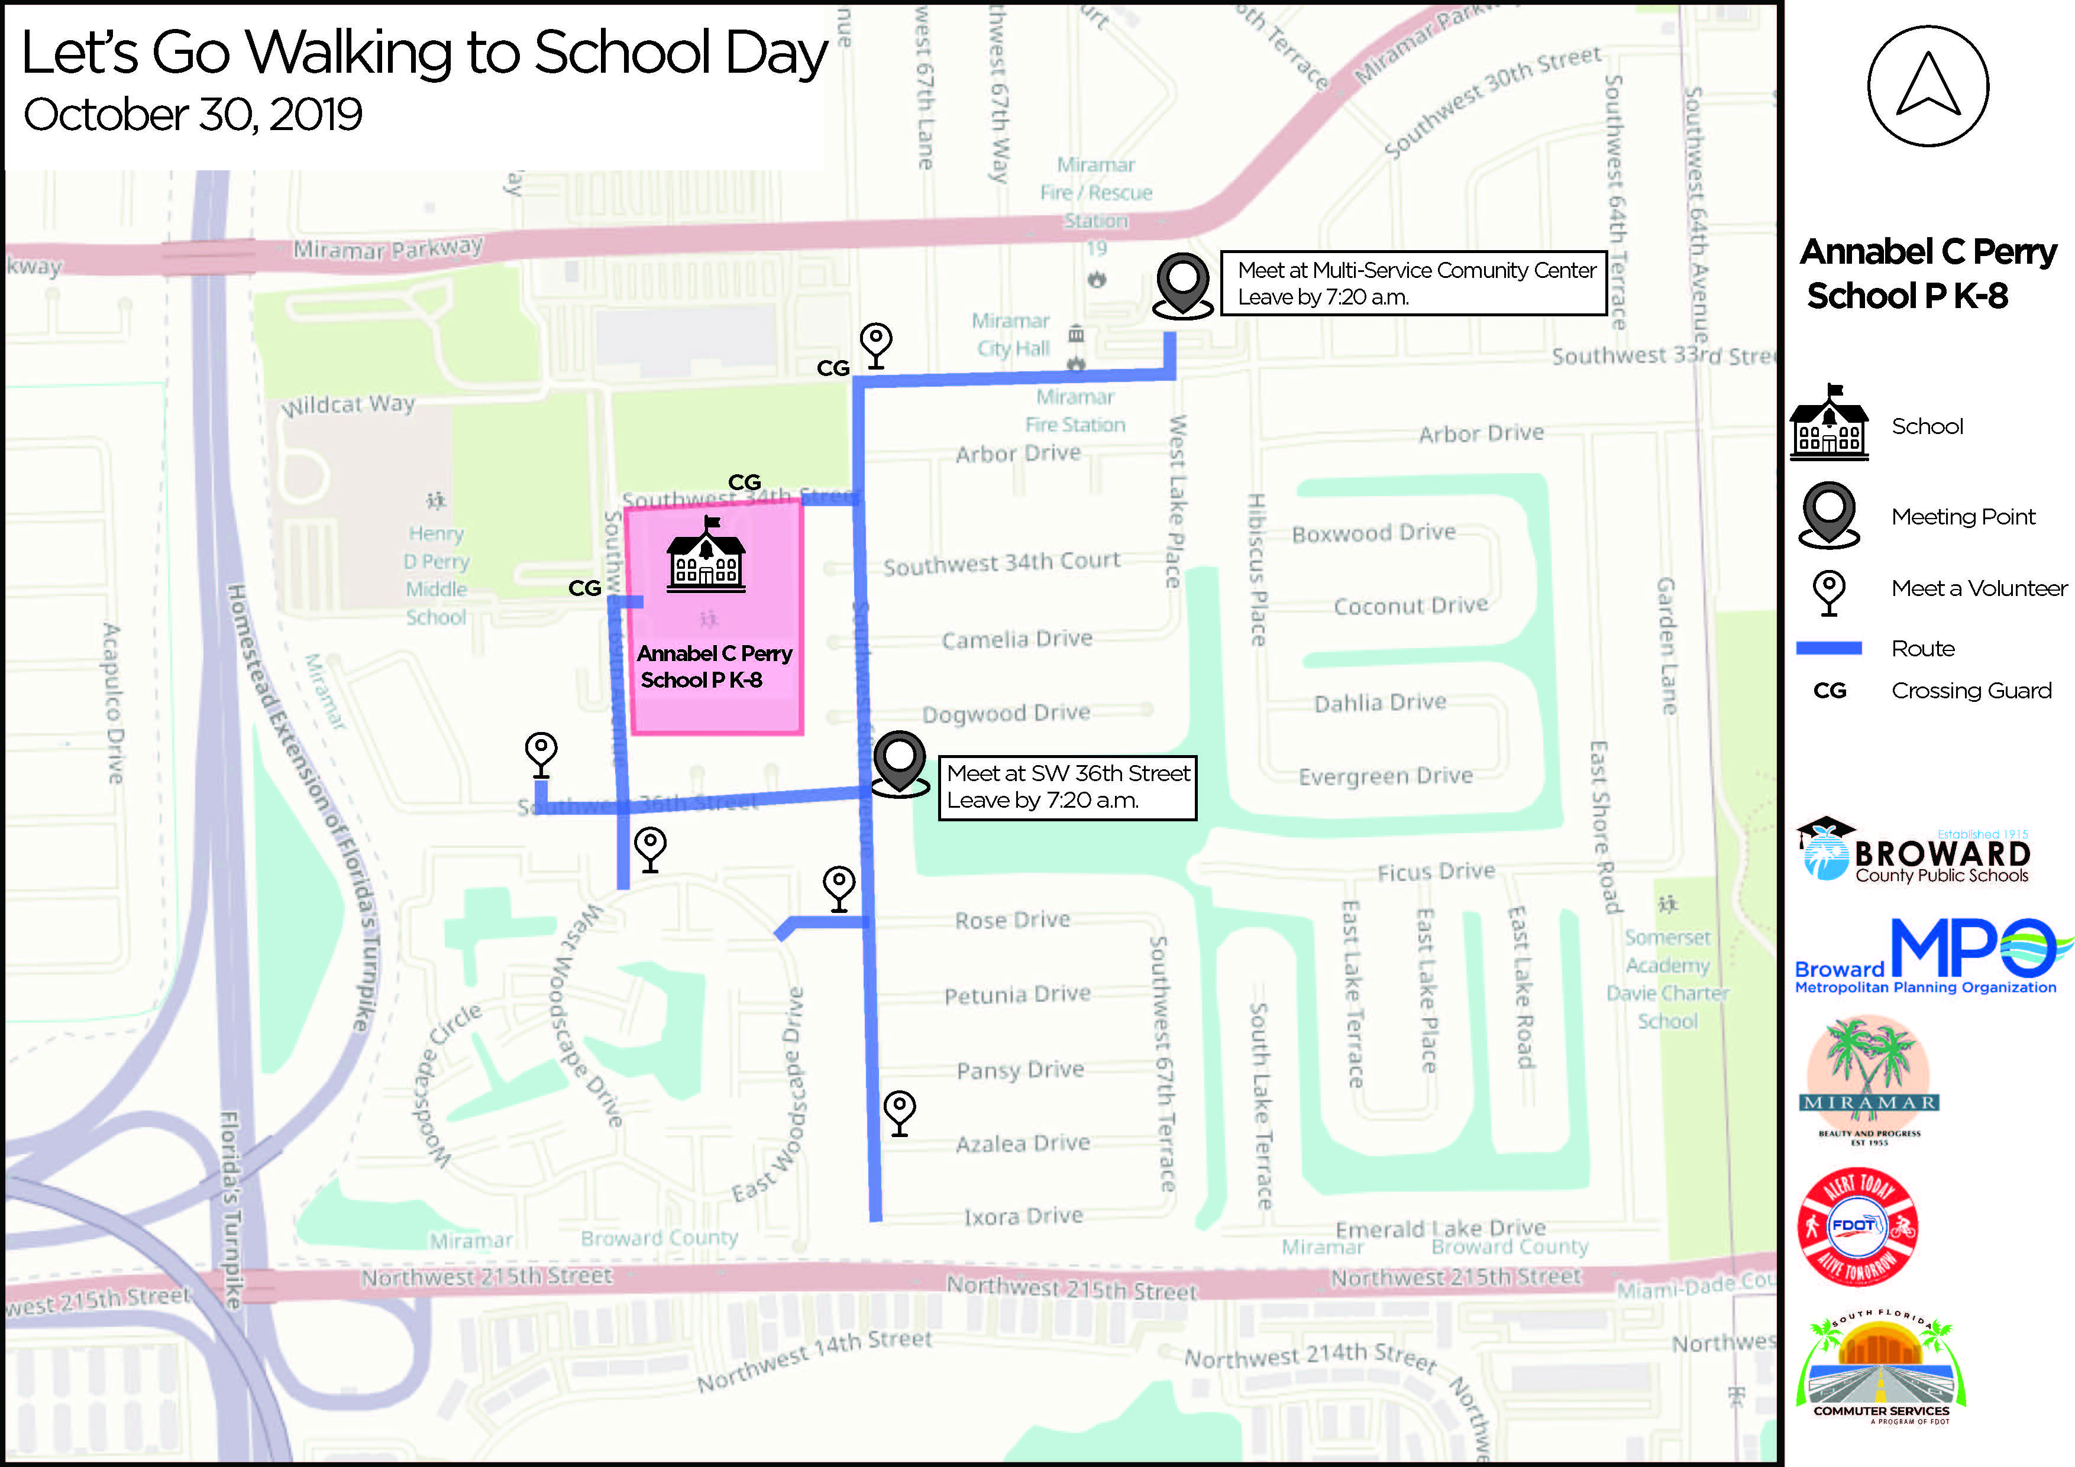
Notes:
Drop off your kids or join us at the meeting locations. School staff will be waiting for you to take your kid to school. We will walk to Wellman Field and to thank for choosing walking to school, there will be giveaways for the kids.
Two meeting locations : Multi service center and the field at SW 36th Street with SW 68 Avenue.

Slide 10
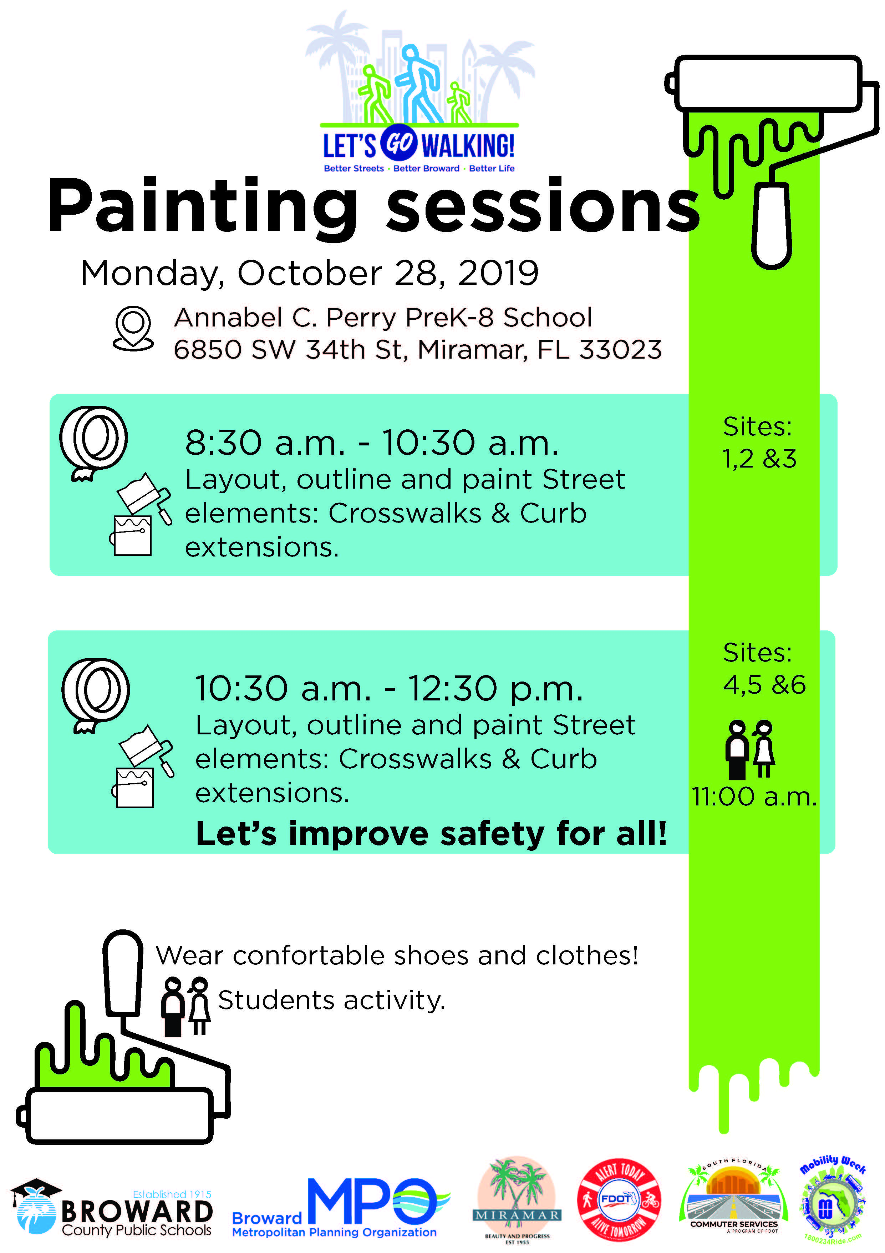
Through this event and the tactical urbanism demonstration, the Broward MPO is aiming to encourage other municipalities and schools to apply to SRTS program.
Activities were carried out safely as planned
Completed 6 locations with painted crosswalks, curb extensions, Mural intersection, logos, etc.
Implemented Tactical Urbanism demonstrations to improve street safety and engage the community through innovative street design.

Slide 11
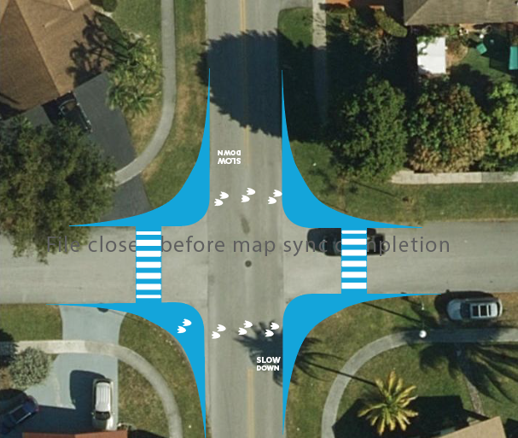
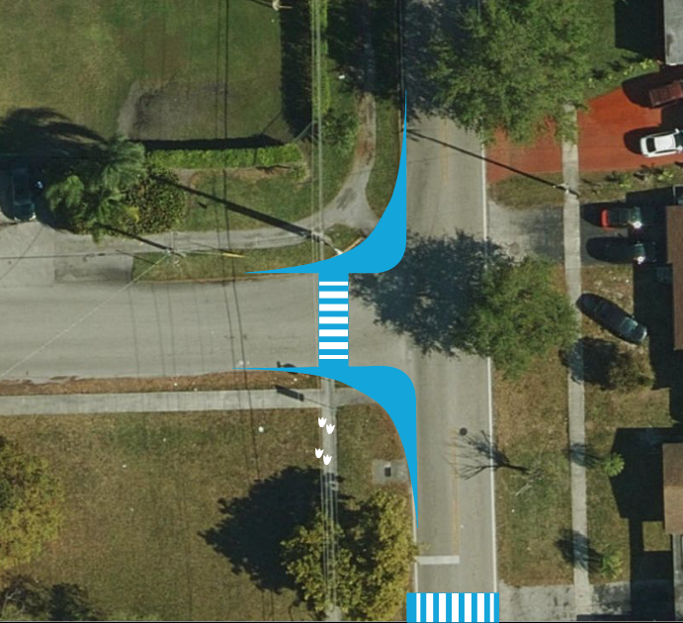
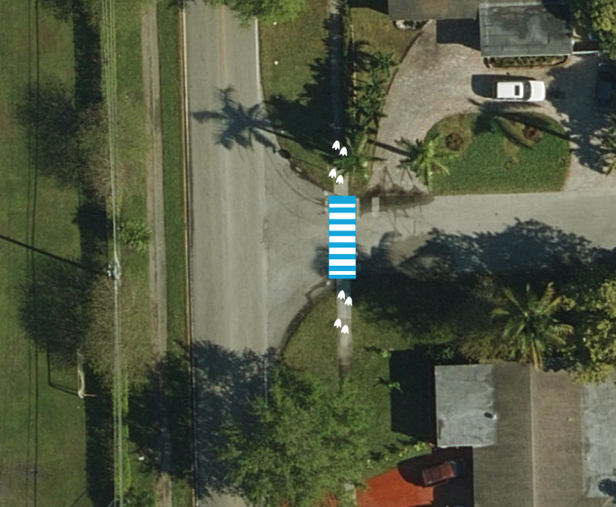
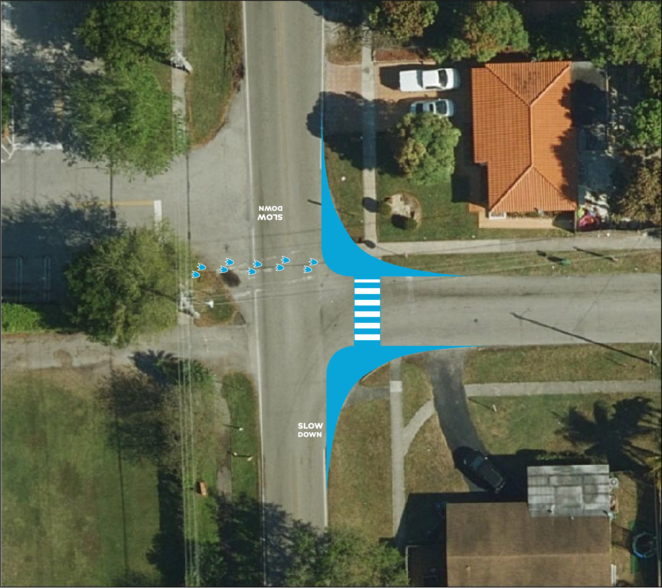
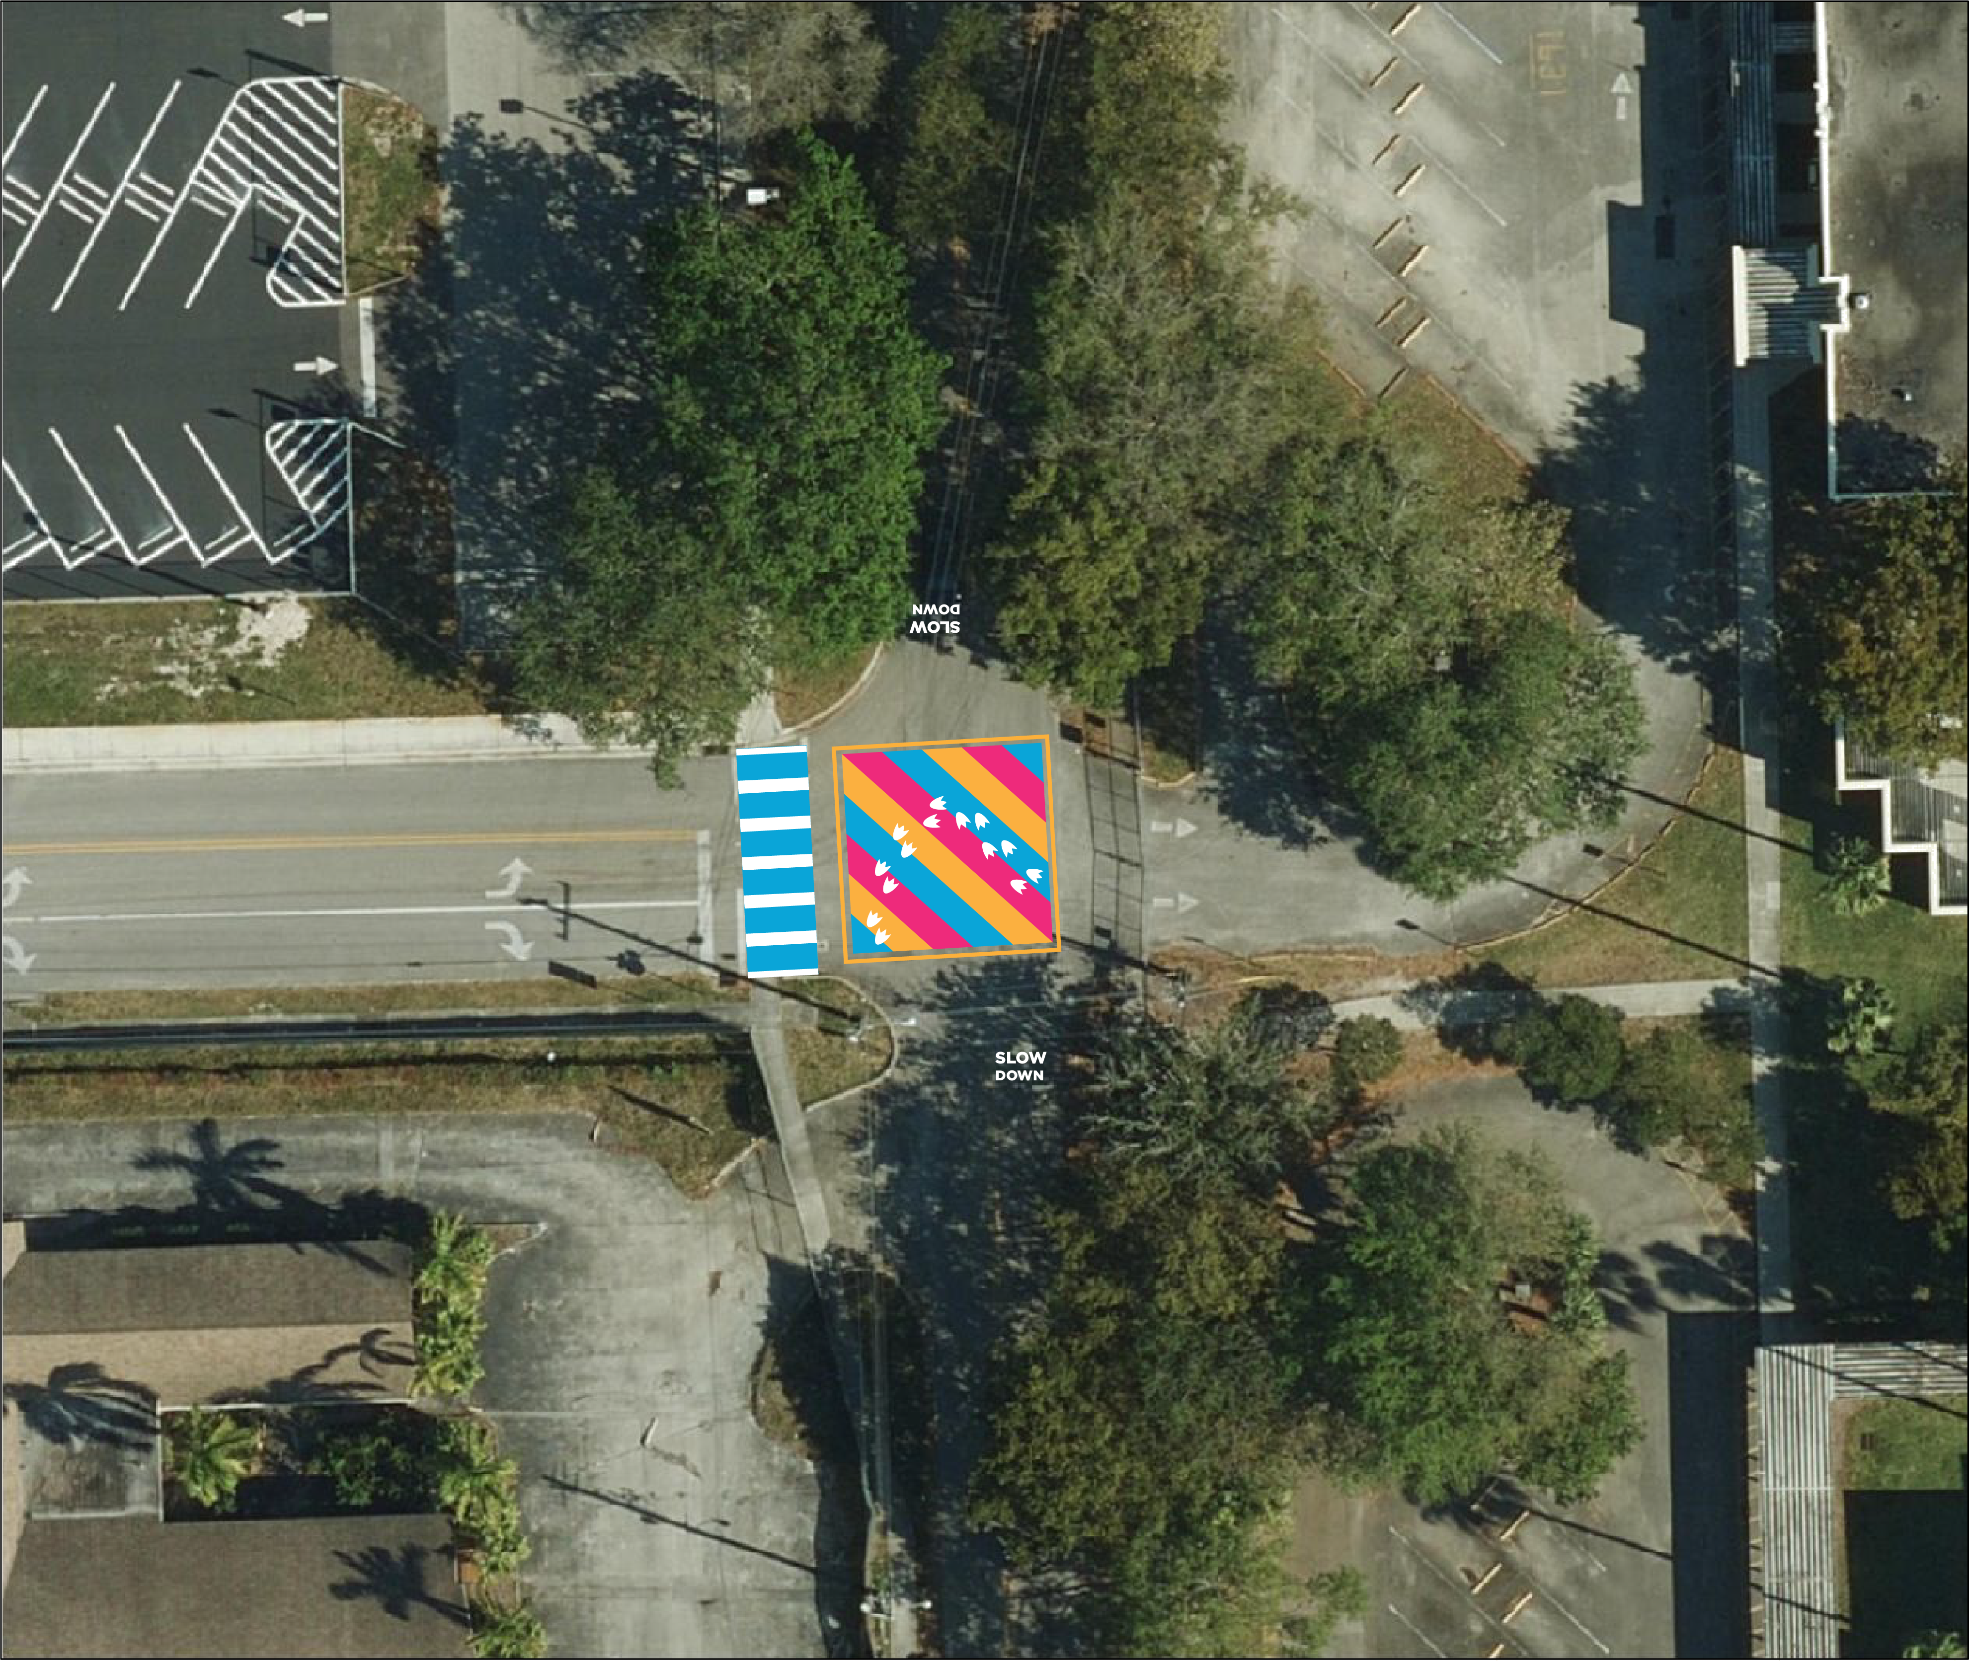
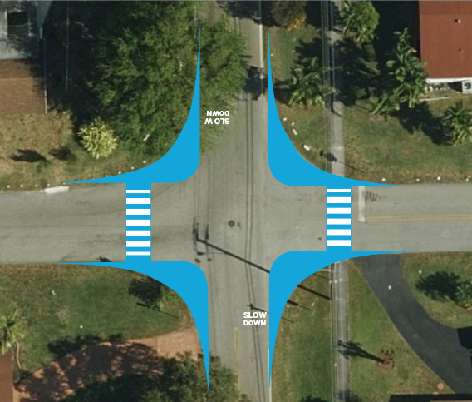

Slide 12
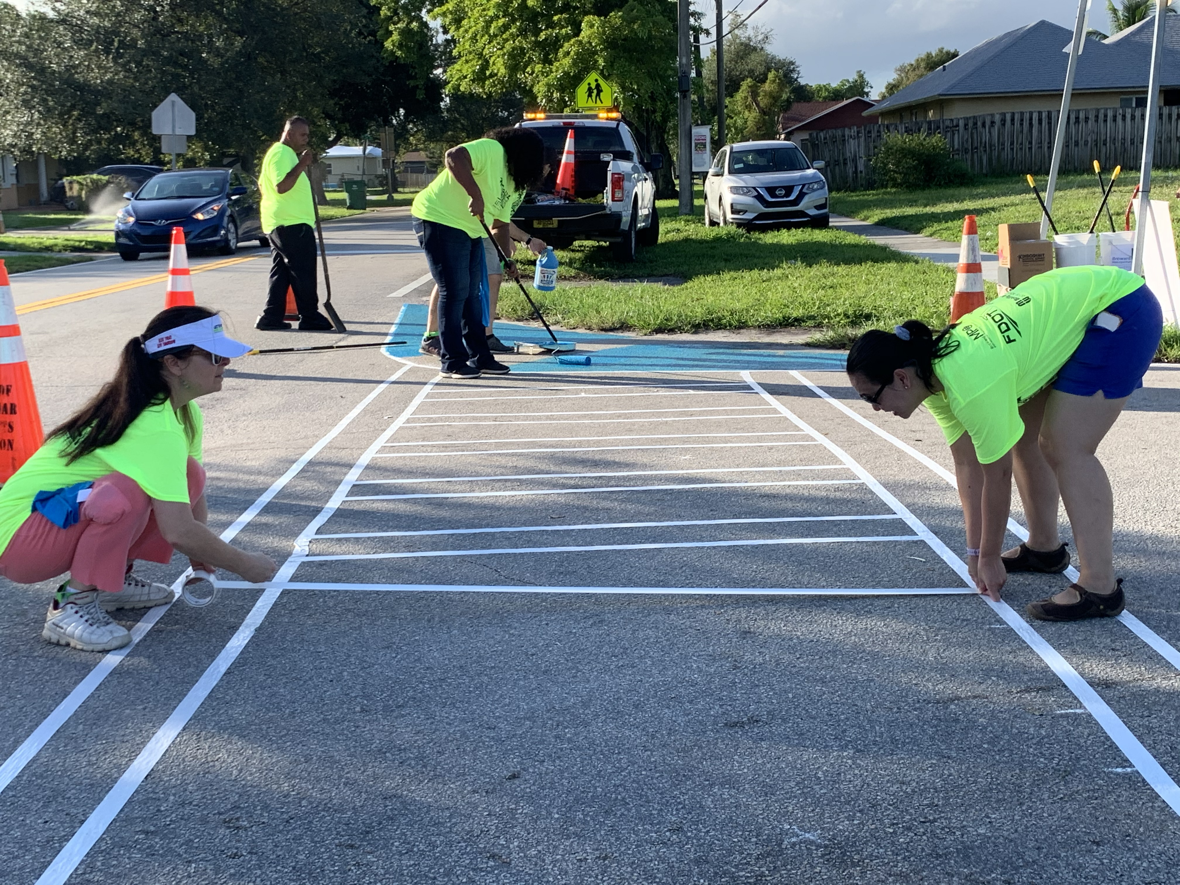

Slide 13
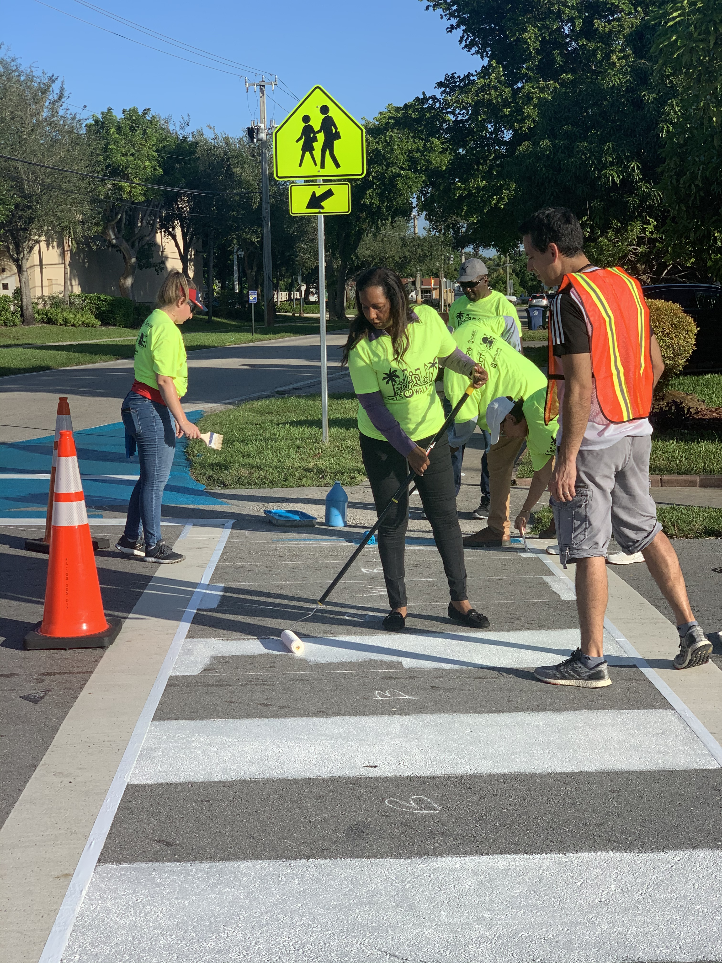

Slide 14
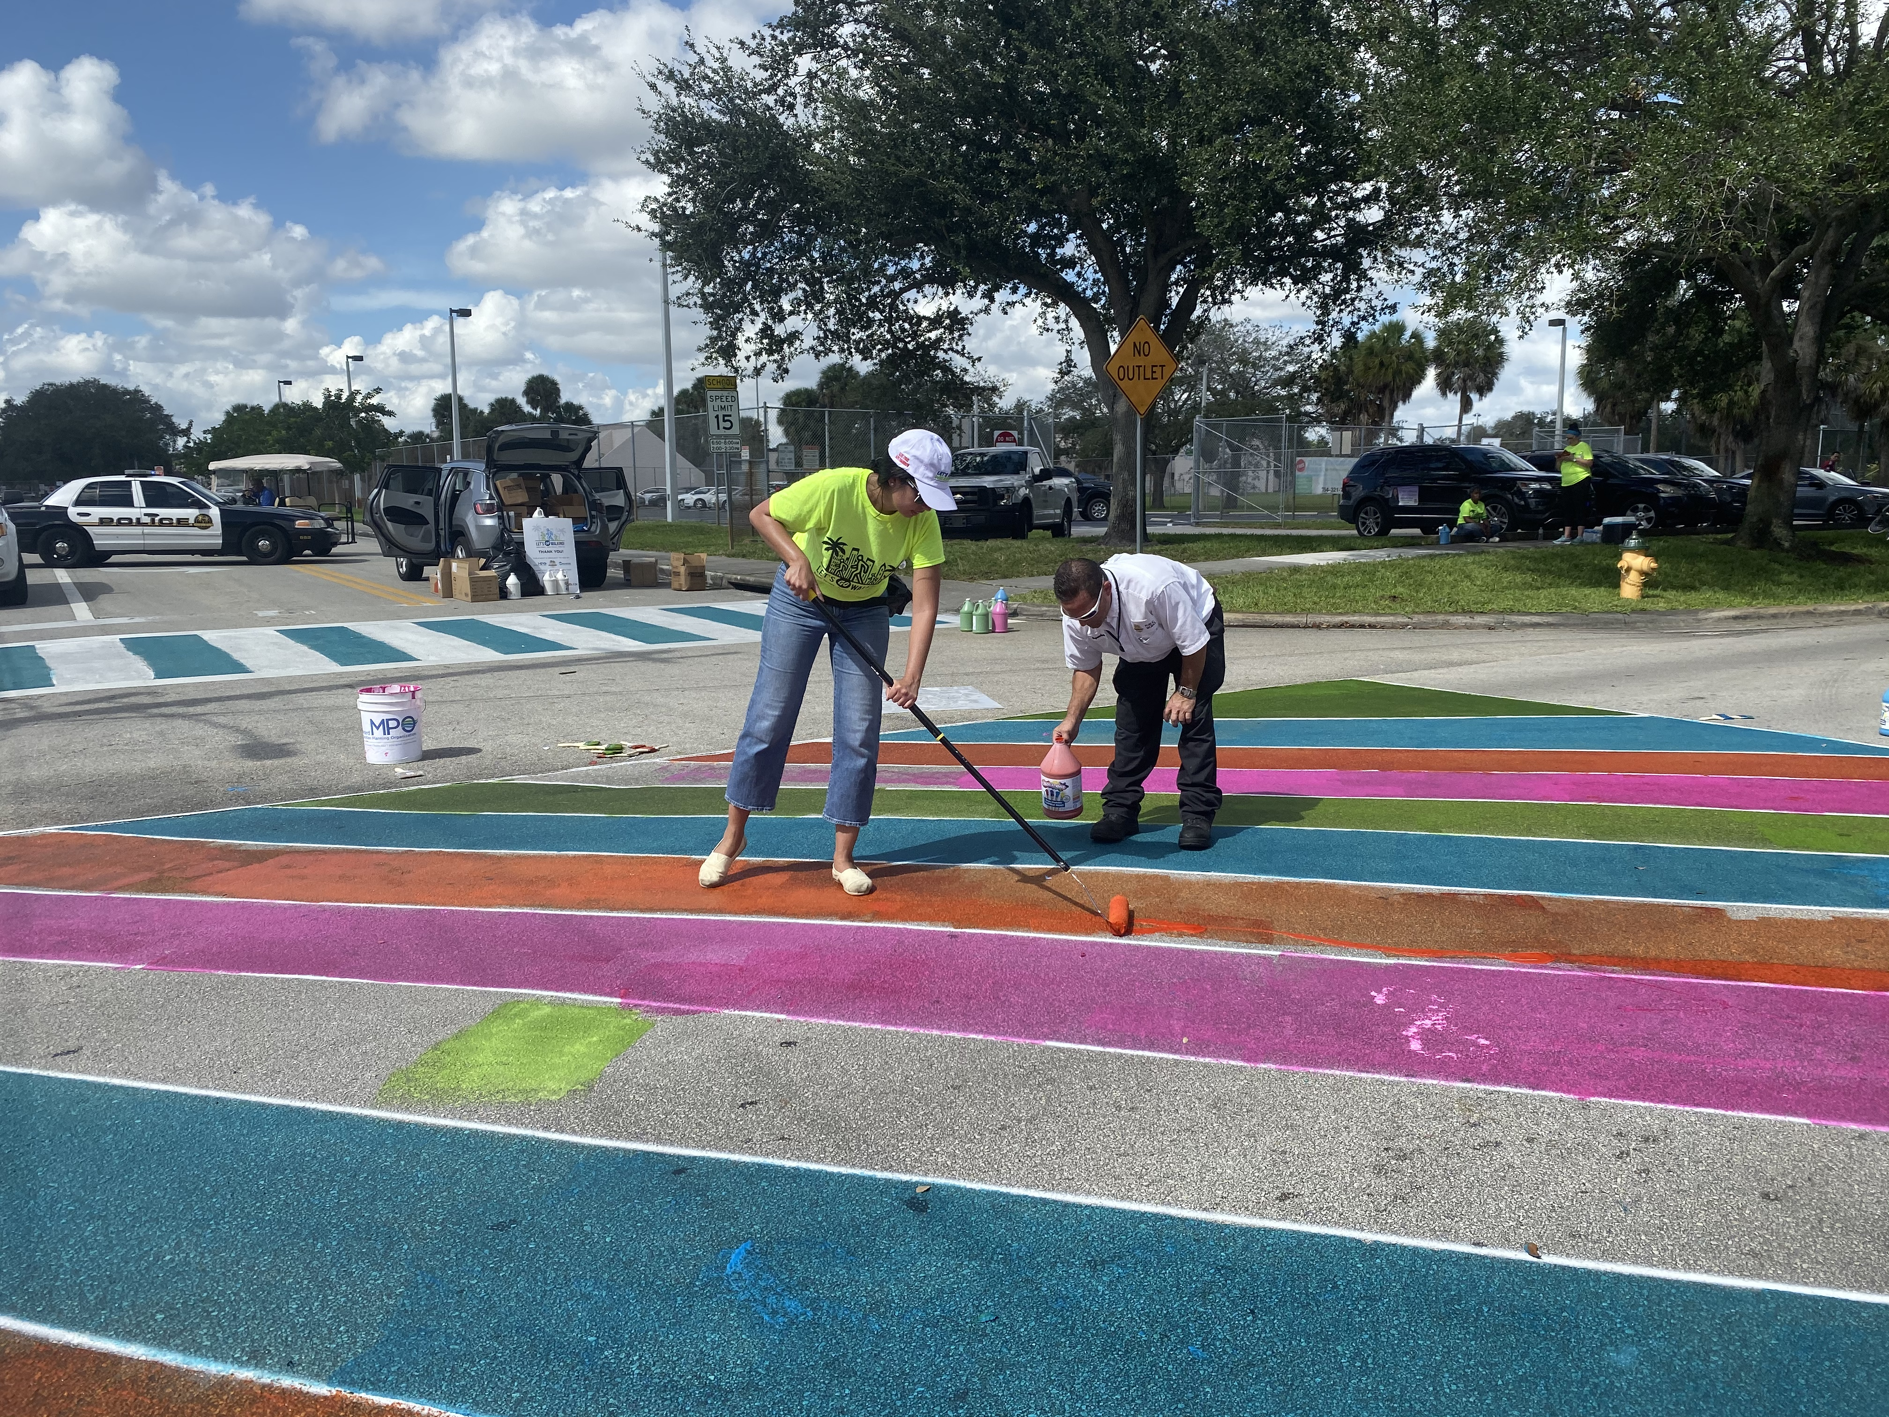

Slide 15
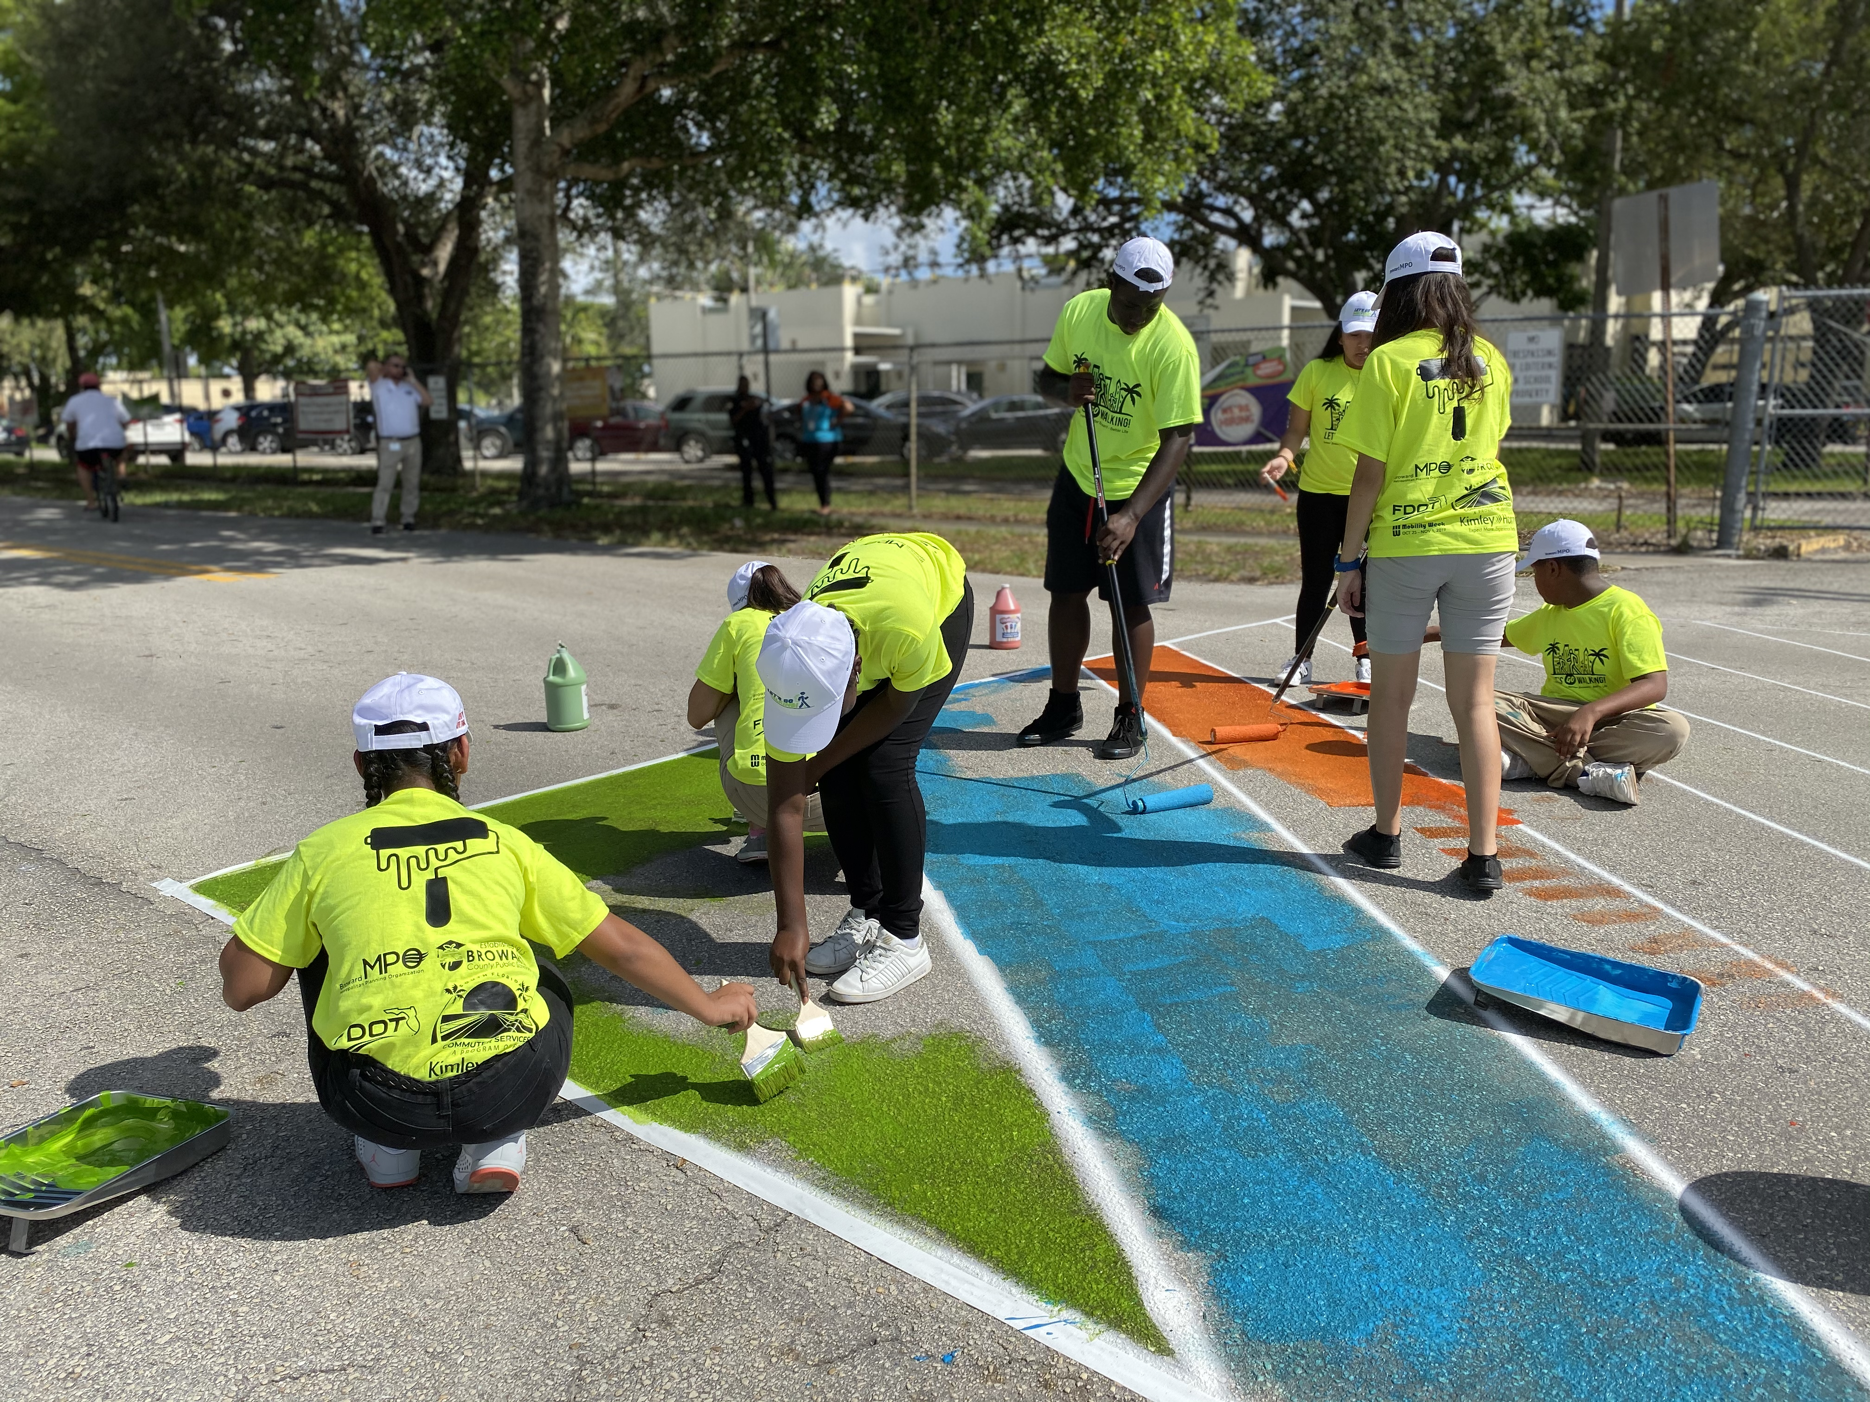

Slide 16
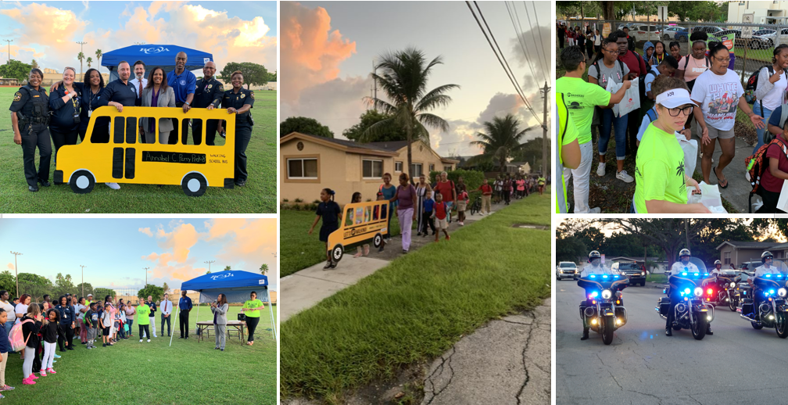

Slide 17
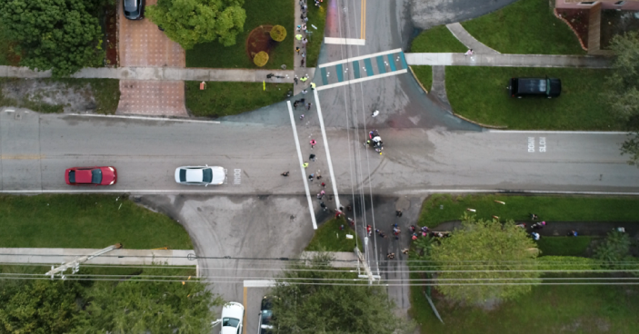

Let’s Go Walking to School
October 30, 2019

Slide 18


Slide 19


Slide 20
Vision 20/20
Bringing a focus on building and implementing a collective regional vision for better streets, better communities, and a better life for all residents.
This year, the Summit is returning to where it all started, Broward County!
February 6 and 7 , 2020
  February 6th, Mobile Workshops/Opening Reception
  February 7th, Main Conference Day
Early Registration ends on December 15th, 2019
Visit Safetreetssummit.org

Slide 21

Metropolitan Transportation Plan
Place Holder
PETER GIES, AICP
SYSTEMS PLANNING MANAGER

Slide 22
Commitment 2045 Metropolitan Transportation Plan (MTP)
Complete Streets Advisory Committee Meeting – November 4, 2019

Slide 23
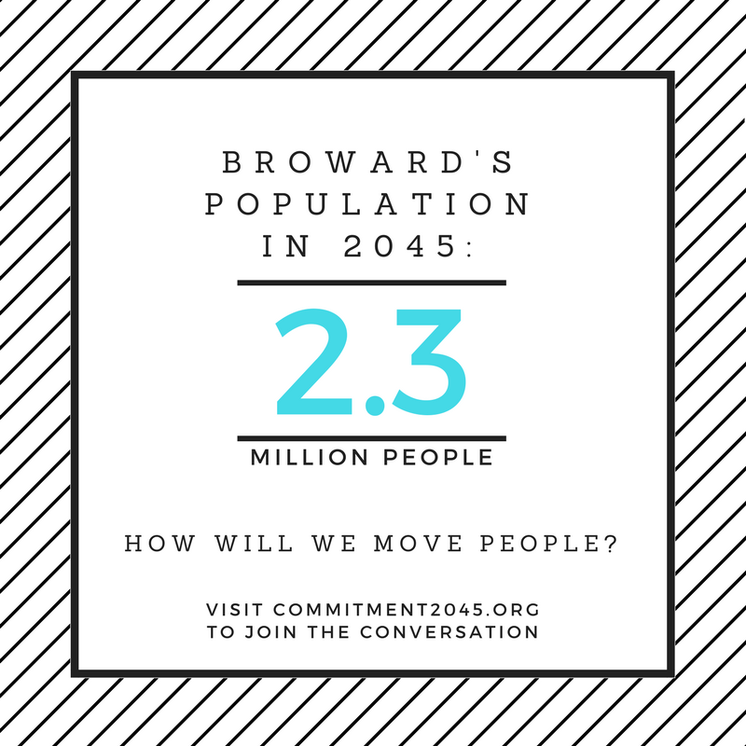

Slide 24

Transportation Planning - Overview
The Broward MPO’s Metropolitan Transportation Plan is a federally required 25-year long-range planning document and is updated every 5 years to help guide federal/state transportation investments.

Slide 25
Transportation Needs Assessment
Transportation needs are identified using partner input and latest available data
Partners
Florida Department of Transportation (FDOT)
Broward County
Municipalities
SFRTA (Tri-Rail)
Port/Airport
Public
Data
Demographics
Future Transportation Demand
Land Use
Resiliency
Future Technology

Slide 26
2045 Household Density and Traffic Projections

Slide 27
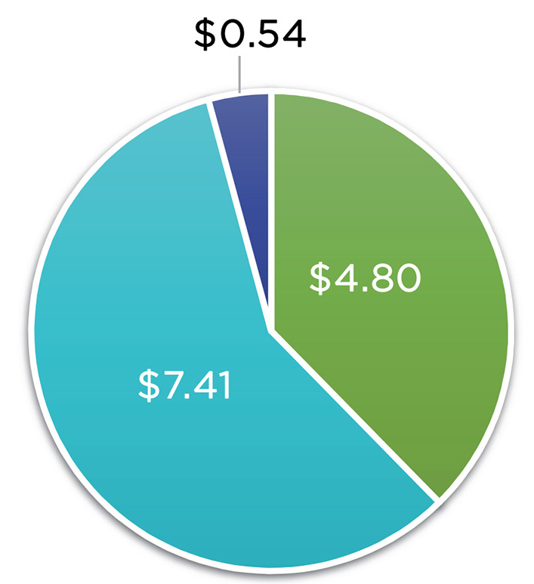
Total Revenues in billions (2045 MTP)
Total Revenues = $12.75 billion
Committed Funding in Transportation Improvement Program (2020–2024)
State/Federal Funding (2025–2045)
MPO Attributable Funding (2025–2045)

Slide 28
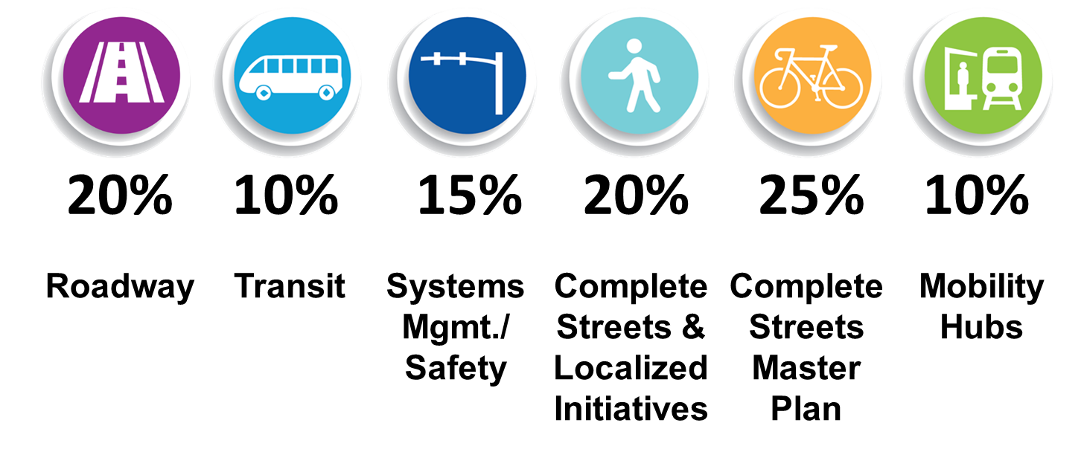
Allocate revenues to funding programs
MPO attributable funds
=55% of MPO Attributable Funds

Slide 29
Total revenues by funding program (2025-2045)

Slide 30
Cost Feasible Plan Summary
75 Roadway Projects
21 State Strategic Intermodal System (SIS)
6 Turnpike
31 On-State System*
17 Off-State System*
Includes 8 Resiliency Studies
6 Transit Projects
1 Federal Transit Formula Funding
1 City of Fort Lauderdale*
2 County Surtax*
2 Tri-Rail*
*All projects included in this portion of the Cost Feasible Plan received a resolution of support from the primary jurisdiction or governing body for the project

Slide 31
2045 Cost Feasible Plan Summary (Programs)
TSM&O/Safety
Funds improvements to existing signal network and critical safety projects
$100M for signal technologies
$289.5M for safety projects
Complete Streets Master Plan
Funds regional bicycle/pedestrian projects
$271.7M
Complete Streets and Other Localized Initiatives
Continues annual program for local projects <$3M
$206.8M
Mobility Hubs
Establishes program for site-specific infrastructure to improve access to transit
$53.9M

Slide 32
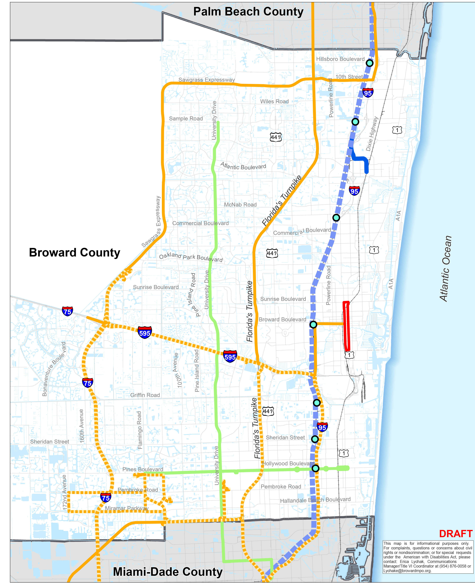
2045 Cost Feasible Plan
Includes all 5 transit projects from MTP cost feasible plan

Slide 33
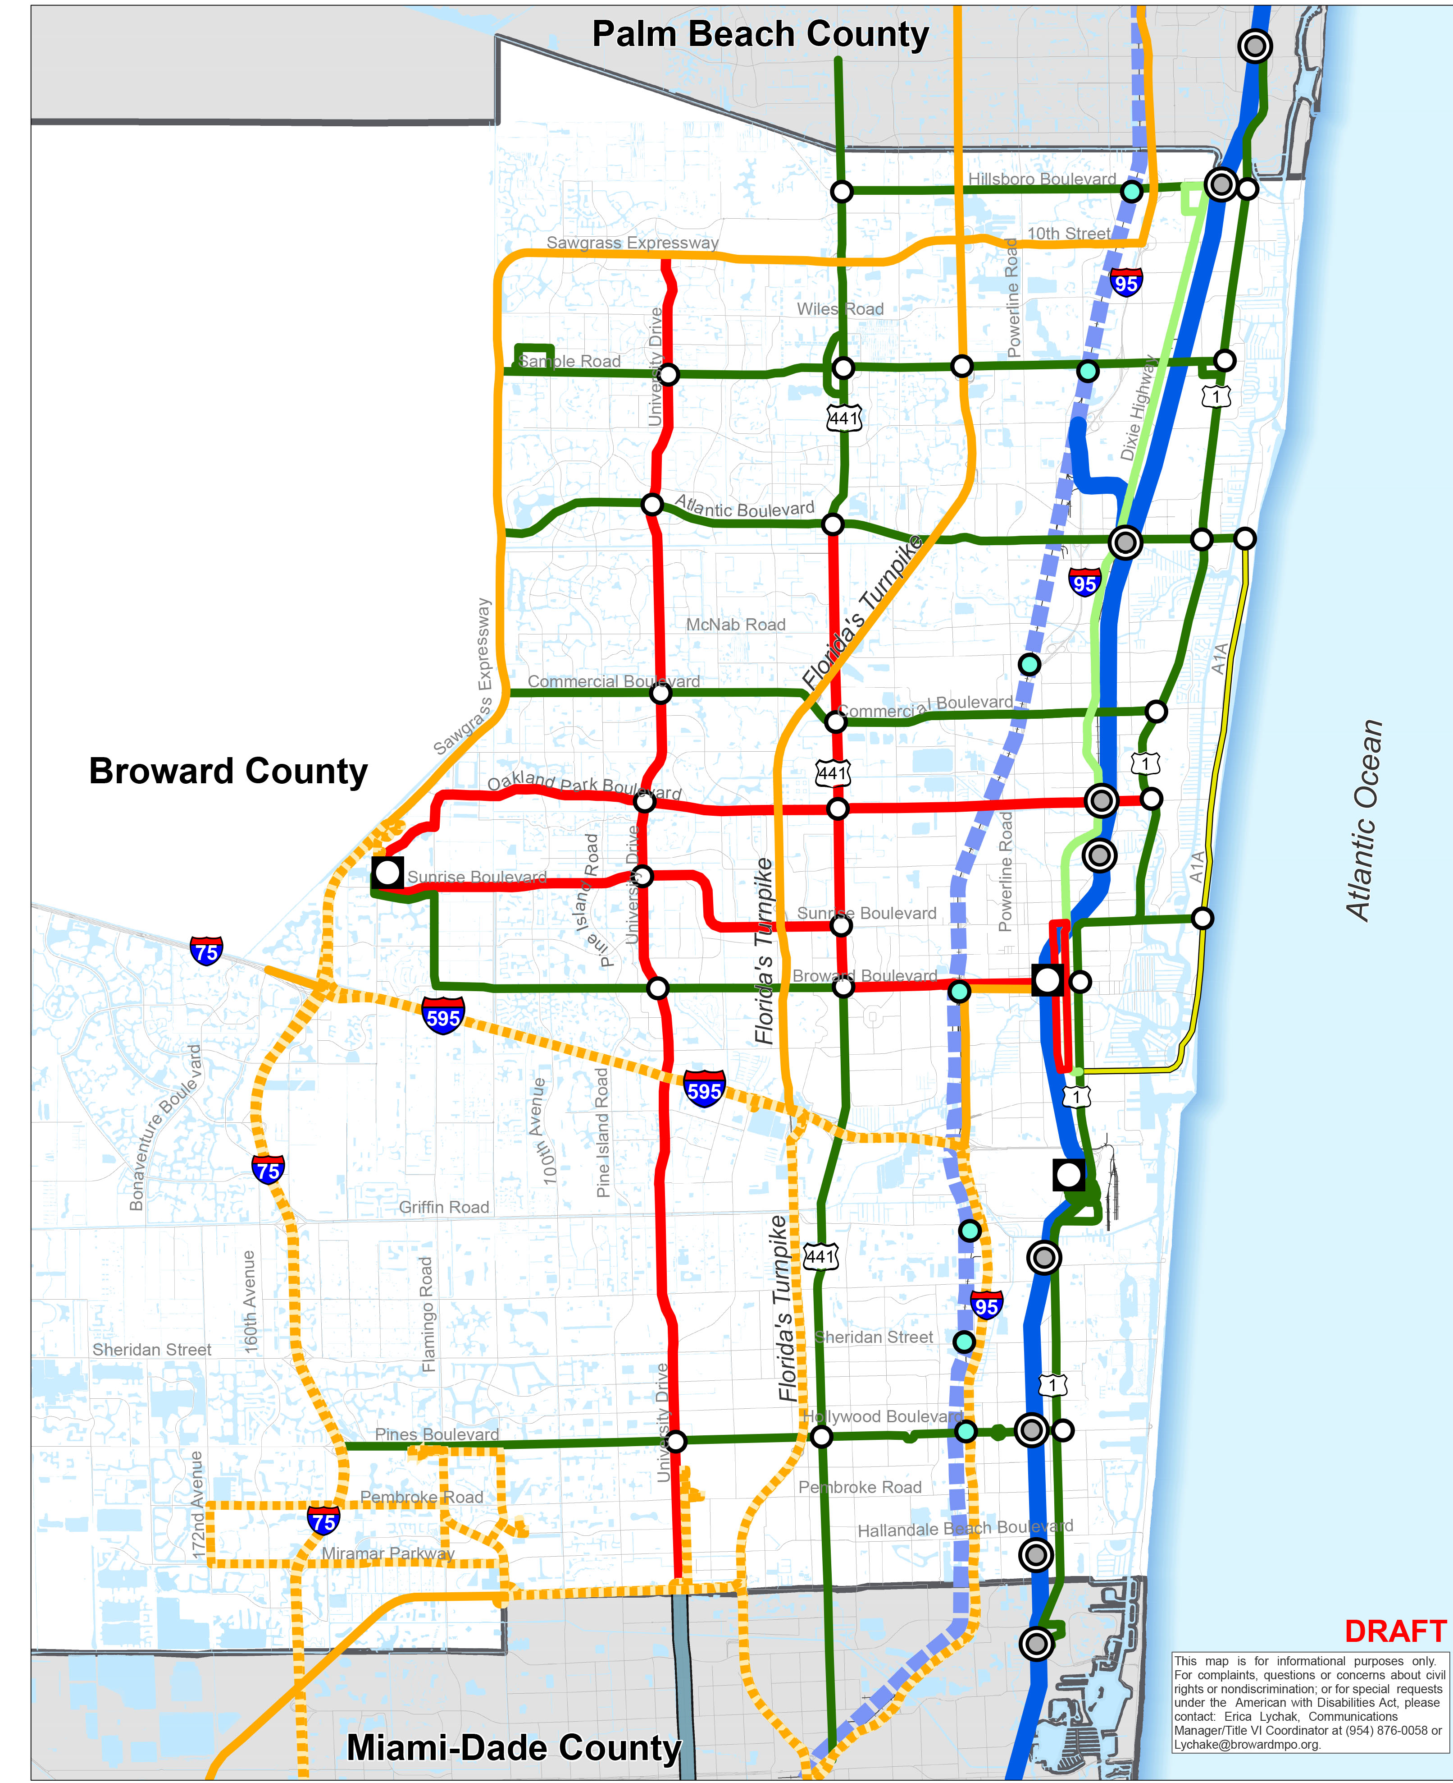
2045 Needs Plan
Includes all 7 BCT “Rapid Bus” corridors

Slide 34
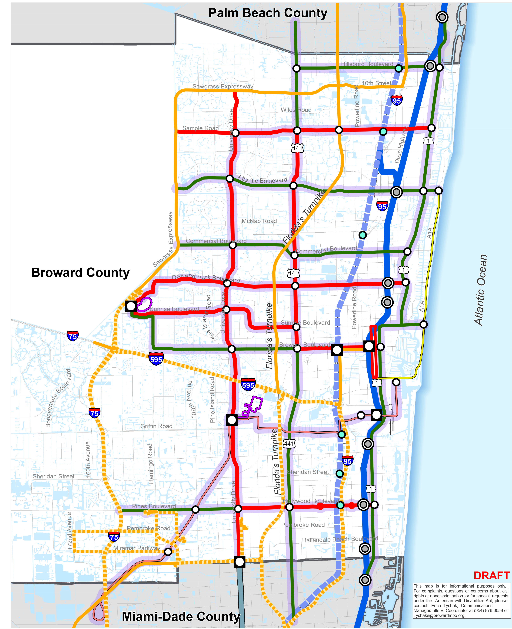
Vision 2100 Plan
Identifies future opportunities that leverage new and emerging technologies to increase transportation options, resiliency, and quality of life for Broward residents

Slide 35




“Call to action” Guiding principles
Guiding Principle 1:
Work Collaboratively with Partners
Guiding Principle 3:
Align Transportation Funding Policy
Guiding Principle 2:
Complement Existing Investments
Guiding Principle 4:
Implement
Vision 2100

Slide 36
Questions
Link to Final Draft MTP: http://browardmpo.org/index.php/mtp-documents

Slide 37
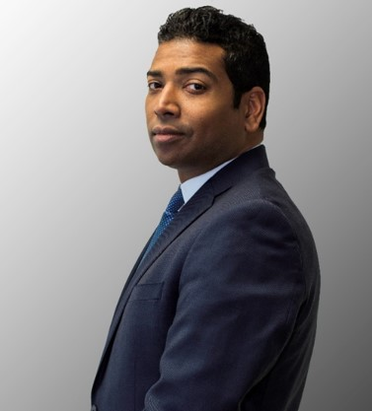
South Florida Commuter Services
Transportation Demand Management
Place Holder
JEREMY MULLINGS, AICP
PROJECT DIRECTOR
MARKETING MANAGER

Slide 38


Slide 39
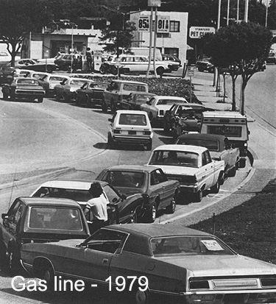
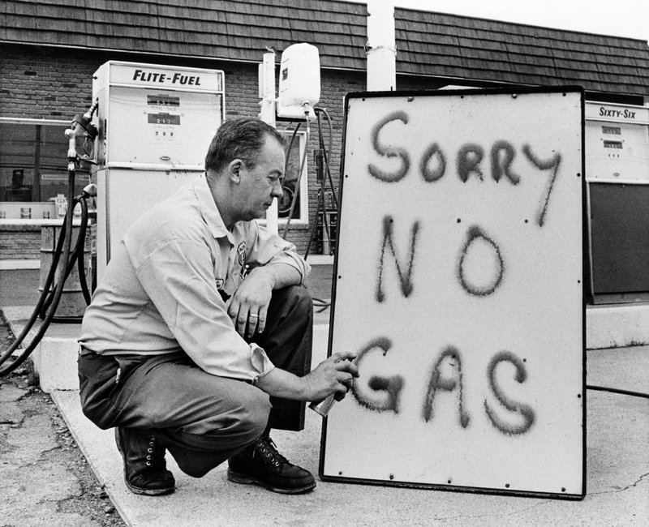
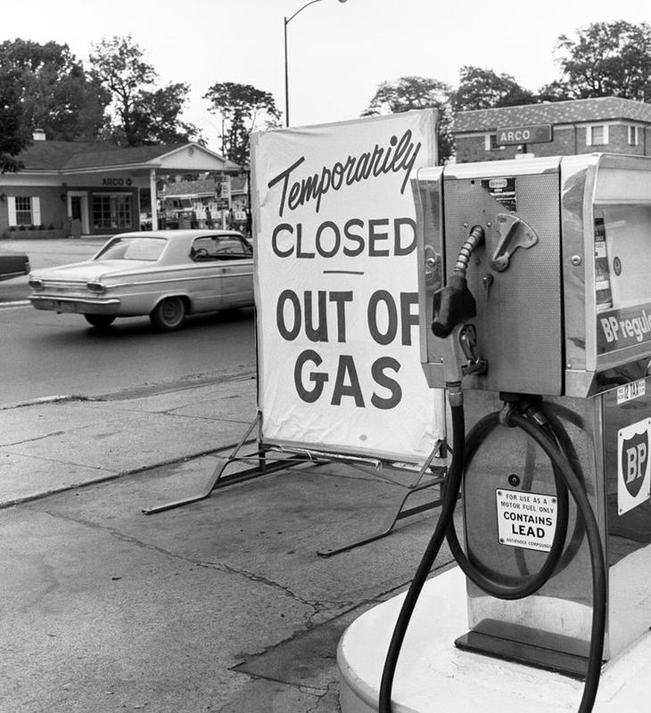
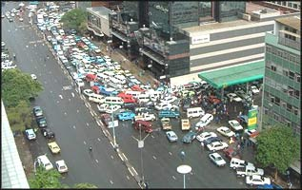

Slide 40


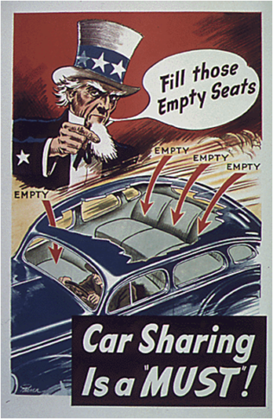

Slide 41
“
…outdated notions that treat TDM as a collection of vaguely related initiatives are constraining the true potential of TDM.
-Transportation Research Board (2010)
Notes:
Can’t use todays standards, take advantage of climate and

Slide 42
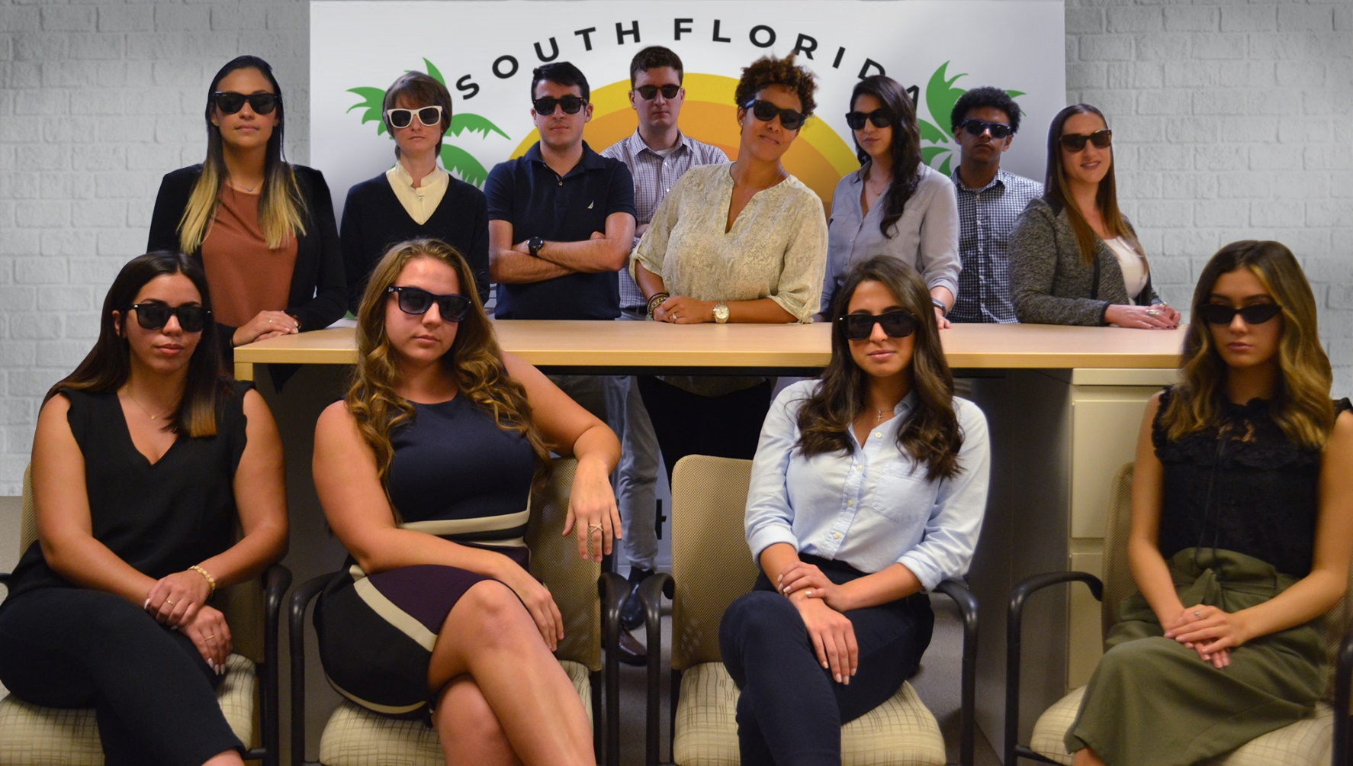
THE SFCS TEAM

Slide 43
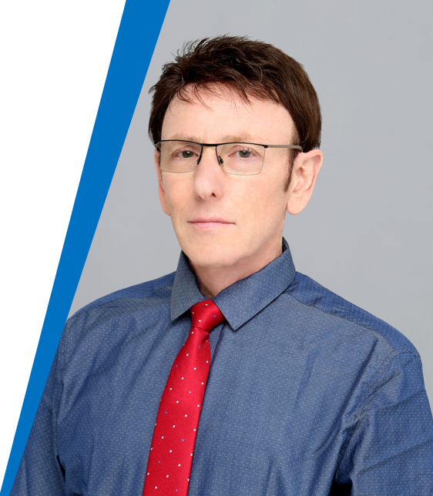
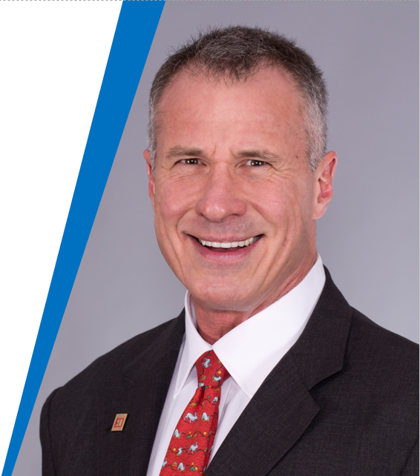
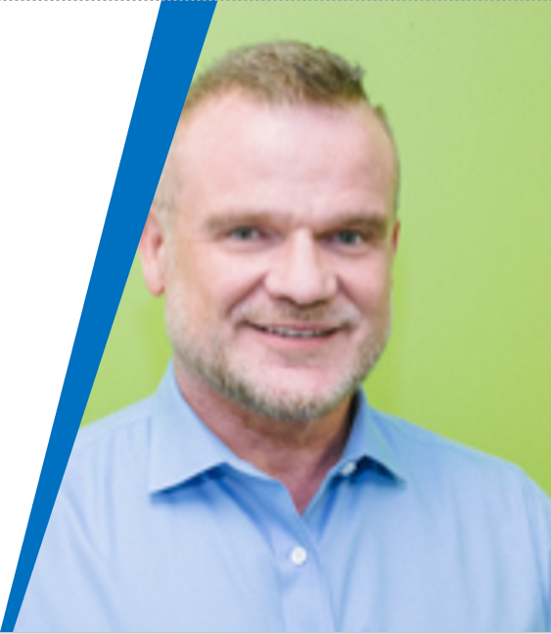
THE SFCS TEAM
Larry Leeds
John Dohm
Stuart Anderson

Slide 44
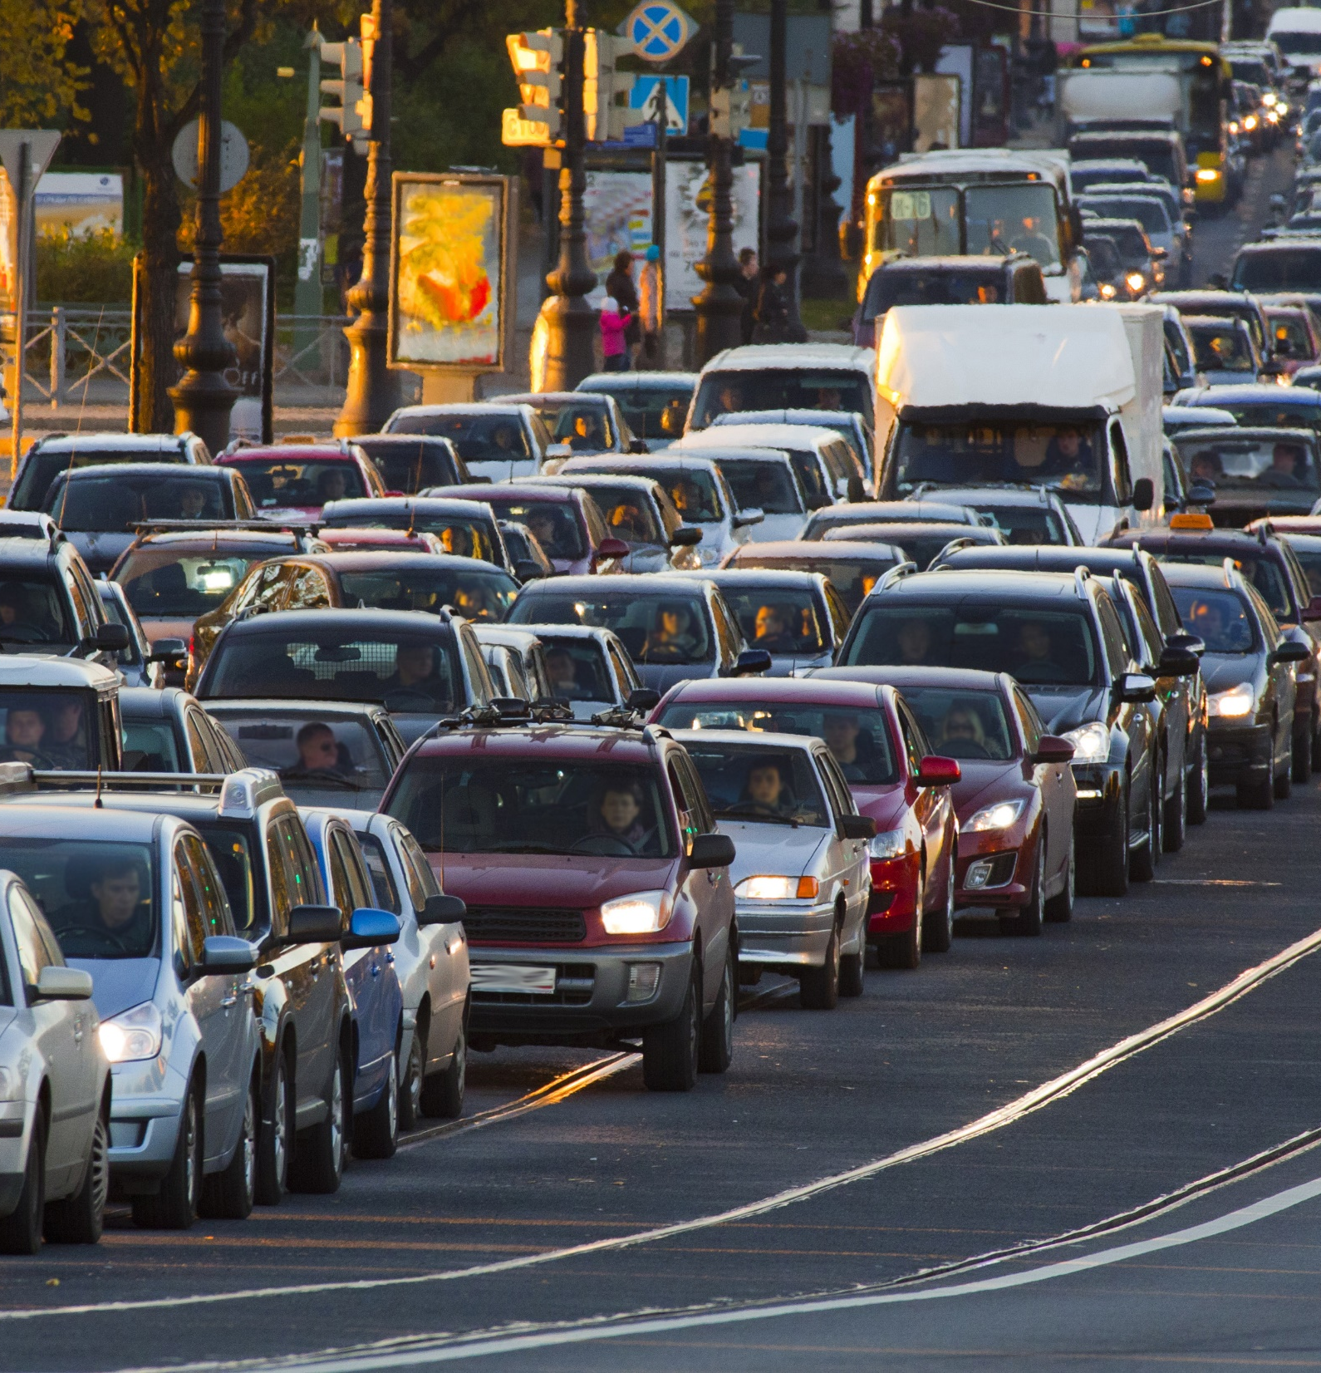
D4’s and D6’s
REGIONAL TDM PROGRAM
"...reduce the number of trips made by single occupant vehicles and enhance the regional mobility...“
-State Management Plan

Slide 45
D4’s and D6’s
REGIONAL TDM PROGRAM
Choice Riders – Changing Behavior
Ridesharing (All Forms)
Modified Work Schedule/Teleworking
New/Improved Regional Transit Services
  [Premium] Park and Ride Lots
  First/Last Mile Connections

Slide 46
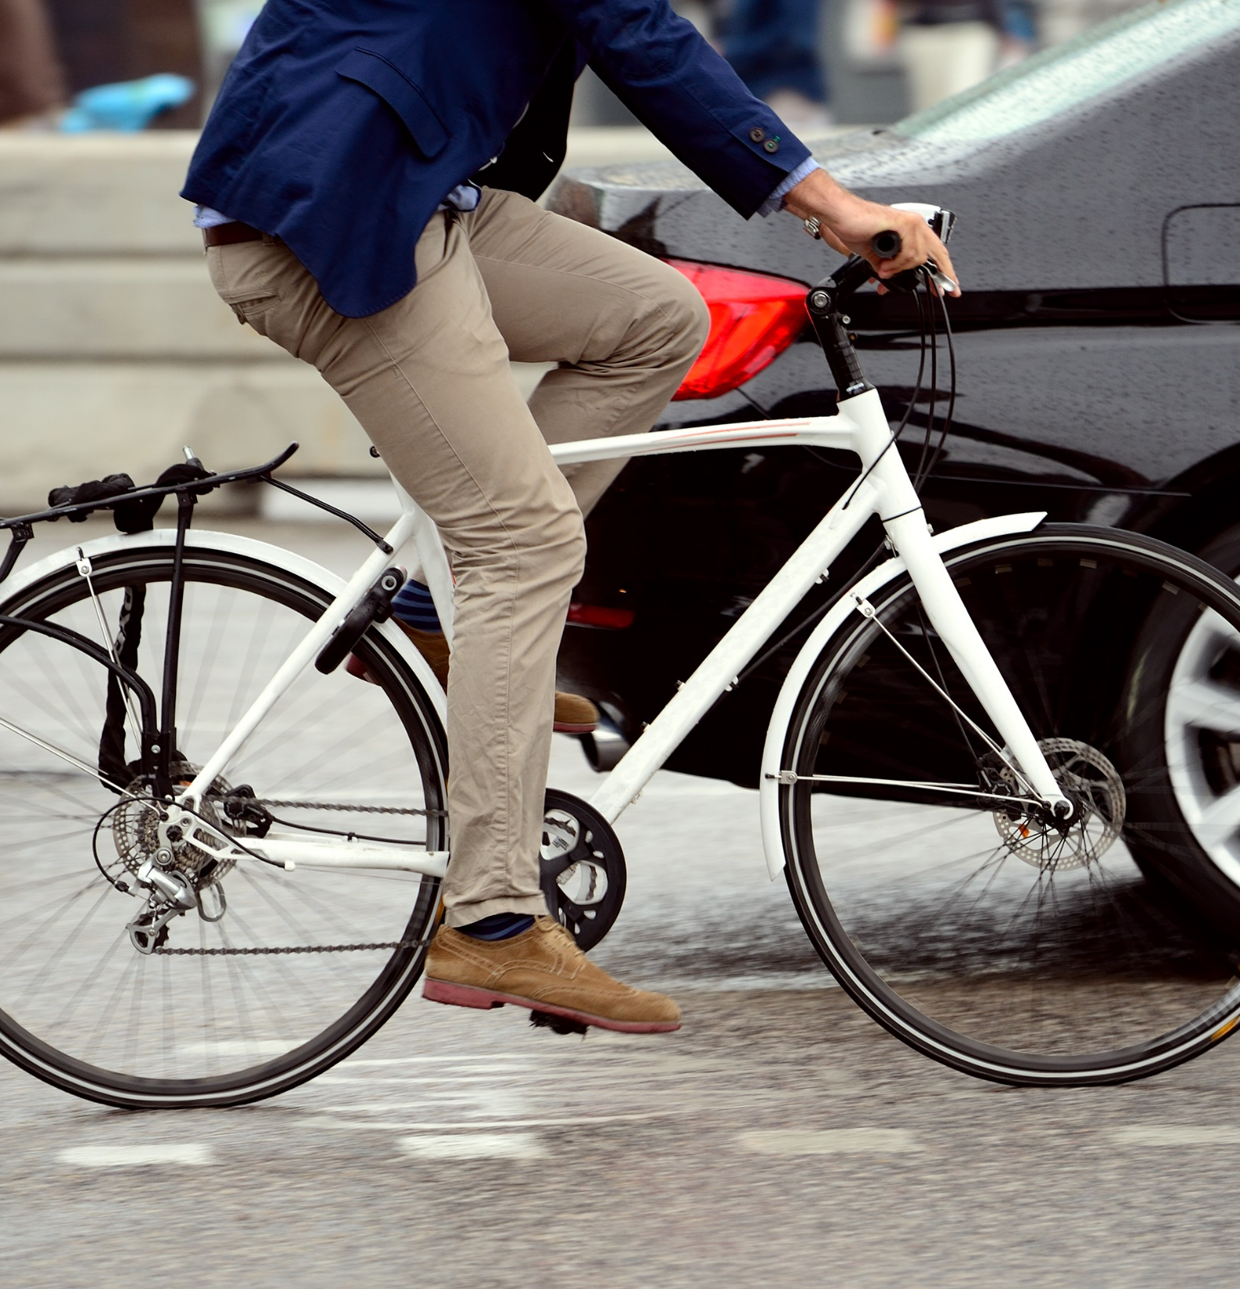
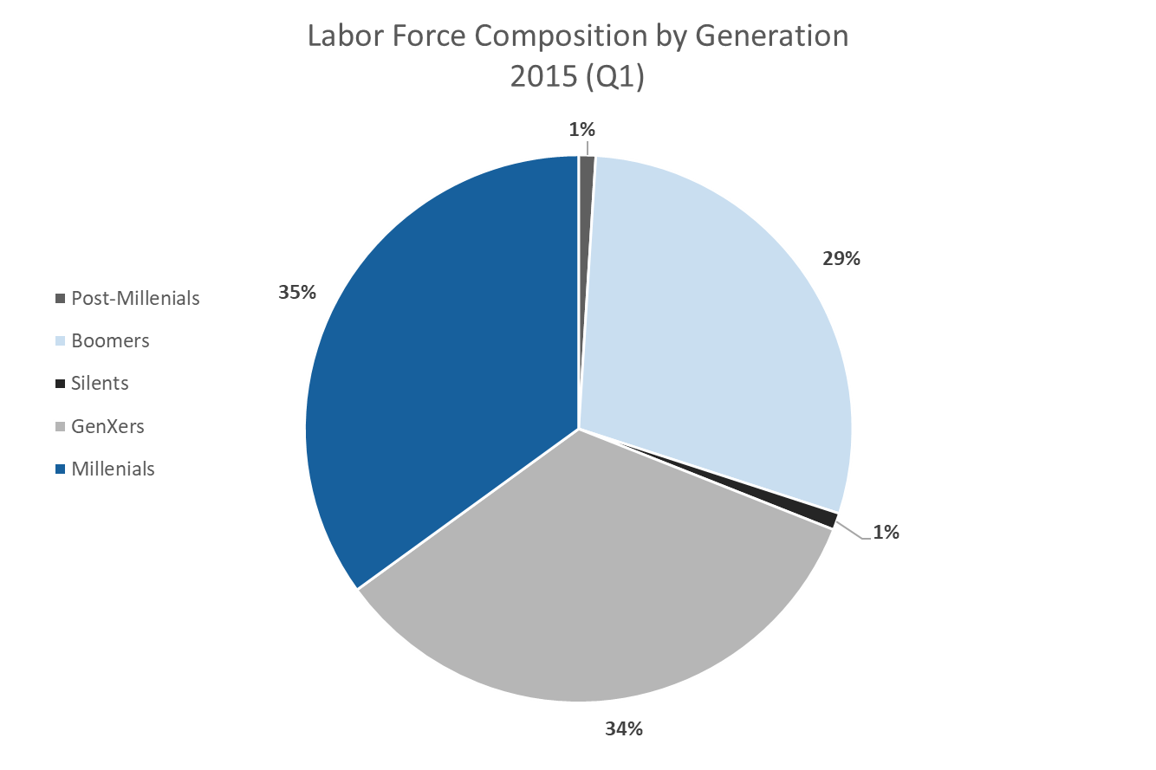
UNDERSTANDING THE MARKET

Slide 47
UNDERSTANDING THE MARKET
-FLHSMV

Slide 48
UNDERSTANDING THE MARKET
FDOT’s Highway Mileage Reports

Slide 49
UNDERSTANDING THE MARKET
-American Community Survey

Slide 50
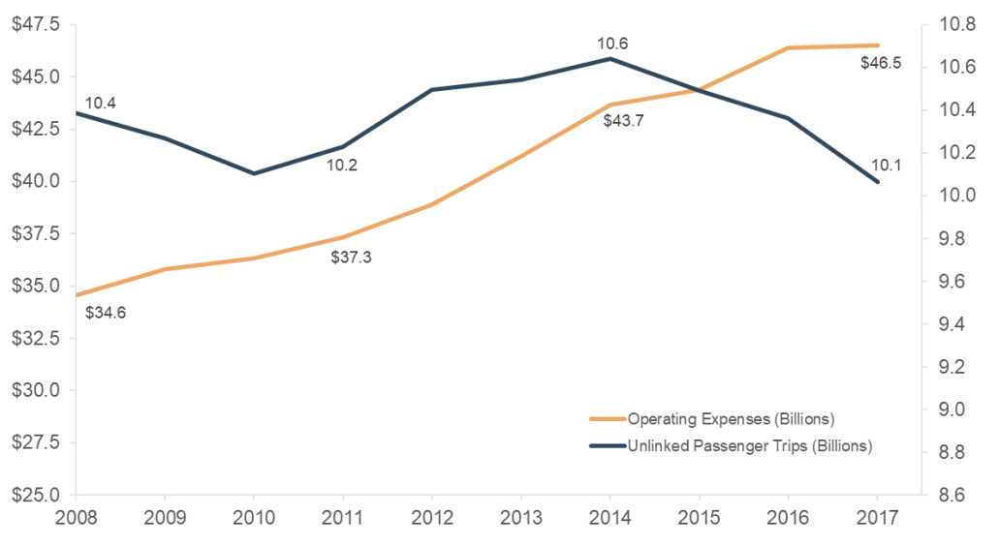
UNDERSTANDING THE MARKET
-National Transit Database (2018)

Slide 51
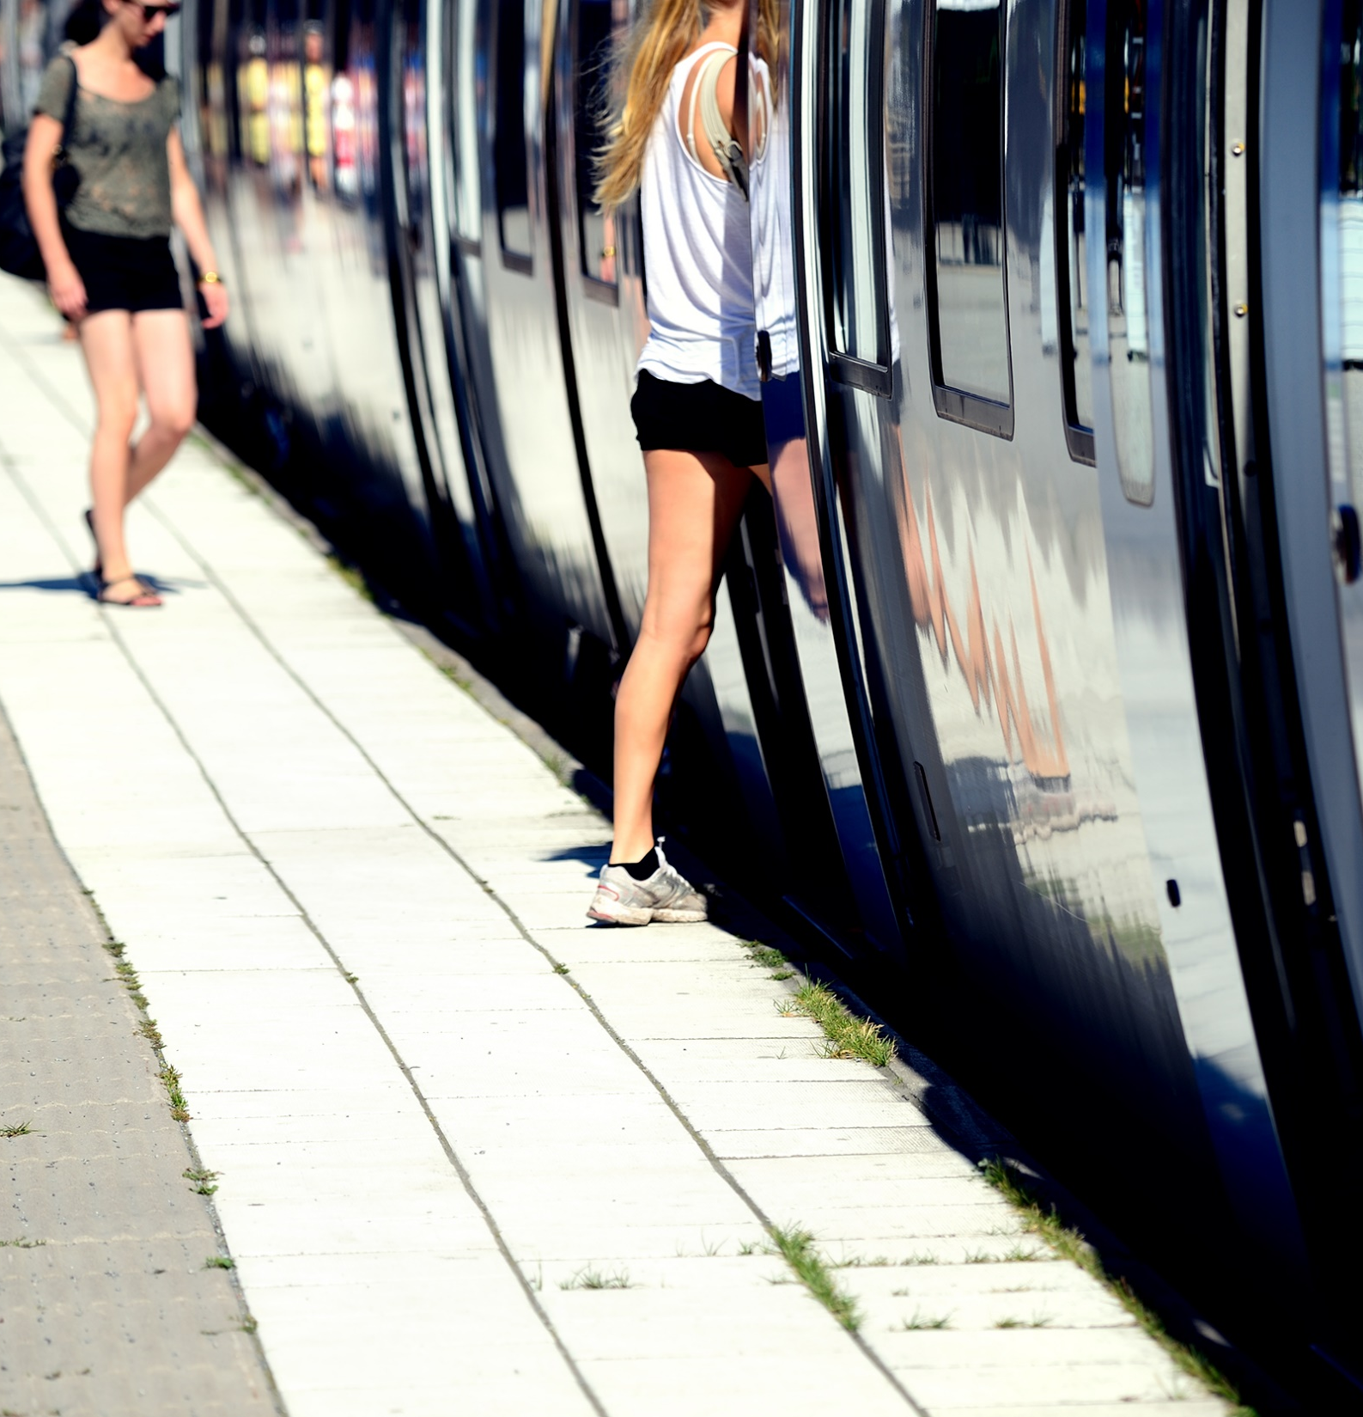
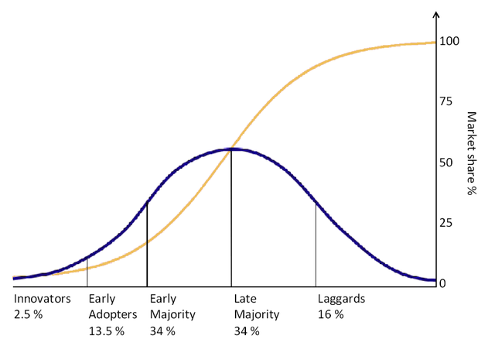
TRANSPORTATION DEMAND
MANAGEMENT

Slide 52
MARKETING
“…Regional Commuter Services will provide ridematching, marketing, survey and other support as determined by the Districts and this procedure…”
-State Management Plan (SMP)

Slide 53
MARKETING
Marketing can be thought of as the group in an organization, or a general set of processes focused on understanding customers and satisfying their needs.
-Wharton.upenn.edu
Marketing helps a firm in creating value by better understanding the needs of its customers and providing them with innovative products and services.
-hbs.edu

Slide 54
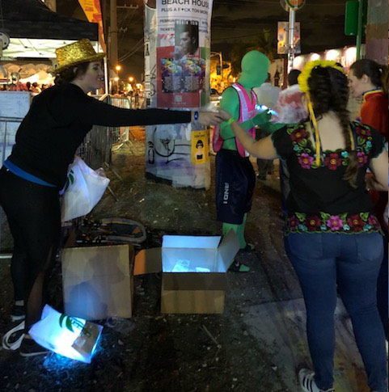


Market Analysis &
Advertising & Outreach Solutions

Slide 55






Market Analysis &
Advertising & Outreach Solutions
Americans with a
Social Media Profile

Slide 56



Market Analysis &
Advertising & Outreach Solutions

Slide 57




Market Analysis &
Advertising & Outreach Solutions

Slide 58


Market Analysis &
Advertising & Outreach Solutions
TryTransitFree.com

Slide 59




Market Analysis &
Advertising & Outreach Solutions

Slide 60



EMERGENCY GUARANTEED RIDE HOME

Slide 61


ALTERNATIVE MODES – CAR/VANPOOL

Slide 62

“
…outdated notions that treat TDM as a collection of vaguely related initiatives are constraining the true potential of TDM.
Thank You!
Notes:
Can’t use todays standards, take advantage of climate and

Slide 63

Context Classification - FDOT
Place holder
LARRY WALLACE
Bike/Ped/Complete Streets Coordinator

Slide 65


MEMBER UPDATES

Slide 66

2020 Meeting Schedule
January 13, 2020
March 9, 2020
May 11, 2020
July 13, 2020 *
September 14, 2020
November 9, 2020

Slide 67
THANK YOU!
Any Final Questions?
Next CSAC Meeting – Monday, January 13, 2020
Don’t Forget to Visit the Complete Streets webpage at: www.browardmpo.org/projects-studies/complete-streets
If you have any questions or comments, please contact Ricardo Gutierrez at 954.876.0044

